Slide 1
Current and Upcoming Features
Star quality ratings
Searching with filters
Recent features:
Reorganized navigation
User guide with video tutorials
State CMF lists
Upcoming features:
Comparison tool

Slide 2
Star Quality Rating
Criteria
Study design
Sample size
Standard error
Potential bias
Data source

Slide 3
Study Design
Methodology of the study
Excellent: Statistically rigorous study design with reference group or randomized experiment and control
Fair: Cross sectional study or other coefficient based analysis
Poor: Simple before/after study

Slide 4
Sample Size
Crashes, mile-years, site-years, miles, or sites
Ex: 8 miles for 5 years is 40 mile-years
Excellent/fair/poor: Larger is better. Rating depends on size of sample, with considerations for study design.

Slide 5
Standard Error
Statistical indication of the reliability of the CMF value
Excellent: Significant at 95% confidence level (SE=0.05, CMF=0.80)
Fair: Significant at 90% confidence level but not 95% confidence (SE=0.11, CMF=0.80)
Poor: Not significant at 90% confidence level (SE=0.20, CMF=0.80)

Slide 6
Potential Bias
Any biases observed by the reviewer
Ex: Makeup of the study site group, issues with analysis or modeling, etc.
Excellent/fair/poor: Better rating for fewer biases.

Slide 7
Data Source
Diversity of the data used to develop the CMF
Excellent: Diversity in States representing different geographies
Fair: Limited to one State, but diversity in geography within State (e.g., CA)
Poor: Limited to one jurisdiction in one State

Slide 8
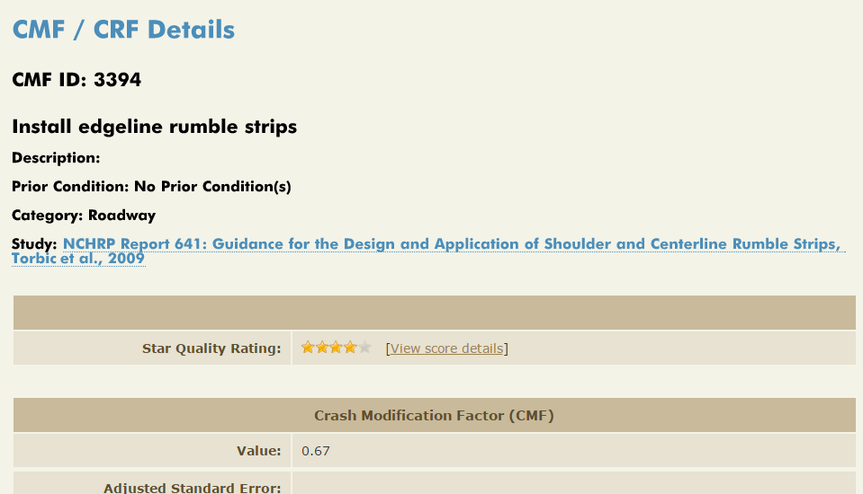
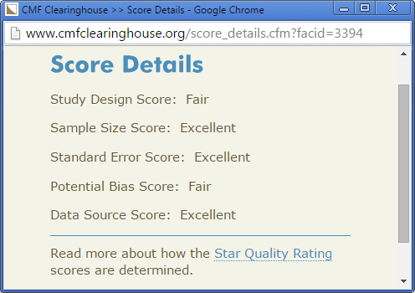
Star Quality Rating

Slide 9
Using Filters
Search “signal” (581 results)
Filter for only 3,4, or 5 star CMFs (389 results)
Filter for only angle crash CMFs (38 results)
Filter for only urban CMFs (24 results)
Discuss all results, why various categories appear

Slide 10
CMFs that look similar in search results
Search for “rumble”
Filter for “run off road” crash type and crash severities of fatal, serious injury, and minor injury
Expand shoulder treatments -> Shoulder rumble strips -> Install shoulder rumble strips
What makes the 1st and 2nd ones different?
Go to Details, see differences in road type and division; AADT range; states of origin

Slide 11
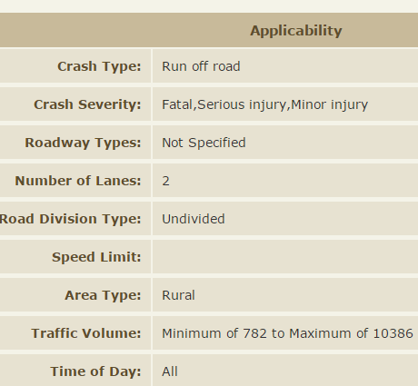
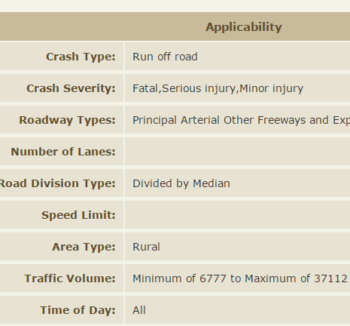
Comparison
CMF = 0.64
CMF = 0.83

Slide 12
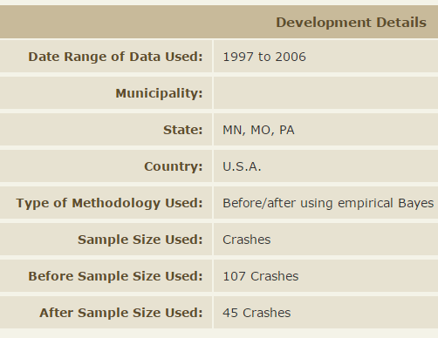
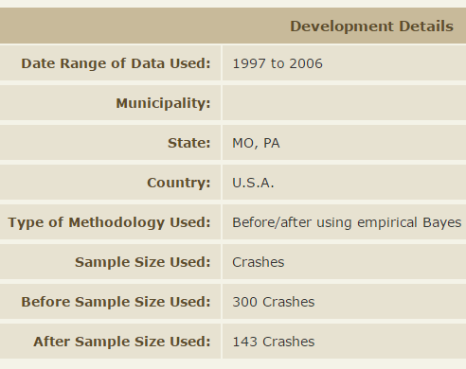
Comparison
CMF = 0.64
CMF = 0.83

Slide 13
Website Features
Recently added
Reorganized navigation
User guide with video tutorials
State CMF lists
Upcoming
Comparison tool

