Slide 1




Using CMF’s in Benefit/Cost Analysis and Project Prioritization
Presented by
Michael McNeill, P.E.
ODOT Safety Program
December 8, 2015

Slide 2
Overview
ODOT Safety Application Process / Project Prioritization
Discuss the ODOT Safety Application Process and how CMFs are used within it
Expand on this process to include how CMFs are applied
Explain how ODOT staff integrates the CMF Clearinghouse
Recommendations for best using the Clearinghouse and countermeasure selection

Slide 3
Application Process
ODOT Safety Application Process
Safety Projects developed the following ways:
-ODOT Priority Lists
-ODOT Sponsored
-Local Sponsored
Applications are submitted through the ODOT Districts to Central Office. (12 ODOT Districts)
Multi-disciplinary ODOT Safety Review Committee reviews all applications once submitted
Consists of Safety Program, Traffic Engineering, Roadway Engineering, Local Programs

Slide 4
Application Process Flow Chart
ODOT Safety Application Process / Project Prioritization
Safety Location Chosen
(ODOT District or Local)
Crash Data Collected & Analyzed
Countermeasures Selected
CMF’s are applied within this tool.
ECAT Completed
Safety Application completed and submitted
Safety Committee Reviews application for funding

Slide 5

How is a location chosen?
Projects developed the following ways:
1) ODOT Priority Lists
Rural Intersection
Rural Segment – Non Freeway
Rural Freeway
Urban Intersection
Urban Segment – Non Freeway
Urban Freeway
2) ODOT Sponsored – District
3) Local Sponsored – County, Municipality, etc.
Local routes not on priority list
Safety Location Chosen
Notes:
Safety Location chosen

Slide 6
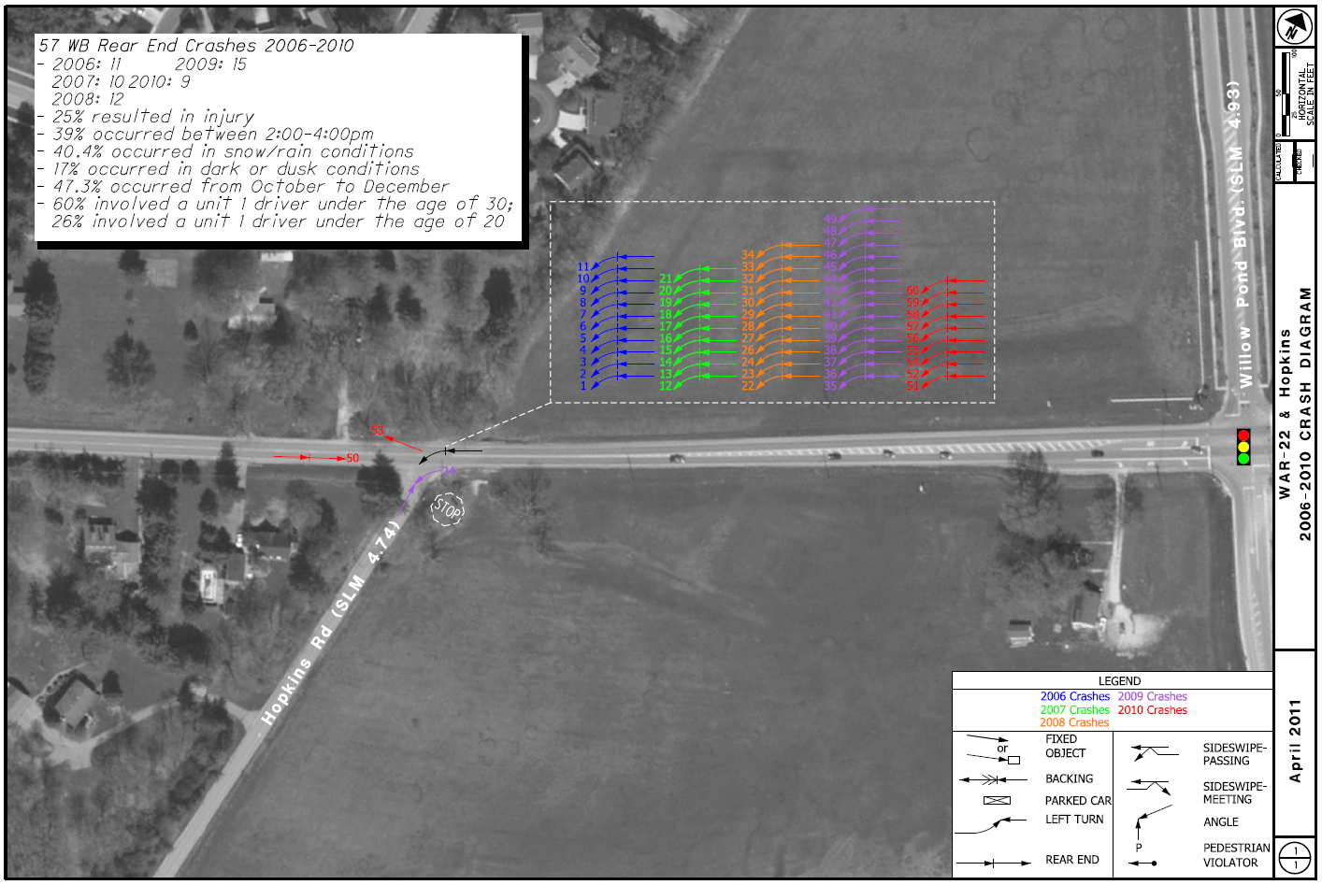
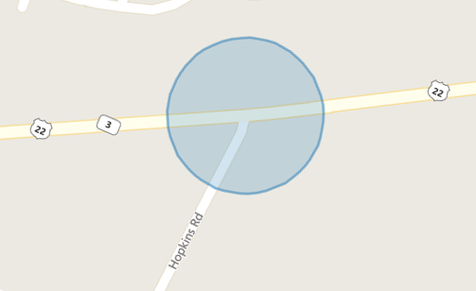
GCAT – What’s the crash patterns?
Crash Data Collected & Analyzed
Notes:
Crash Data Collected and Analyzed

Slide 7
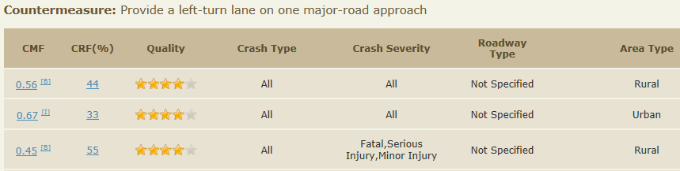
Select Countermeasures
What’s the best countermeasure that will address the crash problems for the lowest cost?
Install Dedicated Left Turn Lane?
57 Rear End crashes from 2006-2010

Slide 8
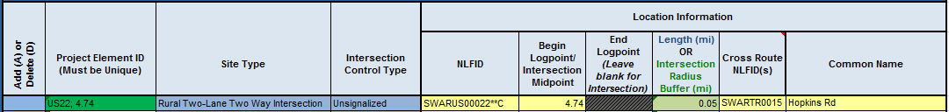
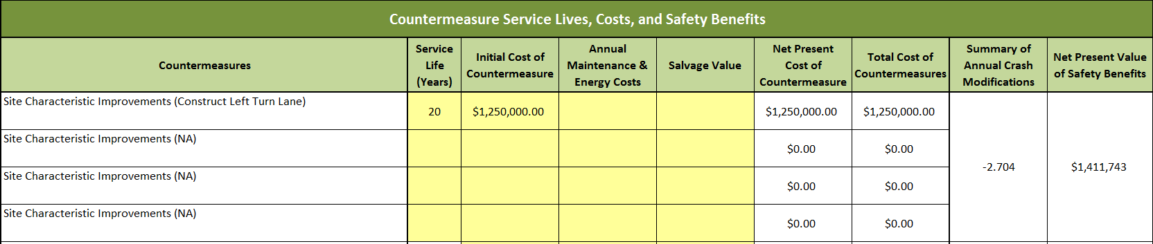
ECAT Analysis
Economic Crash Analysis Tool
Imports crash data from GCAT
Calculates predicted crash frequencies and provides a value for the potential for safety improvement
Notes:
This goes through all of the background calculations seen in the HSM. Takes into account crashes, site type, and provides a net present value of how much the safety benefits are worth for the project. This amount is then compared against the total cost of the countermeasures (as seen in the red box) to yield a Benefit/Cost Ratio.

Slide 9
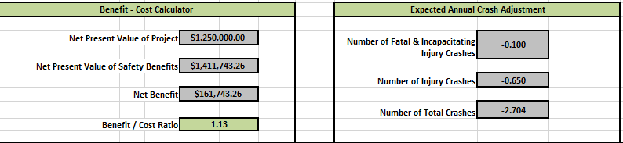
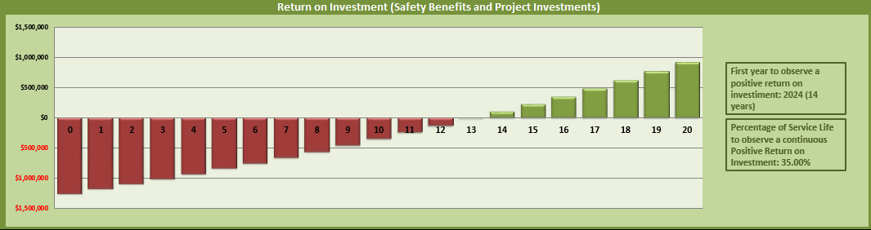
ECAT Analysis
Economic Crash Analysis Tool
Tool has the ability to complete a benefit-cost analysis

Slide 10
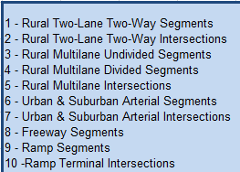
CMF Table in ECAT
Tab dedicated to CMF selection
All information obtained from the Highway Safety Manual and the CMF Clearinghouse
Nearly 60 preloaded CMF’s available for selection
CMF ID’s
Site Type
Countermeasure Name
Suggested Service Life
Star Quality Rating (3 is ODOT’s Minimum)
CMF associated with specific crash type
If countermeasure is not on preloaded list, the CMF clearinghouse can then be referenced and used with the 3 star minimum
Economic Crash Analysis Tool

Slide 11
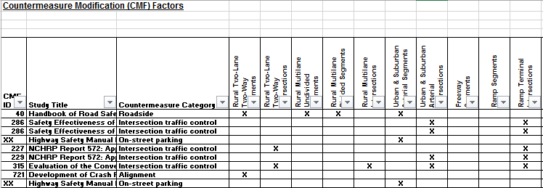
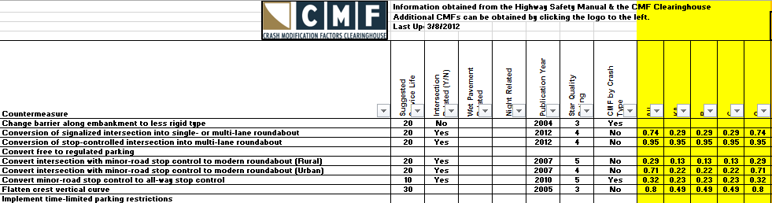
CMF Table in ECAT
Countermeasure names link to research reports
Economic Crash Analysis Tool

Slide 12
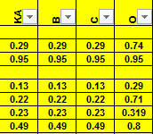
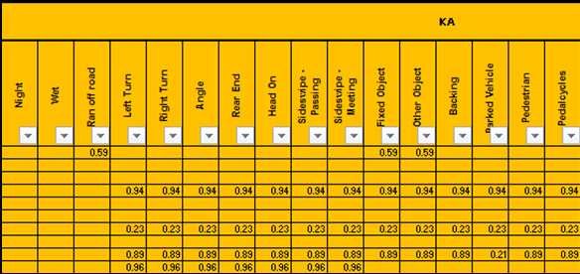
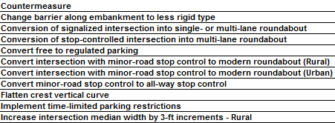
CMF Table in ECAT
How are the modification factors correctly assigned?
If CMF states crash type ‘All’, then it has a
value applied to the severity only.
B) If designed for a specific crash type, each of
those is listed with the corresponding injury
severity

Slide 13
Safety Application Review Committee
Committee reviews project applications
Items included in submission of a safety project application
A) Electronic copy of the Safety Engineering Study
B) All Excel file analysis
1) CAM Tool (Crash data generated from GCAT)
2) ECAT Tool (Displays countermeasures/CMFs and Benefit/Cost)
3) Safety Application and Scoring Tool
C) District Approval Signatures

Slide 14
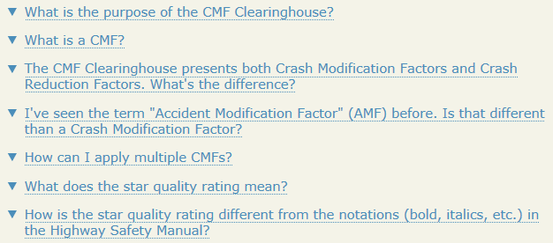
Recommendations
Decisions are most effective when developed through a data driven process.
-Valid research backing these CMF’s
Friends don’t let friends use bad data!
Visit CMF Clearinghouse for reference materials
-Search for CMF’s
1) User Guide - http://www.cmfclearinghouse.org/userguide.cfm
2) FAQ’s - http://www.cmfclearinghouse.org/faqs.cfm
Notes:
Since they gave me the final slot of the day, I wanted to drive home some key points as seen throughout the presentations today.

Slide 15
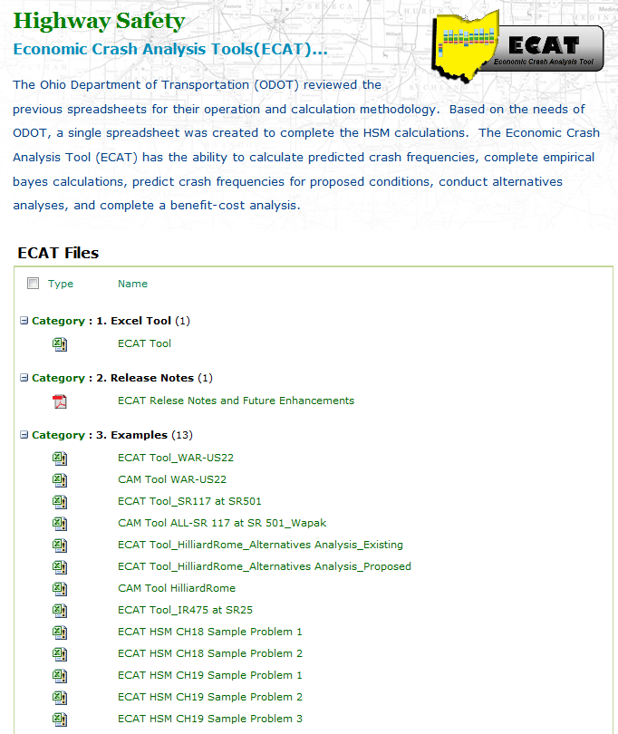
Reference Materials
http://www.dot.state.oh.us/Divisions/Planning/ProgramManagement/HighwaySafety/HSIP/Pages/ECAT.aspx
Website features
Background Information
ECAT File
  CMF Tab
Several Examples provided
Notes:
Oregon DOT has provided a website on how they use CMF’s along with many The link for that is included in the FAQ’s section on the CMF clearinghouse as mentioned in the previous slide.

Slide 16
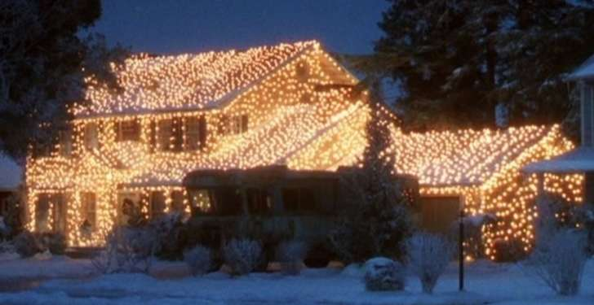



Questions?
What’s the CMF for Highway Lighting?

