Slide 1
Using CMFs in Planning for Virginia’s Project Funding Prioritization
December 2015
Stephen W. Read, P.E.

Slide 2
Project Prioritization Evaluation
Project Planning Process and Funding
Project Evaluation Factors
Developing Planning Level CMFs
CMFs for HB2
Example HB2 use of CMFs

Slide 3
1. Project Planning Process and Funding

Slide 4



Life Cycle of a Candidate Project
How it’s planned.
How it’s scored.
How it’s funded.
Notes:
We are facing many changes with how projects get built. We are here to assist local governments, staff, and the public in understanding the different pieces of new policy and legislation which will guide transportation project planning, scoring, selection, and funding in the Commonwealth beginning with the Six-Year Improvement Program on July 1, 2016.
The vision document, planning, and project scoring outreach which is currently underway, will not only influence, but will determine how projects ultimately make their way from an idea, to an actual funded transportation project.

Slide 5
VTrans - Needs Assessment
Corridors of Statewide Significance
Regional Networks
Urban Dev. Areas
Safety
Note: Map includes all locally designated growth areas that appear consistent with the intent of 15.2-2223.1. OIPI is asking that localities who want their growth areas to qualify for HB2 funding to add a code reference (15.2-2223.1) by October 1, 2015 to ensure that projects submitted to promote these areas meet the HB2 screening requirement. Projects promoting UDA-like designated growth areas with the proper code reference submitted after October 1 will not be considered in the first round of HB2 project screening.
Notes:
High Priority Projects – Project must meet a need identified for
Corridor of Statewide Significance
Regional Network
Construction District Grant Programs – Project must meet a need identified for
Corridor Statewide Significance
Regional Network
Urban Development Area
Safety

Slide 6
2. Project Evaluation Factors

Slide 7
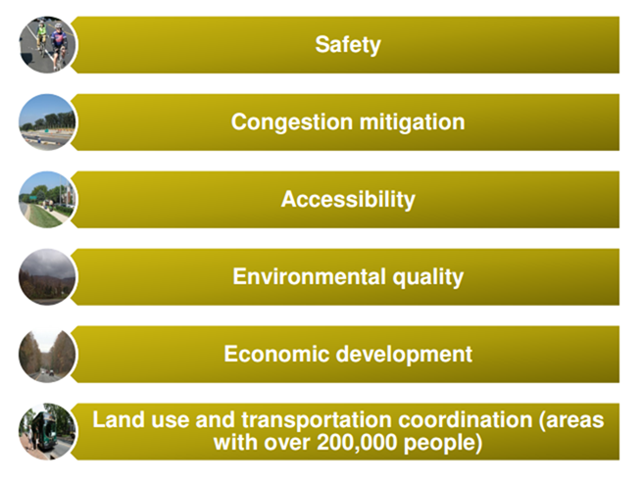
HB2 Factors

Slide 8
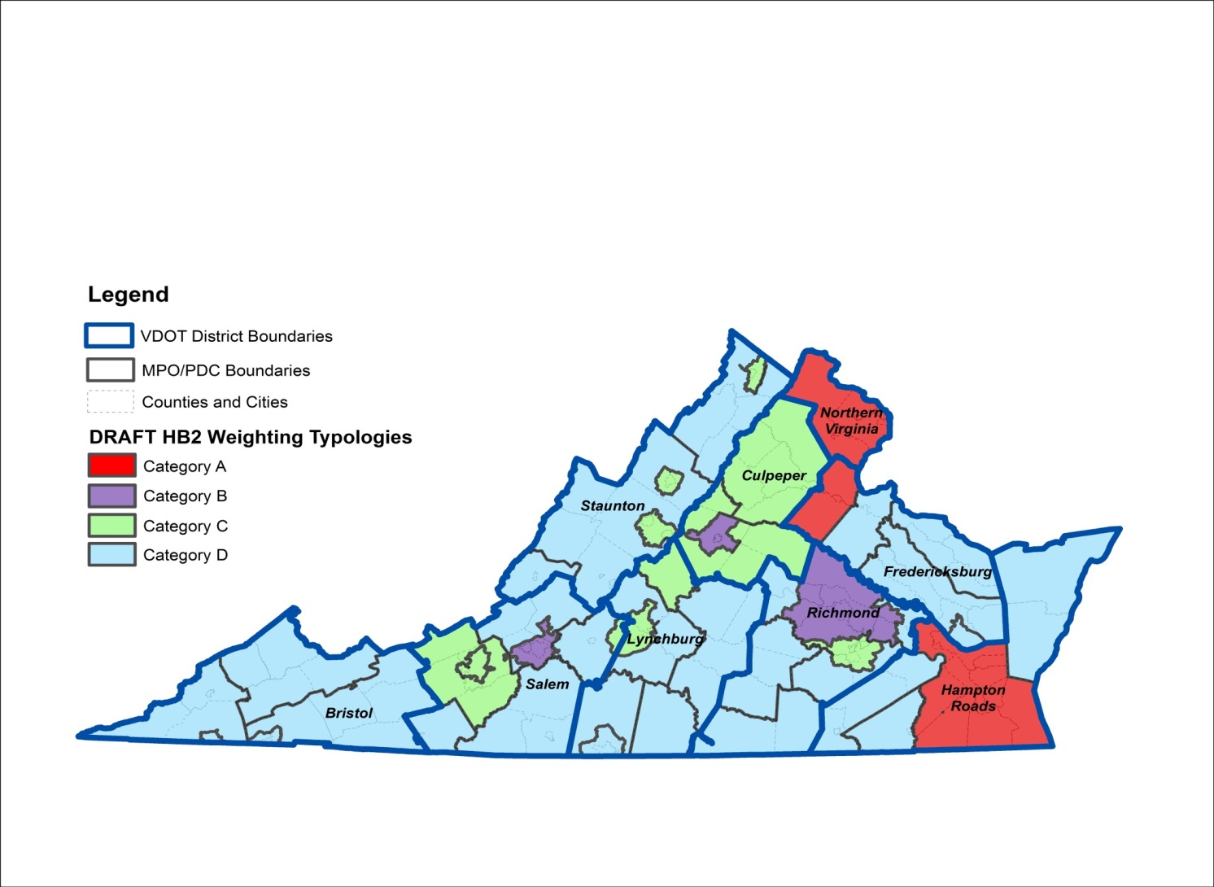
Factors to be Weighted Differently Across the Commonwealth
Factor | Congestion Mitigation | Economic Development | Accessibility | Safety | Environmental Quality | Land Use
Category A | 45% | 5% | 15% | 5% | 10% | 20%
Category B | 15% | 20% | 25% | 20% | 10% | 10%
Category C | 15% | 25% | 25% | 25% | 10%
Category D | 10% | 35% | 15% | 30% | 10%

Slide 9
Measuring SAFETY
50% of score: Expected reduction in total fatalities and severe injuries (100% of score for transit projects)
50% of score: Expected reduction in the rate of fatalities and severe injuries per 100 million vehicle miles traveled

Slide 10
Developing Planning Level CMFs

Slide 11
Developing Planning Level CMFs
Each project extent has several improvement categories -
Project Extents:
Intersection
Interchange
Segments
Bicycle and Pedestrian
Bridges
1. Intersection: Improvement Features
Signal: New
Roundabout: New
New Turn Lane
Add Turn Lane
Remove minor approach left-turns (use right-turn and downstream u-turn)
Improve skew angle

Slide 12
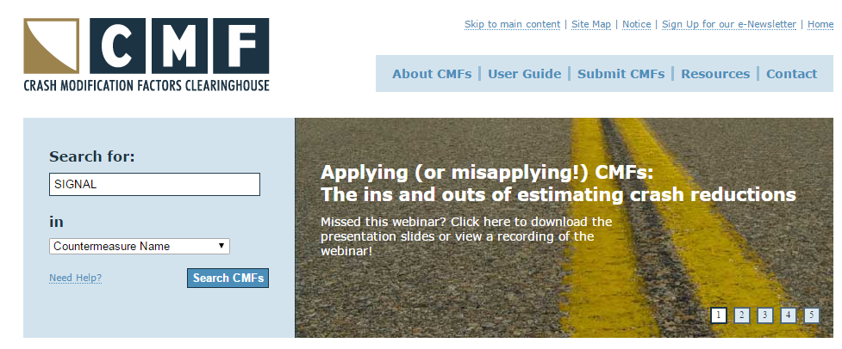
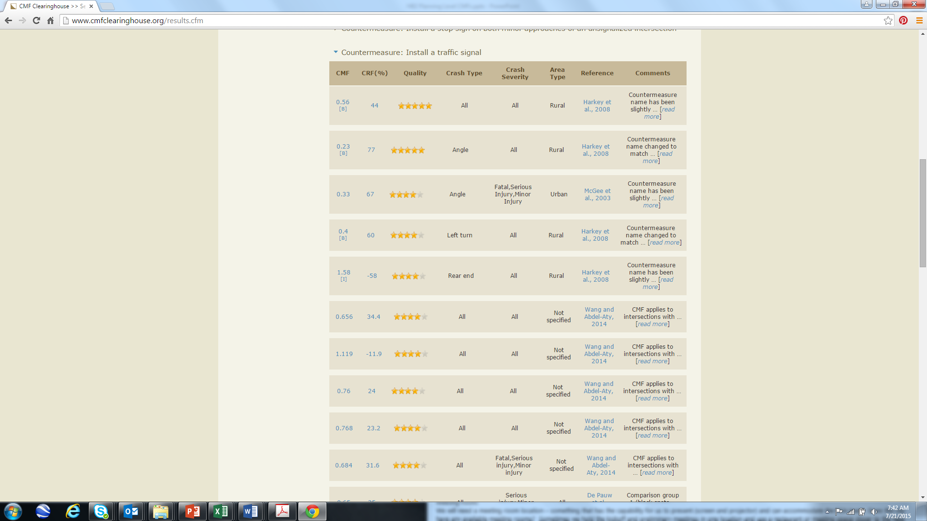
Developing Planning Level CMFs
Compile improvement category values
from the CMF Clearinghouse
1. Intersection
Signal: New

Slide 13
Developing Planning Level CMFs
Select appropriate CMFs for HB2 application
For all crash types
Want to use CMFs with higher quality rating
And fatal and injury crashes

Slide 14
Developing Planning Level CMFs
Define range of CMFs for various conditions to select applicable planning level value.
1. Intersection
Signal: New
Project Extent | Improvement Type | MIN | MAX | AVE | MEDIAN | STDEV | Planning Level CMF
Intersection
 | Signal: New | 0.33 | 0.86 | 0.65 | 0.67 | 0.18 | 0.65

Slide 15
Developing of Planning Level CMFs
Some improvement categories required review of countermeasures combinations:
For project types with multiple improvement choices, countermeasures were grouped and combined into broader categories with the CMF chosen from the range.
Project Extent | Improvement Type | MIN | MAX | AVE | MEDIAN | STDEV | Planning Level CMF
Segments
 | Non-Freeway: Access Control/Management |  |  |  |  |  | 0.75
 | Install median | 0.24 | 1.70 | 0.71 | 0.71 | 0.27
 | Install directional median | 0.76 | 0.82 | 0.79 | 0.80 | 0.03
 | Install RCUT | 0.38 | 0.73 | 0.61 | 0.67 | 0.16
 | Close/relocate driveways | 0.69 | 0.75 | 0.72 | 0.71 | 0.03
Notes:
In order to capture more general improvement types, countermeasures were grouped and combined into broader categories. For example, access control/management included a variety of countermeasures, including the following:
Install median
Install directional median
Install RCUT
Close/relocate driveways
The average CMFs ranged from 0.61 – 0.79
The median CMFs ranged from 0.67 – 0.80
Taking into consideration the standard deviation, a planning level CMF of 0.75 was selected.

Slide 16


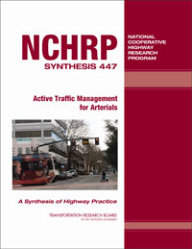
Developing Planning Level CMFs
Other sources for CMFs
Highway Safety Manual
FHWA
NCHRP Reports
VDOT Safety Performance Functions
Virginia Crash Rates

Slide 17
CMFs for Roadway Widening Projects
Since roadway widening projects involve multiple improvement CMFs, VA SPF and crash rates were also used to determine planning CMFs:
A safety performance function (SPF) is an equation for a given roadway type and number of lanes used to predict the average number of crashes per year at a location as a function of exposure (Annual Average Daily Traffic - AADT).
SPF Predicted # Crashes = Function[AADT, Segment Length]
Comparison of predicted crashes per mile for adding lanes CMFs
The CMFs developed using SPFs are dependent on AADT, which is why the min, max, and average were calculated to show the range in CMFs
Improvement Type | MIN | MAX | AVE | Planning Level CMF
Rural Freeway: Widening 2 to 3 Lanes | 0.25 | 1.24 | 0.66 | 0.7
Notes:
Developing a CMF from the SPF is a function of AADT. In order to calculate the CMFs, the min, max, and average values of AADT from the report on the development of the SPFs (report number is FHWA/VCTIR 14-r14). These AADTs were plugged into the SPF equations. This method was used for the following:
-Rural four to six lane
-Urban four to six lane
-Urban four to eight lane
-Urban six to eight lane
Important note: The CMFs that were developed are dependent on AADT, which is why the min, max, and ave were calculated to show the range in CMFs based on AADT.

Slide 18
CMFs for Roadway Widening Projects
For comparison and selection of appropriate CMF values, VA crash rates were also used :
Virginia crashes and traffic volume were categorized by rural and urban functional classes to determine crash rates by severity
The ratio of fatal and severe injury crash rates for widened number of lanes to the existing number of lanes, compared to the SPF derived value, was selected as the CMF –
    For example, Urban arterial widening from 4 to 6 lanes crash rate ratios ranged from 0.7 to 0.9. A CMF of 0.85 was chosen based on the confidence limits of the estimates, VMT and miles of roadway used to determine the rates, and SPF based widening type CMFs.

Slide 19
CMFs for HB2
http://www.virginiahb2.org/resources.html

Slide 20
HB2 Planning Level CMFs
Project Extent | Improvement Type/Features | Planning Level CMF
Intersections
 | Signal: New
 | Convert stop/yield control to signal | 0.65
 | Roundabout: New
 | Roundabout: New - Convert signal to roundabout | 0.40
 | Roundabout: New - Convert stop/yield control to roundabout | 0.20
 | New Turn Lane (none present) | 0.85
 | Add Turn Lane (to existing) | 0.97
 | Remove Minor Approach Left Turns (use right turn and downstream U-turn) | 0.65
 | Improve skew angle
 | 3 Leg Intersection | 0.70
 | 4 Leg Intersection | 0.60

Slide 21
HB2 Planning Level CMFs
Project Extent | Improvement Type/Feature | Planning Level CMF
Interchange
 | At Grade to New interchange | 0.50
 | Non-Freeway Segment: Convert Diamond to DDI | 0.30
 | Non-Freeway Segment: Convert Diamond to SPUI | 0.60
 | Non-Freeway Segment: Replace Arterial Turns with Loops or Directional Ramps | 0.65
 | Freeway Segment: Add Freeway Collector-Distributor Roads | 0.90
 | Add Freeway Independent Loop or Directional Ramp Entrances | 0.95
 | Extend ramp length
 | Extend ramp acceleration length (250') | 0.80
 | Extend ramp acceleration length (500') | 0.65
 | Extend ramp acceleration length (1000') | 0.45
 | Extend ramp deceleration length (250'-500') | 0.85

Slide 22
HB2 Planning Level CMFs
Project Extent | Improvement Type/Feature | Planning Level CMF
Segments | Non-Freeway: (including 2 or more intersections )
 | Non-Freeway: Signal Optimization / Adaptive | 0.92
 | Non-Freeway: ITS for ATM | 0.90
 | Non-Freeway: Alignment Reconstruction | 0.85
 | Non-Freeway: Widen Travel Lanes (by 2 - 3 ft.) | 0.80
 | Non-Freeway: Shoulder/Clear Zone Improvement | 0.65
 | Non-Freeway: Pavement Re-utilization (Road Diet) | 0.55
 | Non-Freeway: Access Management | 0.75
 | Rural Non-Freeway : Widening 2 lanes to multi-lane divided | 0.70
 | Urban Non-Freeway : Widening 2 lanes to 4-lane divided | 0.80
 | Urban Non-Freeway : Widening 2 lanes to 6-lane divided | 0.75
 | Urban Non-Freeway : Widening 4 lanes to 6+-lane divided | 0.85

Slide 23
HB2 Planning Level CMFs
Project Extent | Improvement Type/Feature | Planning Level CMF
Segments | Freeways: ( including 2 or more interchanges )
 | Freeway: ITS for Incident Management | 0.85
 | Freeway: ITS for ATM | 0.80
 | Freeway: ITS for Variable Speed Limits | 0.90
 | Freeway: Add Aux Lanes between Ramps | 0.80
 | Rural Freeway: Directional Widening 2 to 3 Lanes | 0.70
 | Urban Freeway: Directional Widening 2 to 3 Lanes | 0.90
 | Urban Freeway: Directional Widening 2 to 4+ Lanes | 0.75
 | Urban Freeway: Directional Widening 3 to 4+ Lanes | 0.80

Slide 24
HB2 Planning Level CMFs
Project Extent | Improvement Type/Feature | Planning Level CMF
Bike and Pedestrian
 | Add Sidewalk | 0.90
 | Add Bike Lane | 0.95
 | Add Separate 10ft. Mixed-Use Trail | 0.80
 | Improve At-Grade Crossing | 0.85
Bridges | Widen Shoulders | 0.95
 | Add Lanes | See segment values

Slide 25
Example HB2 use of CMFs

Slide 26
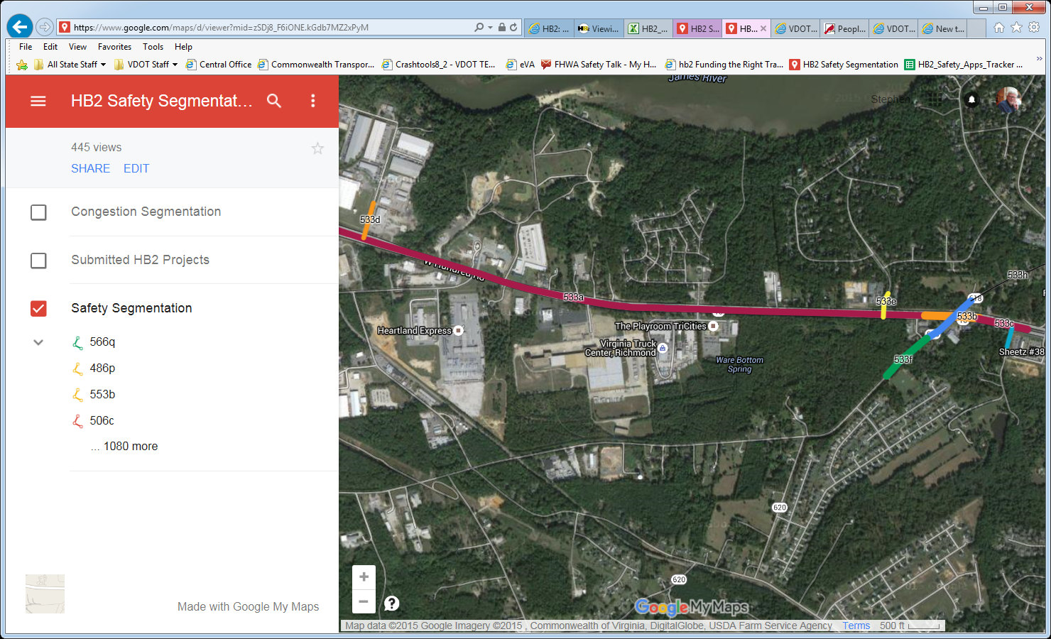
Projects Segmented to Match Planning Level CMFs

Slide 27
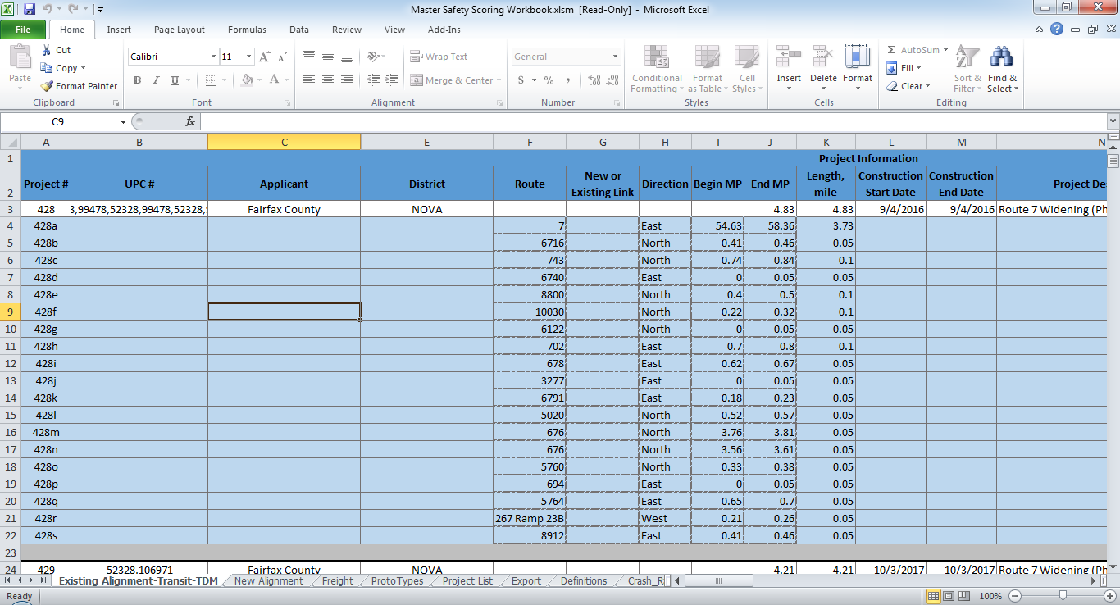
HB2 Safety Scoring Spreadsheet
Row for each Project Segment
Sheet for each Project Type

Slide 28
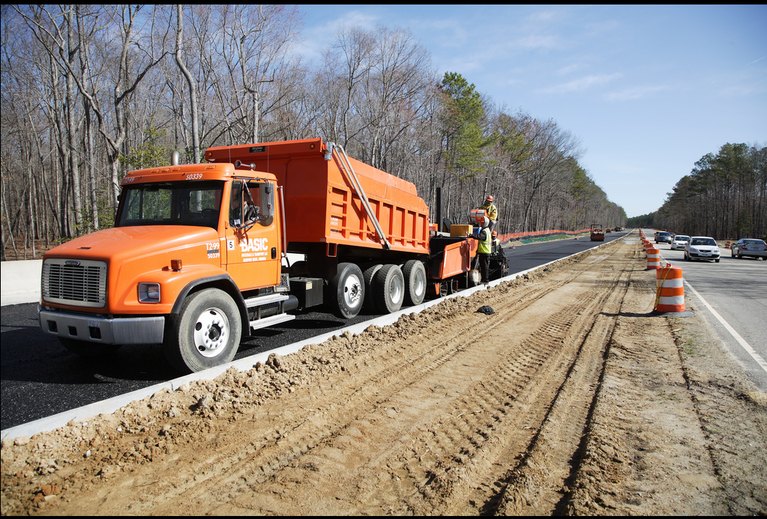
Urban Two Lanes Undivided to
Four Lanes Divided
Reduction in F+SI Crashes (1-CMF) = 1- 0.80 = 20%
S.1: 2010-14 F+SI Crashes = 10 / yr
Project F+SI Avoided = 2 / yr
S.2: F+SI Crash Rate = 0.30 / 100 Million VMT
Project F+SI Rate Avoided = 0.06 HMVMT
Credit: VDOT
Notes:
Assumes average cost of K/A crash = $625,000

Slide 29
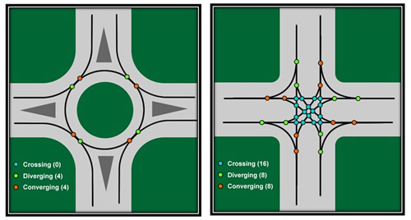
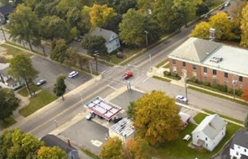
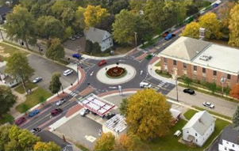
Urban Two Way Stop to
Roundabout Control
Before
After
Reduction in F+SI Crashes (1-CMF) = 1- 0.20 = 80%
S1: 2010-2014 F+SI Crashes = 1.5 / yr
Project F+SI Avoided = 1.2 / yr
S2: F+SI Crash Rate = 0.17 / 100 M VMT
Project F+SI Rate Avoided = 0.14 / HMVMT
Credit: FHWA
Notes:
http://safety.fhwa.dot.gov/intersection/roundabouts/presentations/safety_aspects/short.cfm

Slide 30
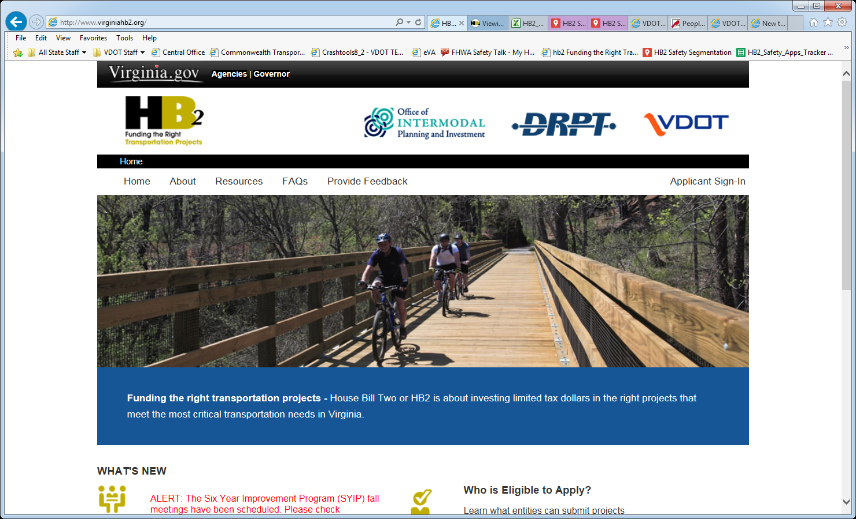
www.virginiaHB2.org

