Slide 1

California Local HSIP Program and the Benefit-Cost Analysis
For FHWA CMF Clearinghouse Webinar
December 17, 2018
Robert Peterson / Richard Ke
Office of Federal Programs
Division of Local Assistance
California Department of Transportation (Caltrans)

Slide 2
Outlines:
    Introduction of California’s HSIP;
    Funding and project selection;
    CA’s Local Roadway Safety Manual (LRSM);
    Benefit Cost Analysis;
    Cycle 9 Call-for-Projects (i.e. Application process); and
    DEMO of HSIP Analyzer.

Slide 3
California’s HSIP
  Wide variety of local agencies: 58 counties & 482 cities
    Big or small; urban or rural; with or without safety analysis expertise; …
  A data driven process and a fair project comparison method are needed;
  Project delivery requirements:
    PE Authorization - within 9 months; and
    CON Authorization - within 36 months

Slide 4
Funding and Project Selection
  Local HSIP apportionments: approx. $81 million per year (2016-2020 average)
  Project selection:
    Benefit Cost Ratio (BCR);
    Funding set-asides.
National | California | California Local HSIP
$2.317 billion/year | $204 million/year | $81 million/year

Slide 5
Funding and Project Selection
9 cycles: 1st - 2007; 9th: 2018.
Cycles 4 to 9: project selection – data driven. $895 million awarded to 1,259 projects. 308 completed/321 in construction. Expected benefits: $11.6 billion!
Cycle | Release Date | Number of Applications | Number of projects selected | Federal funds approved ($M) | Average BCR of selected projects
4 | 2/23/2011 | 357 | 179 | $74.5 | 7.9
5 | 10/19/2012 | 276 | 221 | $111.3 | 14.6
6 | 11/14/2013 | 389 | 231 | $150.0 | 10.7
7 | 11/12/2015 | 212 | 182 | $160.5 | 16.9
8 | 11/21/2016 | 247 | 225 | $216.9 | 10.3
9 | 12/1/2018 | 351 | 221 | $181.8 | 15.5
 | Total | 1,832 | 1,259 | $895.0 | 12.9

Slide 6
  http://www.dot.ca.gov/hq/LocalPrograms/HSIP/2018/CA-LRSM.pdf

Slide 7
Local Roadway Safety Manual for California Local Road Owners (LRSM)
Most recent update: June 2018;
Outlines the basic elements of a proven process for crash analysis & project identification;
Details on safety countermeasures:
  Where to use;
  Why it works;
  CMF (CRF).

Slide 8
Benefit Cost Analysis
Construction Cost Estimate
(CON only)
Project Cost Estimate
(PE+ROW+CON+CE)
Project Cost ($)
Safety Countermeasures
(CRF and Life)
Crash Data
(most recent 3-5 years)
Project Benefit ($)
Benefit Cost Ratio (BCR)
= Project Benefit/Project Cost
Benefit Cost Ratio (BCR) Calculation

Slide 9
Benefit Cost Analysis
  78 safety countermeasures (CMs) are defined in the LRSM:
  40 for intersections
    19 for signalized intersections
    21 for non-signalized intersections
  38 for roadways.

Slide 10
Benefit Cost Analysis
  Each CM is associated with:
  A crash type (all; Ped & Bike; Night; etc.);
  A Crash Reduction Factor (CRF): 10% to 80%; and
  A Service Life: 10 or 20 years.
  Example:
No. | Type | Countermeasure Name | Crash Type | Crash Reduction Factor (CRF) | Expected Life (Years) | Federal Funding Eligibility | Systemic Approach Opportunity
R9 | Geometric Mod. | Install raised median | All | 25% | 20 | 90% | Medium

Slide 11
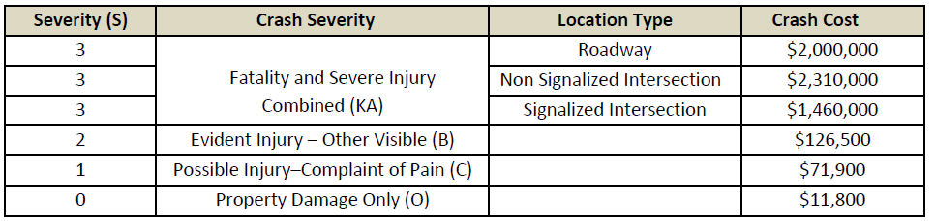
Crash costs used in estimating the safety benefits
Benefit Cost Analysis

Slide 12
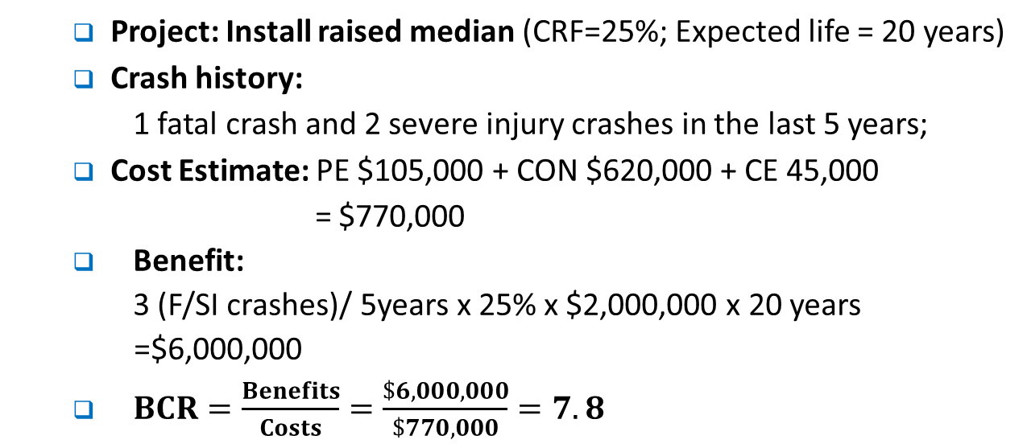
BCR Calculation - Example
Benefit Cost Analysis
  Project: Install raised median (CRF=25%; Expected life = 20 years)
  Crash history:
  1 fatal crash and 2 severe injury crashes in the last 5 years;
  Cost Estimate: PE $105,000 + CON $620,000 + CE 45,000
  = $770,000
  Benefit:
  3 (F/SI crashes)/ 5years x 25% x $2,000,000 x 20 years
  =$6,000,000
  $BCR=\frac{Benefits}{Costs}=\frac{\$6,000,000}{\$770,000}=7.8$

Slide 13
Cycle 9 Call-for-Projects
Funding: $180 million in Federal HSIP Funds; Submittal deadline: 8/31/18.
Submittal of Applications:
  Application form is a savable PDF file;
  The submission is electronic (paperless);
  All required data fields and attachments must be provided.
Review of applications:
  Countermeasures are used correctly;
  BCR calculation has no errors;
  Applications are prioritized based on the BCRs from high to low.

Slide 14
Cycle 9 Call-for-Projects
Application Categories:
BCR Applications;
Set-asides (BCR calculation not required):
  Guardrail Upgrades;
  Horizontal Curve Signing;
  Pedestrian Crossing Enhancements;
  Tribes.

Slide 15
Cycle 9 Call-for-Projects
Applicants need:
  HSIP Guidelines;
  LRSM;
  Application Form;
  HSIP Analyzer.
From the website http://www.dot.ca.gov/hq/LocalPrograms/hsip.html

Slide 16
Cycle 9 Call-for-Projects
Application Form:
  Basic information;
  Required attachments:
    Maps;
    Pictures;
    crash diagrams and crash list;
    warrants (for new signals)
  Completed HSIP Analyzer (data and calculation).

Slide 17
HSIP Analyzer
Downloadable at http://www.dot.ca.gov/hq/LocalPrograms/HSIP/apply_nowHSIP.htm.
A PDF form based software that streamlines the project cost estimate, safety improvement countermeasure evaluation, crash data input and Benefit Cost Ratio (BCR) calculation. It simplifies the application work by integrating multiple documents.
HSIP Analyzer is required to use for all applications:
  For an applications with BCR:
  Engineer’s estimate for construction items; Project cost estimate; Selection of CMs; Crash data; BCR calculation
  For an applications without BCR:
  Engineer’s estimate for construction items; Project cost estimate

Slide 18
HSIP Analyzer
Works for either spot locations or systemic approach.
Section I. Construction Cost Estimate and Cost Breakdown
  for construction costs only
Section II. Project Cost Estimate
  for all phases (PE, ROW, CON & CE) and all funding sources
Section III. Project Location Groups, Countermeasures
and Crash Data
  For either spot locations or systemic approach
Section IV. Calculation and Results
  with automatic error-checking.

Slide 26

CA Local HSIP Website: http://www.dot.ca.gov/hq/LocalPrograms/hsip.html
Or
Google search: “CA Local HSIP”

