Slide 1
Understanding & Navigating the CMF Clearinghouse Rating System Changes
(for Researchers)

Slide 2
Webinar "Housekeeping"
Rejoining the Program
All Lines are Muted
Control Panel
Questions/Assistance
Webinar Recording

Slide 3
Poll
Please identify your affiliation. (select all that apply)
  Grad Student
  Academic Research Staff / Professor
  Government
  Private
  Other

Slide 4
Agenda
CMF Rating Transition
  Taha Saleem, UNC Highway Safety Research Center
Questions & Answers
  Dave Petrucci, FHWA Resource Center
Wrap-up
  Karen Scurry, FHWA Office of Safety

Slide 5
CMF Inclusion Criteria
The CMF Clearinghouse presents CMFs from studies that meet the following criteria:
  The study must be based on crash data
  The study must have the objective of quantifying the safety effect of a roadway feature or characteristic
  The study must be focused on determining the safety effect of an infrastructure characteristic, feature, or modification that would fall under engineering responsibilities
  The study must explicitly present quantified CMF values or CMFunctions

Slide 6
CMF Clearinghouse Rating Transition

Slide 7
Why is the CMF Clearinghouse Transitioning to a New Rating Criteria?
The NCHRP 17-72 project recently developed a CMF rating system to update CMFs for the Highway Safety Manual
The CMF Clearinghouse rating system transitioned on Feb 15, 2021 to be consistent with the NCHRP 17-72 rating process
Account for Various Factors
Detailed / Rigorous
Notes:
Let us start with the big question. Why is the CMF Clearinghouse transitioning to a new rating criteria?
To give you guys a bit of a background, the legacy CMF Star Rating System has been in use since the inception of CMF Clearinghouse in 2009. Recently, the NCHRP 17-72 project developed a CMF rating system to update CMFs for the upcoming 2nd edition of the Highway Safety Manual. With this, the CMF Clearinghouse rating system transitioned on Feb 15, 2021 to be consistent with the NCHRP 17-72 rating scheme. This system is very detailed and rigorous, and provides scores for various factors, which we will be discussing more on later in this presentation.

Slide 8
Poll
How often do you use the CMF Clearinghouse? (select one answer)
  Daily
  Weekly
  Monthly
  Once or Twice Per Year
  Never

Slide 9
Legacy CMF Clearinghouse Rating System
Notes:
Before we talk about the rating system changes, lets talk briefly about the Legacy CMF Star Rating System.

Slide 10
Legacy CMF Star Rating System
Single rating scheme for Before/After, Cross-Sectional, Meta-Analysis, and Meta-Regression studies
CMFs are rated based on five criteria:
  Study Design (weight of 2)
  Sample Size (weight of 2)
  Standard Error (weight of 1)
  Potential Bias (weight of 1)
  Data source (diversity in states) (weight of 1)
Points are assigned to each criteria based on the level of rigor (excellent = 2 points, fair = 1 point, or poor = 0 points)
Notes:
Currently, we use a single rating scheme to rate the CMFs developed from either Before/After, Cross-Sectional, Meta-Analysis, or Meta-Regression studies and that scheme is based on five criteria, that are, study design, sample size, standard error, biases, and data source. In this rating scheme, study design and sample size are given a weight of 2, whereas the other criteria’s carry a weight of 1. Points are assigned to each criteria based on the level of rigor, where excellent equates to 2 points, fair equates to 1 point, and poor equates to 0 points.

Slide 11
Legacy CMF Star Rating System
Score | Star Rating
14 (max possible) | 5 Stars
11 - 13 | 4 Stars
7 - 10 | 3 Stars
3 - 6 | 2 Stars
1 - 2 | 1 Star
0 | 0 Stars
Overall Score = (2 * study design) + (2 * sample size) + standard error + potential bias + data source
Max Possible Points = 14
  Very few 5 Star CMFs unless the study included multiple States
Notes:
The overall score of a CMF is calculated using the formula that you can see on your screens and this accounts for the weight of 2 given to the study design and sample size.
The maximum number of possible points a CMF can get are 14. The table here shows the conversion from the 14-point scale to the star ratings. To get a 5-star rating, a study must check all boxes to receive the maximum possible, 14 points (hence currently there are very few 5 Star CMFs unless the study that developed CMFs included data from multiple States).

Slide 12
NCHRP 17-72 CMF Rating System
Notes:
Now that we have briefly talked about the current CMF Star Rating System, lets move towards discussing the rating system developed by NCHRP 17-72 and how it is different from the legacy rating system.

Slide 13
NCHRP 17-72 Rating Procedure
Before/After and Cross-Sectional studies:
Sample Size
Study Design and Statistical Methodology
Statistical Significance (standard error is used to determine statistical significance)
Meta-Analysis and Meta-Regression studies:
Methodology and Data
Individual CMF Quality
Appropriateness of Combining / Developing CMFunctions
Statistical significance / Appropriateness of Analysis
Maximum possible score is 150
Detailed scoring criteria is available at http://cmfclearinghouse.org/sqr.cfm
Notes:
NCHRP 17-72 provides separate rating criteria for CMFs developed using Before/After, Cross-Sectional, Meta-Analysis, and Meta-Regression studies.
The ratings for Before/After and Cross-Sectional studies consider factors such as the sample size, study design, methodology, and standard error of the CMF to determine significance.
Whereas the ratings for Meta-Analysis and Meta-Regression studies consider factors such as data, methodology, individual CMF quality, appropriateness of combining CMFs, significance, and the appropriateness of analysis.
There are multiple levels within the different factors, and points are assigned for each level for a maximum possible score of 150 points.
In the next few slides, we will discuss more details about the Before/After rating criteria. You can always visit the Star Quality Ratings page ate link displayed on the slide for more details about the rating criteria for all study types.

Slide 14
Before/After Studies
Scoring Details
Factors | Subcategories | Total Points
Data | Number of miles/sites and number of crashes for reference/comparison and treatment groups | 55
Study Design and Statistical Methodology | Potential biases, accounting for trends, and appropriateness of statistical procedures | 75
Statistical Significance | Statistical significance of CMF | 20
Notes:
Let's take a closer look at what goes into the ratings for before/after studies.
A total of 55 points are allocated to data where consideration is given to the number of miles/sites and number of crashes for reference/comparison and treatment groups. Study design and statistical methodology accounts for the potential biases, trends, and appropriateness of statistical procedures and have a total of 75 points. The statistical significance of CMFs carry a total of 20 points.

Slide 15
Before/After Studies
Scoring Details
Description | Max Possible Points
Number of Miles/Sites in the reference/comparison and treatment groups | 20
Number of Crashes in the reference/comparison and treatment groups | 20
Reference/comparison group appropriately account for Spillover/Crash Migration | 5
Traffic Volumes reported for before and after periods | 10
Addresses potential bias due to RTM | 25
Accounts for changes in Traffic Volumes | 10
Accounts for Time Trends and other changes | 10
Reference/comparison and treatment groups have similar AADT | 10
Reference/comparison and treatment groups belong to same Roadway/Site Type | 10
Estimation of appropriate SPFs | 10
Statistical Significance | 20
Notes:
This table shows the all the different rating inputs that go into rating a CMF from a Before/After study.

Slide 16
Before/After Studies
Scoring Details
Description | Max Possible Points
Number of Miles/Sites in the reference/comparison and treatment groups | 20
Number of Crashes in the reference/comparison and treatment groups | 20
Reference/comparison group appropriately account for Spillover/Crash Migration | 5
Traffic Volumes reported for before and after periods | 10
Addresses potential bias due to RTM | 25
Accounts for changes in Traffic Volumes | 10
Accounts for Time Trends and other changes | 10
Reference/comparison and treatment groups have similar AADT | 10
Reference/comparison and treatment groups belong to same Roadway/Site Type | 10
Estimation of appropriate SPFs | 10
Statistical Significance | 20
Notes:
The 55 points for the data come from these four categories where 20 points each are assigned to the number of miles/sites and the number of crashes in the reference/comparison and treatment groups. There are 5 points assigned for the reference/comparison group appropriate accounting for spillover or crash migration and 10 points are assigned for the reporting of before and after traffic volumes.

Slide 17
Before/After Studies
Scoring Details
Description | Max Possible Points
Number of Miles/Sites in the reference/comparison and treatment groups | 20
Number of Crashes in the reference/comparison and treatment groups | 20
Reference/comparison group appropriately account for Spillover/Crash Migration | 5
Traffic Volumes reported for before and after periods | 10
Addresses potential bias due to RTM | 25
Accounts for changes in Traffic Volumes | 10
Accounts for Time Trends and other changes | 10
Reference/comparison and treatment groups have similar AADT | 10
Reference/comparison and treatment groups belong to same Roadway/Site Type | 10
Estimation of appropriate SPFs | 10
Statistical Significance | 20
Notes:
The 75 points for study design and methodology come from these six categories where a major chunk of 25 points are assigned for addressing of the potential biases' due to RTM, and 10 points each are assigned to accounting for changes in traffic volumes, accounting for time trends, ensuring that the reference/comparison and treatment groups have similar AADTs and belong to the roadway or site type, and lastly estimation and use of appropriate SPFs.

Slide 18
Before/After Studies
Scoring Details
Description | Max Possible Points
Number of Miles/Sites in the reference/comparison and treatment groups | 20
Number of Crashes in the reference/comparison and treatment groups | 20
Reference/comparison group appropriately account for Spillover/Crash Migration | 5
Traffic Volumes reported for before and after periods | 10
Addresses potential bias due to RTM | 25
Accounts for changes in Traffic Volumes | 10
Accounts for Time Trends and other changes | 10
Reference/comparison and treatment groups have similar AADT | 10
Reference/comparison and treatment groups belong to same Roadway/Site Type | 10
Estimation of appropriate SPFs | 10
Statistical Significance | 20
Notes:
Lastly, there are 20 points assigned for statistical significance of the CMF with points available for 95%, 90% and 85% significance levels.

Slide 19
Before/After Studies
Scoring Details
Description | Max Possible Points
Number of Miles/Sites in the reference/comparison and treatment groups | 20
Number of Crashes in the reference/comparison and treatment groups | 20
Reference/comparison group appropriately account for Spillover/Crash Migration | 5
Traffic Volumes reported for before and after periods | 10
Addresses potential bias due to RTM | 25
Accounts for changes in Traffic Volumes | 10
Accounts for Time Trends and other changes | 10
Reference/comparison and treatment groups have similar AADT | 10
Reference/comparison and treatment groups belong to same Roadway/Site Type | 10
Estimation of appropriate SPFs | 10
Statistical Significance | 20
Notes:
As you can see that for these various rating inputs, the scoring is heavily dependent on you as researchers reporting the data in your studies.
Now, let us go a step further and see what’s constitutes the 20 points for the number of miles/sites and the number of crashes

Slide 20
Before/After Studies
Scoring Details
Description | Max Possible Points
Number of Miles/Sites in the reference/comparison and treatment groups | 20
Number of Crashes in the reference/comparison and treatment groups | 20
Reference/comparison group appropriately account for Spillover/Crash Migration | 5
Traffic Volumes reported for before and after periods | 10
Addresses potential bias due to RTM | 25
Accounts for changes in Traffic Volumes | 10
Accounts for Time Trends and other changes | 10
Reference/comparison and treatment groups have similar AADT | 10
Reference/comparison and treatment groups belong to same Roadway/Site Type | 10
Estimation of appropriate SPFs | 10
Statistical Significance | 20
Notes:
First let us talk about what it takes to get the maximum possible 20 points for the number of miles/sites.

Slide 21
Before/After Studies
Number of Miles/Sites in the reference/comparison and treatment groups are scored independently with each group getting a maximum of 10 points.
Number of Miles/Sites in the Reference/Comparison Group
50 or more Miles/Sites | 10 Points
25 to 49 Miles/Sites | 5 Points
< 25 Miles/Sites or Cannot be Determined | 0 Points
Number of Miles/Sites in the Treatment Group
50 or more Miles/Sites | 10 Points
25 to 49 Miles/Sites | 5 Points
< 25 Miles/Sites or Cannot be Determined | 0 Points
Notes:
So, the number of miles/sites in the reference/comparison and treatments groups are scored independently with each group getting a maximum of 10 points.
As you can see from the tables shown on screen, using 50 or more miles/sites for your reference/comparison and treatment groups would lead to 10 points. There are 5 points available for using 25 to 49 miles/sites. Using <25 miles/sites would lead to 0 points. One thing to note here, is that if the number of miles/sites are not reported in your study (or in other words cannot be determined), it would receive 0 points.

Slide 22
Before/After Studies
Scoring Details
Description | Max Possible Points
Number of Miles/Sites in the reference/comparison and treatment groups | 20
Number of Crashes in the reference/comparison and treatment groups | 20
Reference/comparison group appropriately account for Spillover/Crash Migration | 5
Traffic Volumes reported for before and after periods | 10
Addresses potential bias due to RTM | 25
Accounts for changes in Traffic Volumes | 10
Accounts for Time Trends and other changes | 10
Reference/comparison and treatment groups have similar AADT | 10
Reference/comparison and treatment groups belong to same Roadway/Site Type | 10
Estimation of appropriate SPFs | 10
Statistical Significance | 20
Notes:
Now, let us talk about what it takes to get the maximum possible 20 points for the number of crashes.

Slide 23
Before/After Studies
Number of Crashes in the reference/comparison and treatment groups are scored independently with each group getting a maximum of 10 points.
Number of Crashes in the Reference/Comparison Group
500 or more crashes and 100 or more crashes per year on average | 10 Points
500 or more crashes and less than 100 crashes per year on average | 7 Points
250 to 499 crashes | 5 Points
< 250 crashes or Cannot be Determined | 0 Points
Number of Crashes in the Before Period + Crashes Expected in the After Period without the treatment, for Treatment Group
200 or more crashes | 10 Points
100 to 200 crashes | 5 Points
< 100 crashes or Cannot be Determined | 0 Points
Notes:
So, similar to the number of miles/sites, the number of crashes in the reference/comparison and treatments groups are scored independently with each group getting a maximum of 10 points.
For the reference/comparison group, 10 points are assigned if there are 500 or more crashes and 100 or more crashes per year on average, while 7 points are assigned if there are 500 or more crashes and less than 100 crashes per year on average. 5 points are available if there are between 250 to 499 crashes in the reference/comparison group, while less than 250 crashes or cannot be determined leads to 0 points.
For the treatment group, we look at the sum of the number of crashes in the before period plus the expected crashes in the after period without the treatment. In this case 200 or more crashes leas to 10 points, between 100 and 200 crashes lead to 5 points, while less than 1000 crashes or cannot be determined leads to 0 points.

Slide 24
Poll
Do you prefer us reaching out to you when reviewing your studies for further information? (select one answer)
  Yes
  No
  Don’t Care

Slide 25
Poll
Do you have any of your studies/reports that are included in CMF Clearinghouse currently? (select one answer)
  Yes
  No
  Not Sure

Slide 26
How are Star Ratings Changing?
Notes:
Now, lets move to discussing how NCHRP 17-72 ratings will be converted to star ratings and what changes you can expect.

Slide 27
How are Star Ratings Changing?
Score (current 14-point scale) | Star Rating in CMF Clearinghouse
14 (max) | 5 Star
11-13 | 4 Star
7-10 | 3 Star
3-6 | 2 Star
1-2 | 1 Star
NCHRP 17-72 Rating Score (150-point scale) | Star Rating in CMF Clearinghouse
135-150 | 5 Star
110-134 | 4 Star
75-109 | 3 Star
35-74 | 2 Star
0-34 | 1 Star
The CMFs are not changing, only their Star ratings are changing
Under both rating systems, a CMF must score 50% of total possible points to receive a 3 Star rating
Notes:
So, how are the star ratings changing? The major change is going from a 14-point rating scale to a more rigorous 150-point rating scale.
Under the legacy rating system, to get a 5 star rating, a CMF must score the maximum possible 14 points. Using the NCHRP 17-72 rating system, a CMF must score between 135-150 points to get for a 5 star rating.
Note that, while star ratings may change in the new system, the CMFs themselves won’t.
One thing that is common Under both rating systems, is that a CMF must score 50% of total possible points — 7 points in the old system and 75 points in the new one — to receive a 3 Star rating.

Slide 28
Changes to Legacy CMF Star Ratings?
There will be movement between the star ratings with some CMFs being rated differently from their current ratings in the CMF Clearinghouse.
NCHRP 17-72 Rating Score | 5 Star | 4 Star | 3 Star | 2 Star | 1 Star
1 Star (0-34) | 3 | 21 | 116 | 341 | 215
2 Star (34-74) | 1 | 89 | 639 | 666 | 59
3 Star (75-109) | 67 | 485 | 1903 | 264 | 25
4 Star (110-134) | 91 | 954 | 988 | 11 | 4
5 Star (135-150) | 137 | 210 | 56 | 0 | 0
Notes:
There will be movement between the star ratings, with some CMFs being rated differently from their legacy star ratings.
The table shown here provides information on how the legacy star rated CMFs will fare under the new rating system.

Slide 29
Changes to Legacy CMF Star Ratings?
There will be movement between the star ratings with some CMFs being rated differently from their current ratings in the CMF Clearinghouse.
NCHRP 17-72 Rating Score | 5 Star | 4 Star | 3 Star | 2 Star | 1 Star
1 Star (0-34) | 3 | 21 | 116 | 341 | 215
2 Star (34-74) | 1 | 89 | 639 | 666 | 59
3 Star (75-109) | 67 | 485 | 1903 | 264 | 25
4 Star (110-134) | 91 | 954 | 988 | 11 | 4
5 Star (135-150) | 137 | 210 | 56 | 0 | 0
Notes:
To provide some context, about 52% of the CMFs would maintain their legacy star ratings under the new rating system.

Slide 30
Changes to Legacy CMF Star Ratings?
There will be movement between the star ratings with some CMFs being rated differently from their current ratings in the CMF Clearinghouse.
NCHRP 17-72 Rating Score | 5 Star | 4 Star | 3 Star | 2 Star | 1 Star
1 Star (0-34) | 3 | 21 | 116 | 341 | 215
2 Star (34-74) | 1 | 89 | 639 | 666 | 59
3 Star (75-109) | 67 | 485 | 1903 | 264 | 25
4 Star (110-134) | 91 | 954 | 988 | 11 | 4
5 Star (135-150) | 137 | 210 | 56 | 0 | 0
Notes:
On the other hand, about 114 CMFs with legacy ratings of 4 stars of higher will be rated 2 stars or lower under the new rating system.

Slide 31
Changes to Legacy CMF Star Ratings?
There will be movement between the star ratings with some CMFs being rated differently from their current ratings in the CMF Clearinghouse.
NCHRP 17-72 Rating Score | 5 Star | 4 Star | 3 Star | 2 Star | 1 Star
1 Star (0-34) | 3 | 21 | 116 | 341 | 215
2 Star (34-74) | 1 | 89 | 639 | 666 | 59
3 Star (75-109) | 67 | 485 | 1903 | 264 | 25
4 Star (110-134) | 91 | 954 | 988 | 11 | 4
5 Star (135-150) | 137 | 210 | 56 | 0 | 0
Notes:
While, about 15 CMFs with legacy ratings of 2 stars or lower will be rated 4 stars under the new system.

Slide 32
Poll
On a scale of 1 (not important) to 5 (very important), please rate the relative importance of the CMF star quality ratings to you and your work? (select one answer)
  5 (very important)
  4 (somewhat important)
  3 (indifferent)
  2 (less important)
  1 (unimportant)

Slide 33
Example Ratings under the Legacy & NCHRP 17-72 Rating Systems
Notes:
Now, lets discuss some specific CMF examples to help you better understand how the NCHRP 17-72 rating system works.

Slide 34
CMF ID 8441: 5 Star Rating (both Legacy and 17-72 Rating Schemes)
Current CMF Clearinghouse Rating Scheme
Study Design | 2
Sample Size | 2
Standard Error | 2
Potential Bias | 2
Data Source | 2
OVERALL SCORE | 14
STAR RATING | 5 Star
NCHRP 17-72 Rating Scheme
Rating for number of miles/sites of reference/comparison group | 10
Rating for number of crashes in reference/comparison group | 10
Rating for number of miles/sites of treatment group | 10
Rating for number of before plus expected after crashes | 10
Rating for providing at least one traffic volume count in before and after periods | 10
Rating for reference/comparison group and treatment group having similar AADT | 10
Rating for reference/comparison group and treatment group having similar roadway characteristics | 10
Rating for CMF significance level | 20
Rating for addressing RTM or system wide implementation | 25
Rating for accounting for spillover/crash migration | 5
Rating for accounting for changes in traffic volume | 10
Rating for accounting for time trends and other changes | 10
Rating for appropriate SPF functional form | 10
OVERALL RATING | 150
STAR RATING | 5 Star
Notes:
For our first example, lets look at the perfect case of CMF ID 8441 developed from a before/after study.

Slide 35
CMF ID 8441: 5 Star Rating (both Legacy and 17-72 Rating Schemes)
Current CMF Clearinghouse Rating Scheme
Study Design | 2
Sample Size | 2
Standard Error | 2
Potential Bias | 2
Data Source | 2
OVERALL SCORE | 14
STAR RATING | 5 Star
NCHRP 17-72 Rating Scheme
Rating for number of miles/sites of reference/comparison group | 10
Rating for number of crashes in reference/comparison group | 10
Rating for number of miles/sites of treatment group | 10
Rating for number of before plus expected after crashes | 10
Rating for providing at least one traffic volume count in before and after periods | 10
Rating for reference/comparison group and treatment group having similar AADT | 10
Rating for reference/comparison group and treatment group having similar roadway characteristics | 10
Rating for CMF significance level | 20
Rating for addressing RTM or system wide implementation | 25
Rating for accounting for spillover/crash migration | 5
Rating for accounting for changes in traffic volume | 10
Rating for accounting for time trends and other changes | 10
Rating for appropriate SPF functional form | 10
OVERALL RATING | 150
STAR RATING | 5 Star
Notes:
This CMF scores perfectly under the legacy rating system getting the maximum possible 14-points leading to a 5 Star rating.

Slide 36
CMF ID 8441: 5 Star Rating (both Legacy and 17-72 Rating Schemes)
Current CMF Clearinghouse Rating Scheme
Study Design | 2
Sample Size | 2
Standard Error | 2
Potential Bias | 2
Data Source | 2
OVERALL SCORE | 14
STAR RATING | 5 Star
NCHRP 17-72 Rating Scheme
Rating for number of miles/sites of reference/comparison group | 10
Rating for number of crashes in reference/comparison group | 10
Rating for number of miles/sites of treatment group | 10
Rating for number of before plus expected after crashes | 10
Rating for providing at least one traffic volume count in before and after periods | 10
Rating for reference/comparison group and treatment group having similar AADT | 10
Rating for reference/comparison group and treatment group having similar roadway characteristics | 10
Rating for CMF significance level | 20
Rating for addressing RTM or system wide implementation | 25
Rating for accounting for spillover/crash migration | 5
Rating for accounting for changes in traffic volume | 10
Rating for accounting for time trends and other changes | 10
Rating for appropriate SPF functional form | 10
OVERALL RATING | 150
STAR RATING | 5 Star
Notes:
It also checks all boxed under the NCHRP 17-72 rating system scoring maximum points for each factor resulting in an overall rating of 150 points or 5 Stars.

Slide 37
CMF ID 9198: 3 Star Rating (Legacy) and
5 Star Rating (17-72 Rating Scheme)
Current CMF Clearinghouse Rating Scheme
Study Design | 2
Sample Size | 0
Standard Error | 2
Potential Bias | 2
Data Source | 1
OVERALL SCORE | 9
STAR RATING | 3 Star
NCHRP 17-72 Rating Scheme
Rating for number of miles/sites of reference/comparison group | 10
Rating for number of crashes in reference/comparison group | 10
Rating for number of miles/sites of treatment group | 0
Rating for number of before plus expected after crashes | 5
Rating for providing at least one traffic volume count in before and after periods | 10
Rating for reference/comparison group and treatment group having similar AADT | 10
Rating for reference/comparison group and treatment group having similar roadway characteristics | 10
Rating for CMF significance level | 20
Rating for addressing RTM or system wide implementation | 25
Rating for accounting for spillover/crash migration | 5
Rating for accounting for changes in traffic volume | 10
Rating for accounting for time trends and other changes | 10
Rating for appropriate SPF functional form | 10
OVERALL RATING | 135
STAR RATING | 5 Star
Notes:
While CMF ID 8441 presented an ideal case where both rating systems lead to the same star rating, this ideal situation only applies to about 52% of the CMFs.
CMF ID 9198 developed from a before/after study presents an example of going from the 3 Star to a 5 Star rating.

Slide 38
CMF ID 9198: 3 Star Rating (Legacy) and
5 Star Rating (17-72 Rating Scheme)
Current CMF Clearinghouse Rating Scheme
Study Design | 2
Sample Size | 0
Standard Error | 2
Potential Bias | 2
Data Source | 1
OVERALL SCORE | 9
STAR RATING | 3 Star
NCHRP 17-72 Rating Scheme
Rating for number of miles/sites of reference/comparison group | 10
Rating for number of crashes in reference/comparison group | 10
Rating for number of miles/sites of treatment group | 0
Rating for number of before plus expected after crashes | 5
Rating for providing at least one traffic volume count in before and after periods | 10
Rating for reference/comparison group and treatment group having similar AADT | 10
Rating for reference/comparison group and treatment group having similar roadway characteristics | 10
Rating for CMF significance level | 20
Rating for addressing RTM or system wide implementation | 25
Rating for accounting for spillover/crash migration | 5
Rating for accounting for changes in traffic volume | 10
Rating for accounting for time trends and other changes | 10
Rating for appropriate SPF functional form | 10
OVERALL RATING | 135
STAR RATING | 5 Star
Notes:
Under the legacy rating system, this CMF received a 3 Star rating due to insufficient sample size and not using data from multiple states.

Slide 39
CMF ID 9198: 3 Star Rating (Current) and
5 Star Rating (17-72 Rating Scheme)
Current CMF Clearinghouse Rating Scheme
Study Design | 2
Sample Size | 0
Standard Error | 2
Potential Bias | 2
Data Source | 1
OVERALL SCORE | 9
STAR RATING | 3 Star
NCHRP 17-72 Rating Scheme
Rating for number of miles/sites of reference/comparison group | 10
Rating for number of crashes in reference/comparison group | 10
Rating for number of miles/sites of treatment group | 0
Rating for number of before plus expected after crashes | 5
Rating for providing at least one traffic volume count in before and after periods | 10
Rating for reference/comparison group and treatment group having similar AADT | 10
Rating for reference/comparison group and treatment group having similar roadway characteristics | 10
Rating for CMF significance level | 20
Rating for addressing RTM or system wide implementation | 25
Rating for accounting for spillover/crash migration | 5
Rating for accounting for changes in traffic volume | 10
Rating for accounting for time trends and other changes | 10
Rating for appropriate SPF functional form | 10
OVERALL RATING | 135
STAR RATING | 5 Star
Notes:
When reviewed using the NCHRP 17-72 rating system, this CMF still looses points due to insufficient sample size for the treatment group but scores perfectly for sample size of the reference/comparison group and in the various other categories. This led to this CMF getting an overall rating of 135 points or 5 Stars under the new system.

Slide 40
Poll
Do you expect the new ratings to impact you and/or your customers? (select one answer)
  Yes, definitely
  Yes, likely but not in a significant way
  No, it’s unlikely
  No, absolutely not
  I’m not sure

Slide 41
Navigating the Rating Changes on the CMF Clearinghouse Website
Notes:
In the next few slides, we will talk about navigating the rating system changes on the CMF Clearinghouse website.

Slide 42
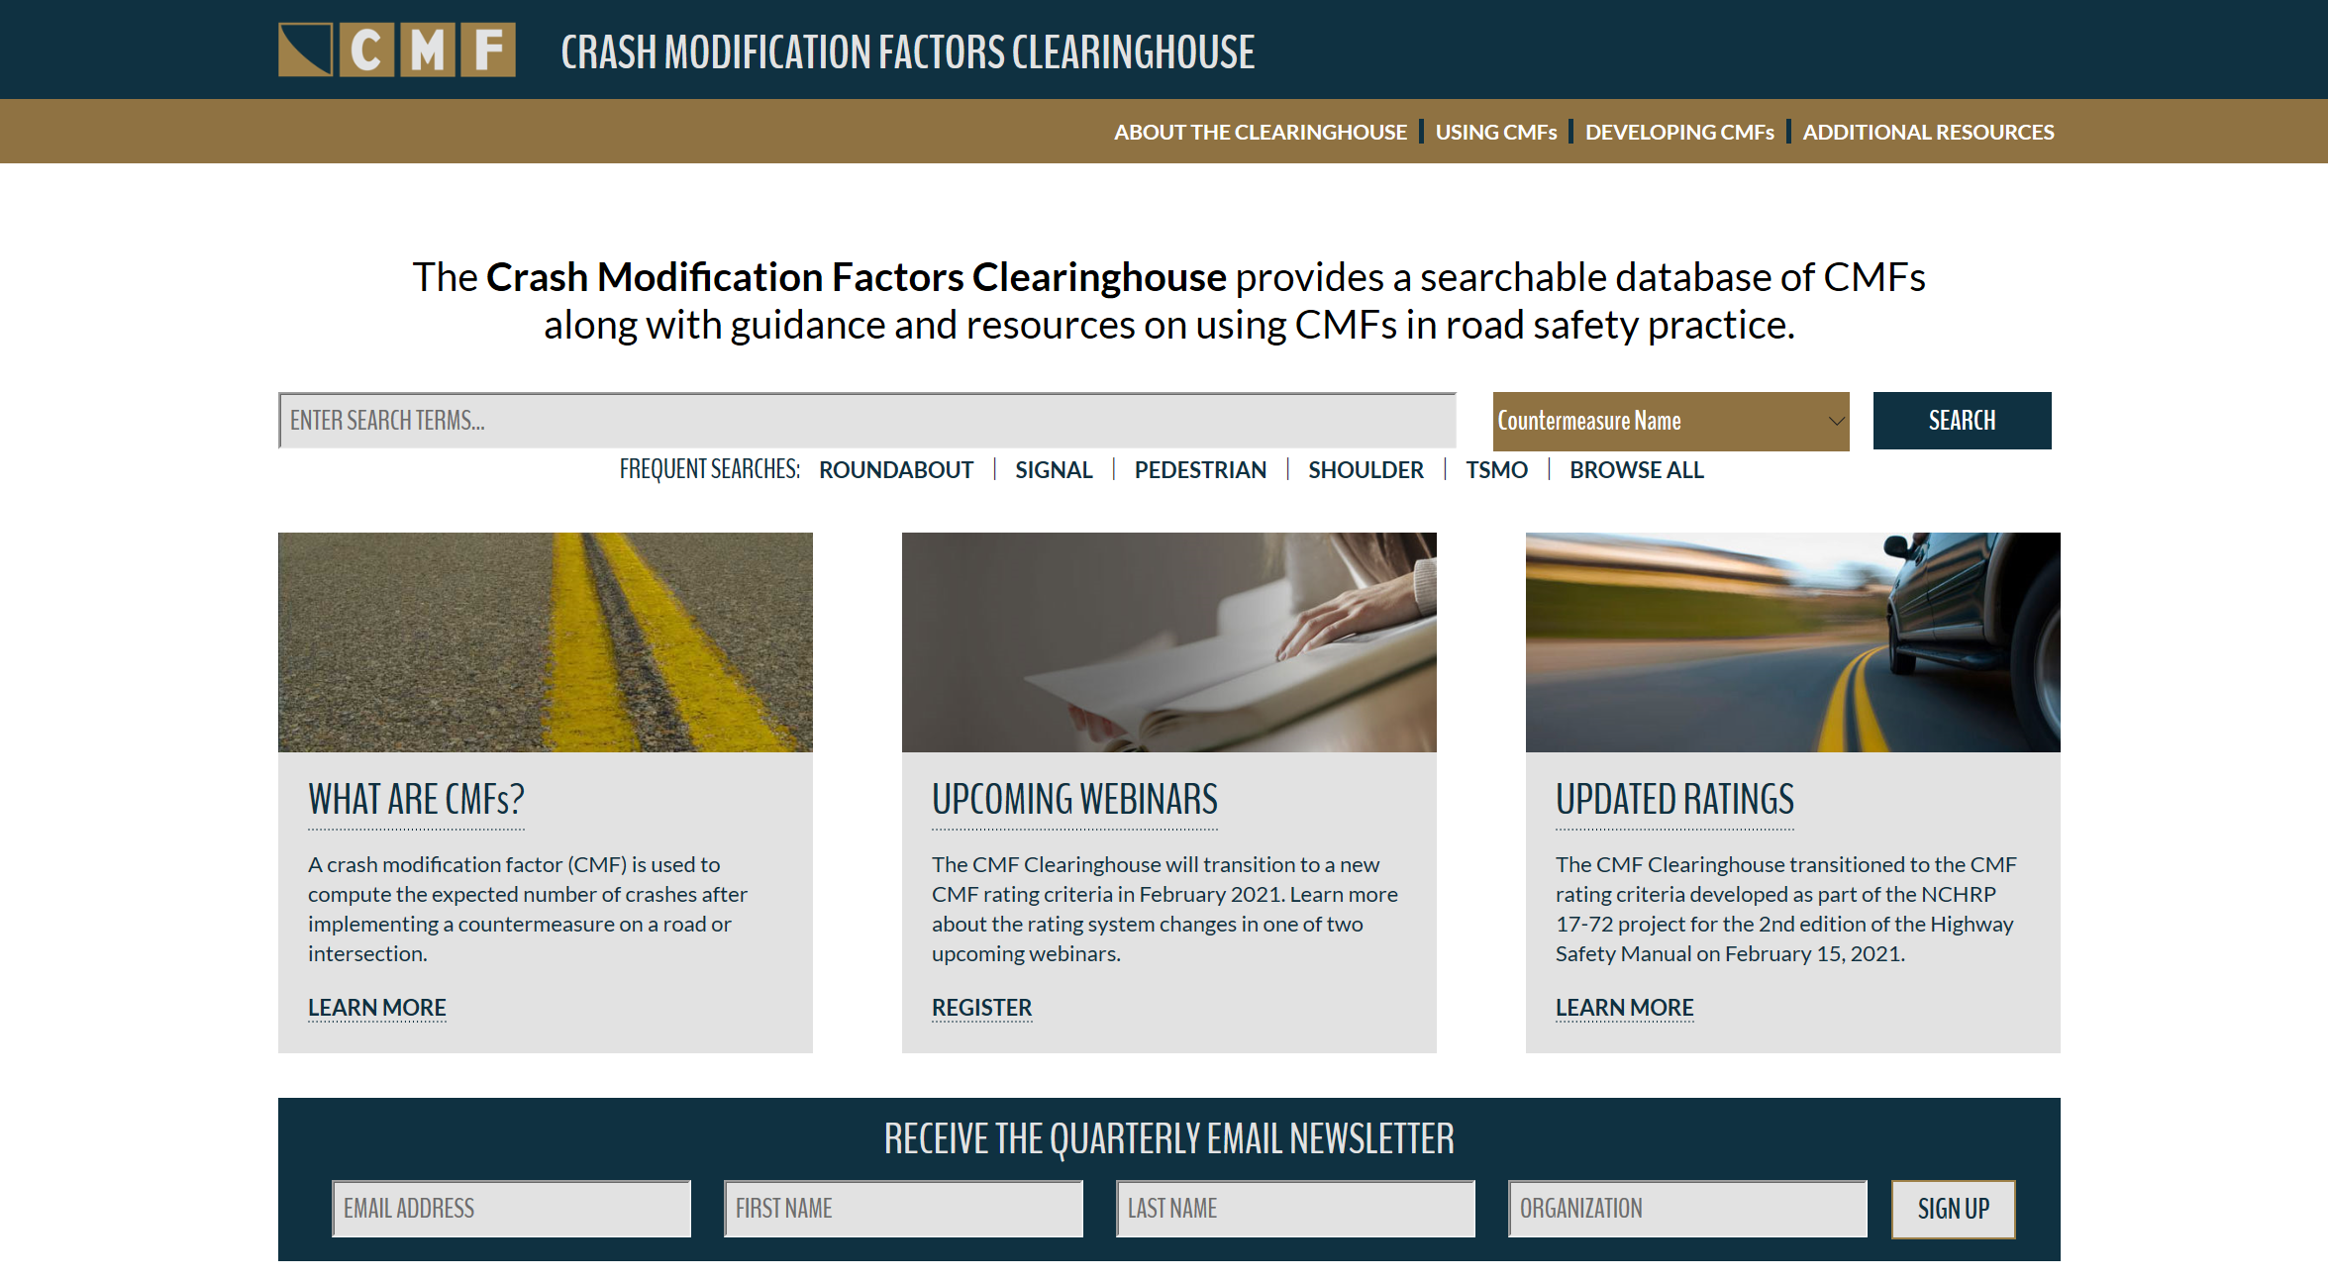
CMF Clearinghouse Website
http://www.cmfclearinghouse.org
Notes:
Early last year we gave the CMF CH a facelift. I’m sure many of you have figured out already that it’s still the same CMF Clearinghouse that we all know and love, with just a different look and feel.

Slide 43
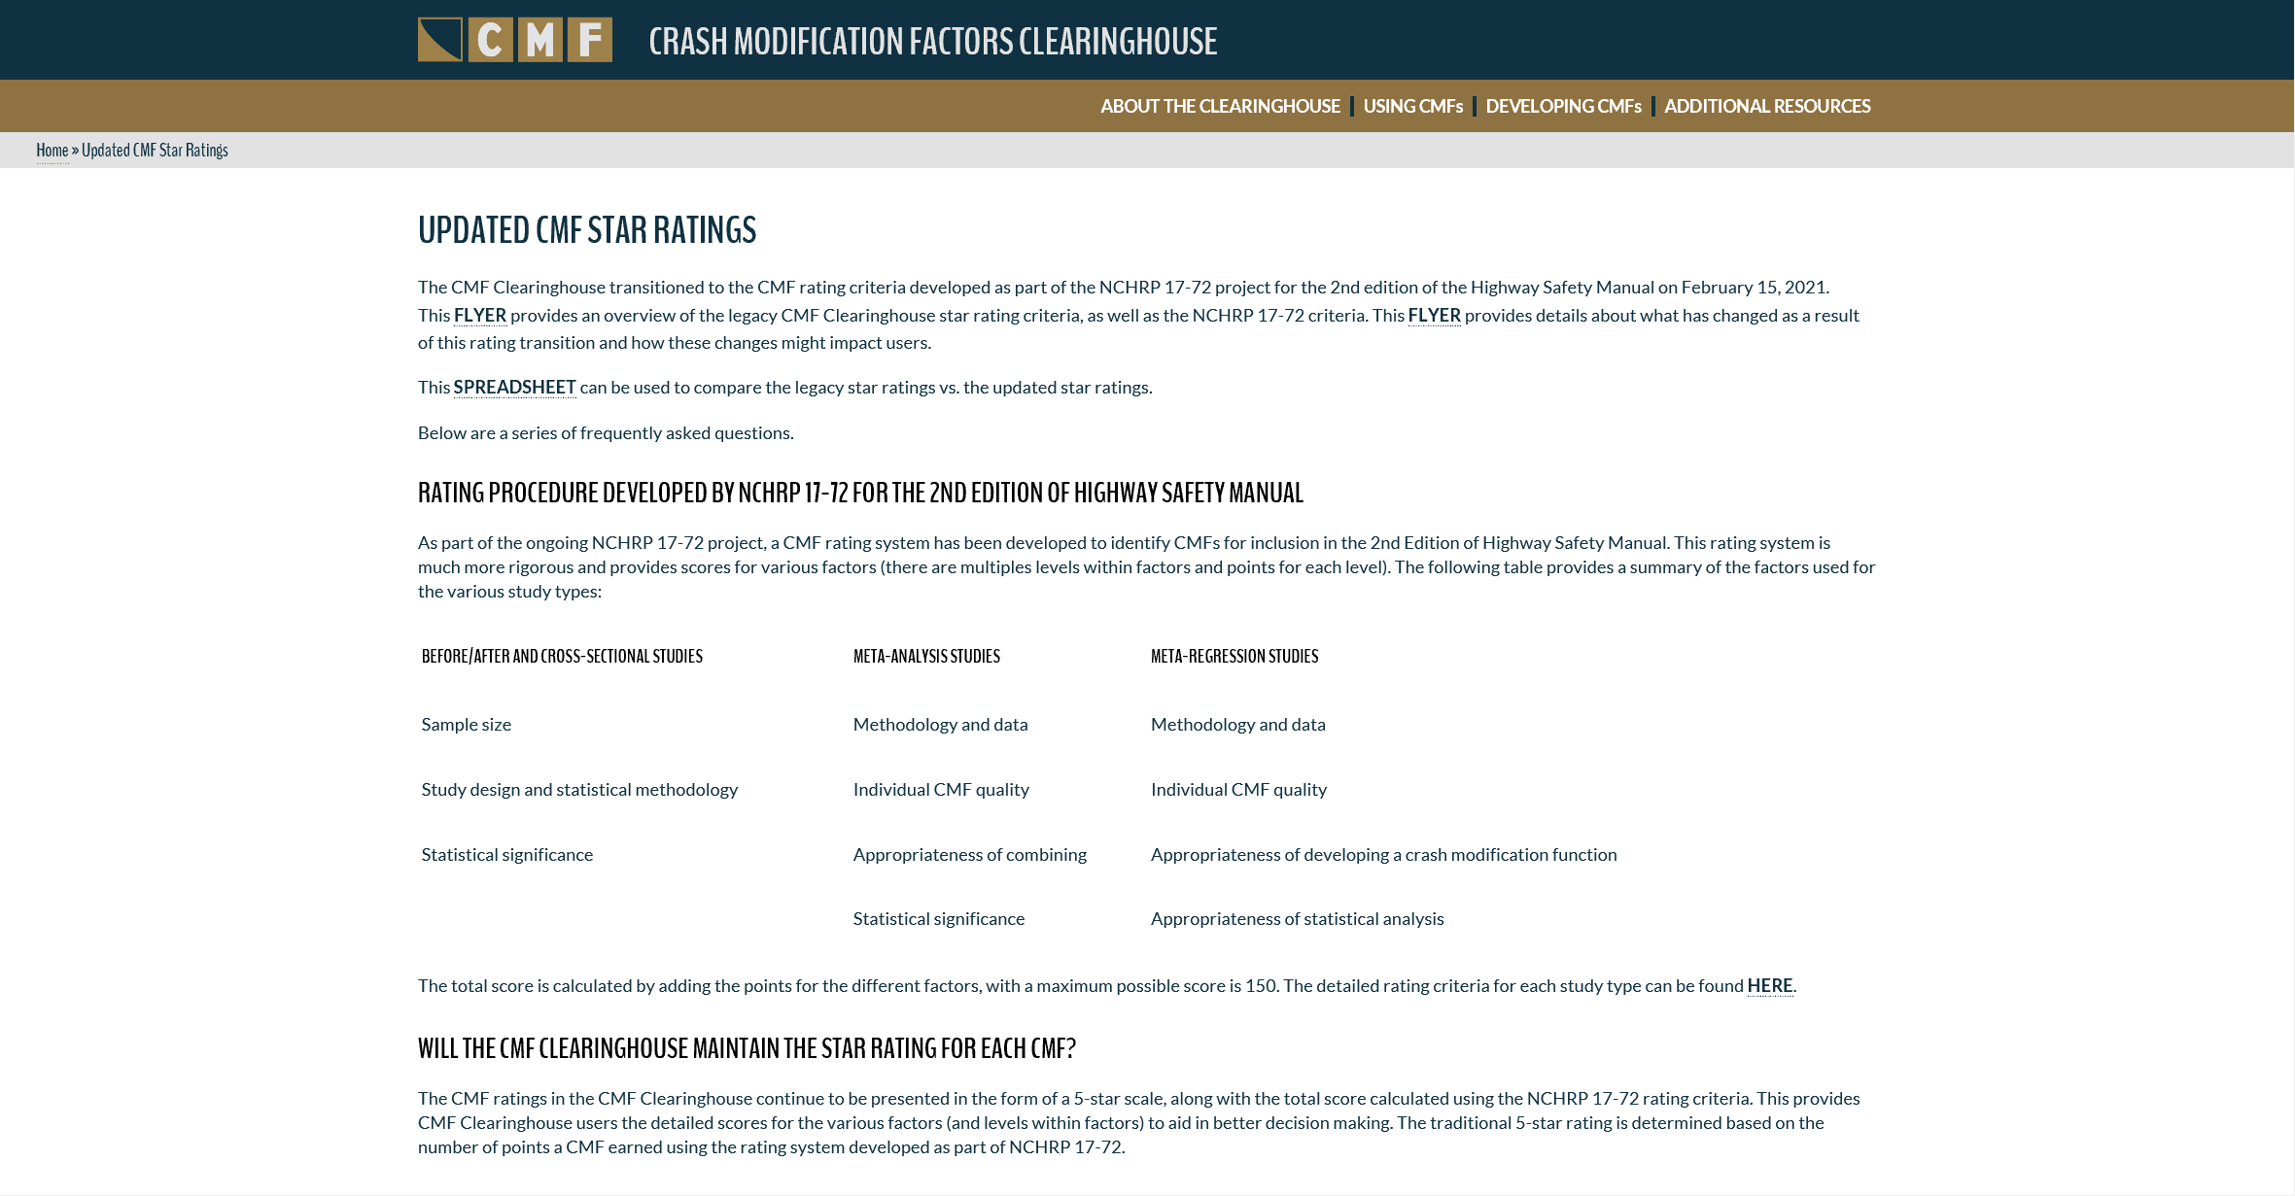
Updated CMF Star Ratings Page
http://www.cmfclearinghouse.org/changes.cfm
Notes:
All resources and FAQs related to the CMF Rating Criteria Change

Slide 44
Comparison Spreadsheet
http://www.cmfclearinghouse.org/collateral/Ratings_Comparison.xlsx
Notes:
We also have a ratings comparison spreadsheet (available on the updated CMF Star Ratings page and downloadable using the link shown on this slide). This spreadsheet provides both the legacy and the new ratings for all CMFs (prior to the rating transition) and is a tool you would use to identify any star rating changes to your CMF of interest.

Slide 45
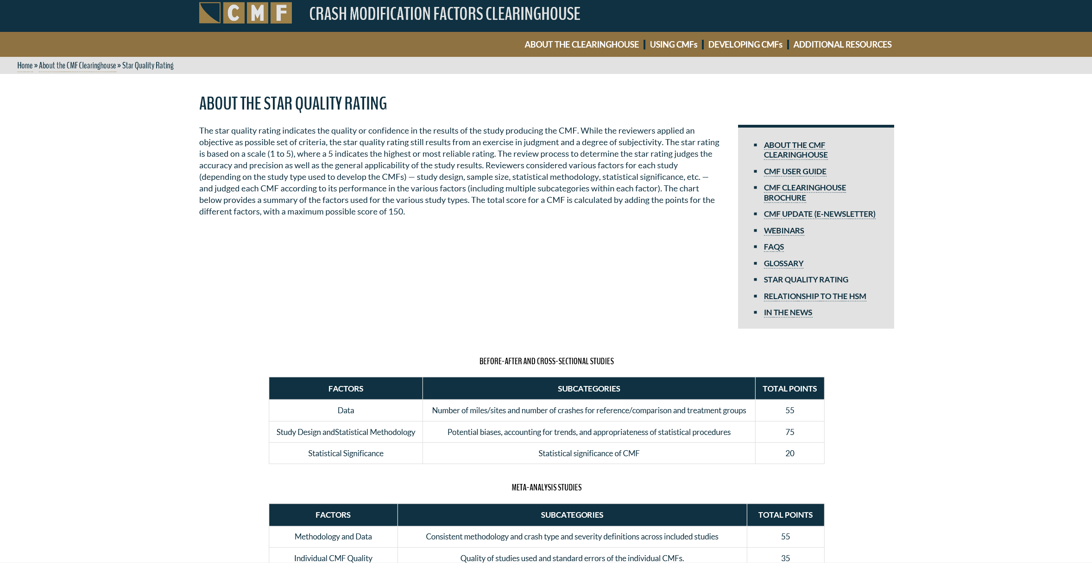
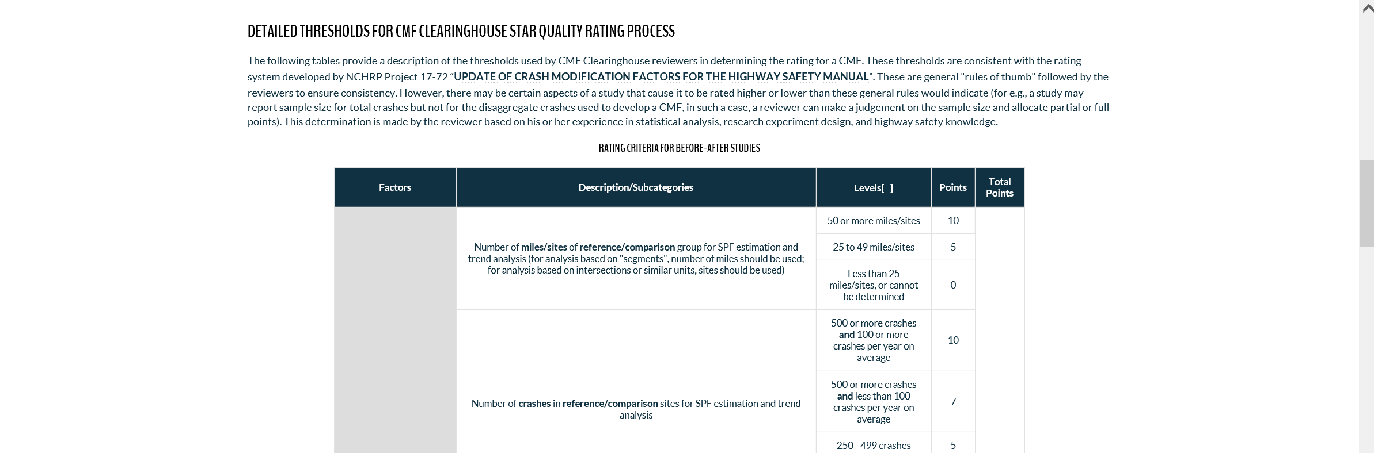
Star Quality Rating Page
http://www.cmfclearinghouse.org/sqr.cfm
Notes:
The star quality ratings page (housed under About the Clearinghouse dropdown menu), provides details about the new rating system and the various thresholds a study must meet to get a higher star rating.

Slide 46
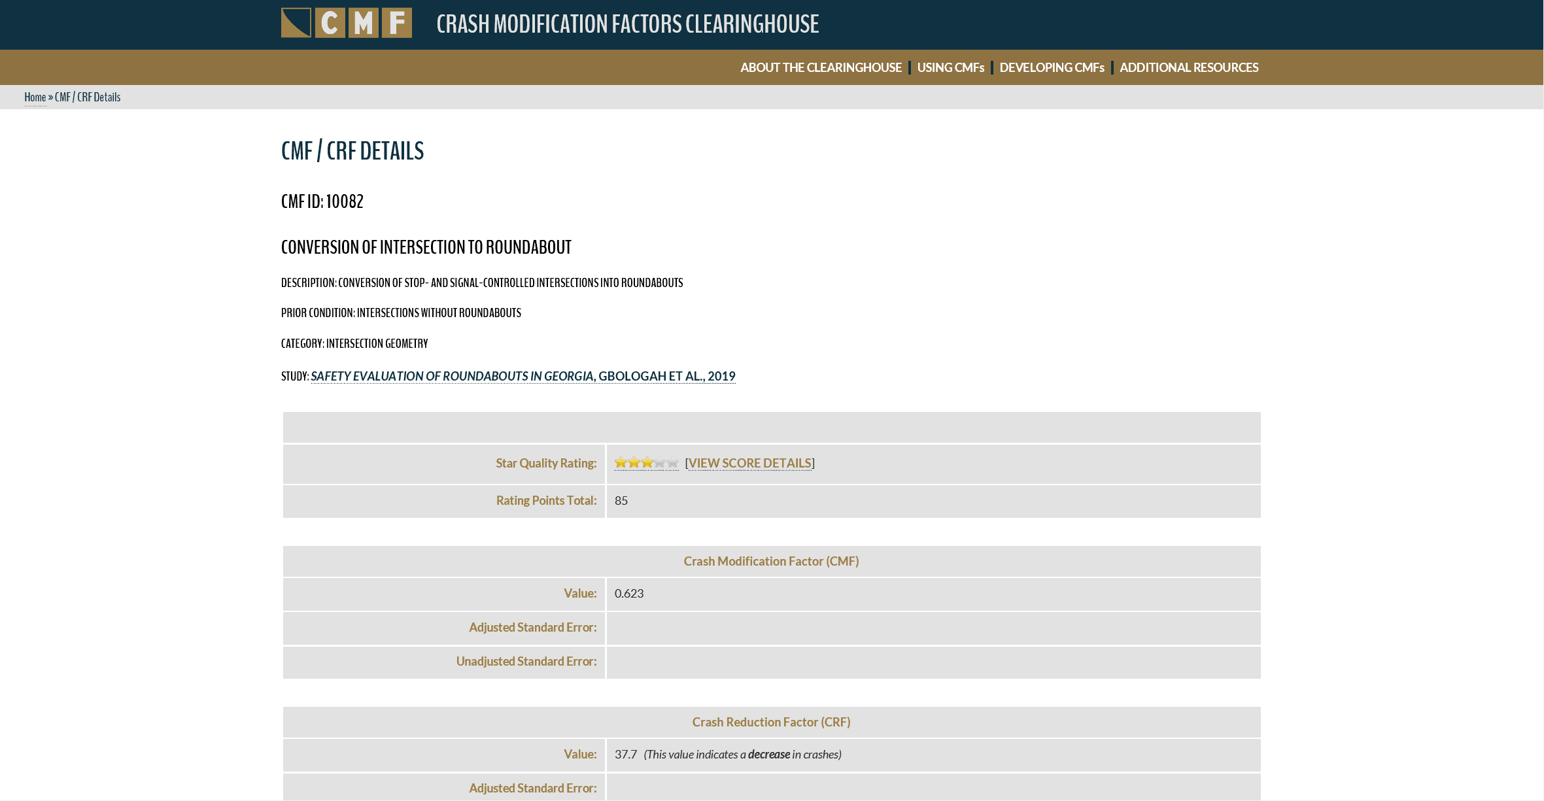
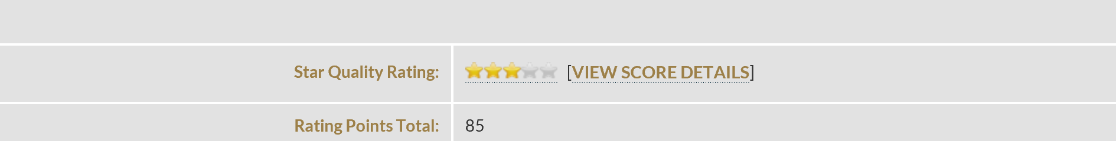
CMF Details Page
http://www.cmfclearinghouse.org/detail.cfm?facid=XXXXX
Replace XXXXX in the above URL with the CMF ID
Notes:
The CMF Details page provides the star quality rating and the total rating points a CMF received along with other relevant information to aid in CMF applicability decisions. There is also a View Score Details link, clicking on it opens a new window with details on how the CMF fared under the various rating categories.

Slide 47
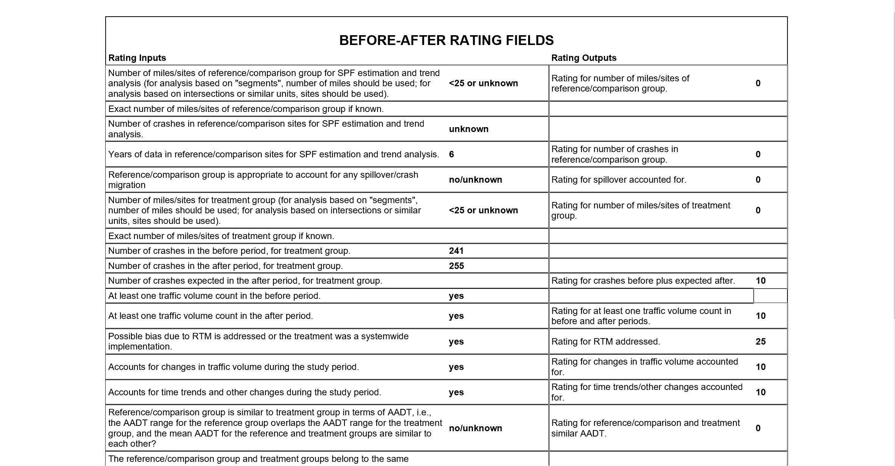
Score Details
Notes:
Here is the example of the Score Details page. Presented here are the information on all rating inputs for the various factors and their subsequent rating scores.

Slide 48
Questions & Answers

Slide 49
What should I do next, if anything?
It depends, but if you, your organization, or your projects are using or developing CMF's, and their star quality ratings are of interest, we encourage you to review the changes discussed today.

Slide 50
Has FHWA changed CMF's?
No, the CMF/CRF values themselves remain the same. The only changes are the updated score and resultant star quality rating using the rating system discussed during this webinar.

Slide 51
Will users still have access to the previous star quality ratings?
Yes, the Clearinghouse includes a comparison spreadsheet that contains both legacy and updated star quality ratings. All CMF's added to the Clearinghouse after February 15, 2021 will be rated using the updated rating system. Visit this URL below:
http://www.cmfclearinghouse.org/collateral/Ratings_Comparison.xlsx

Slide 52
Should I select CMF based solely on the Star Rating?
No. Star ratings should not be the sole factor used to select CMFs.

Slide 53
Is the new rating system better?
The new rating system is more rigorous and objective than the legacy rating system. Users should ensure that any selected CMF is applicable to their project based on road and other conditions.

Slide 54
Your Questions?

Slide 55
Wrap-Up

Slide 56
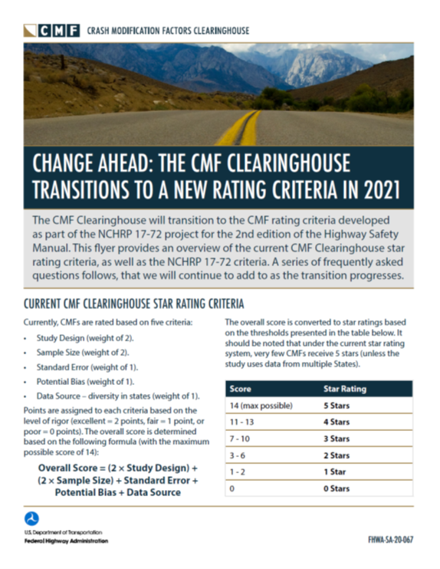
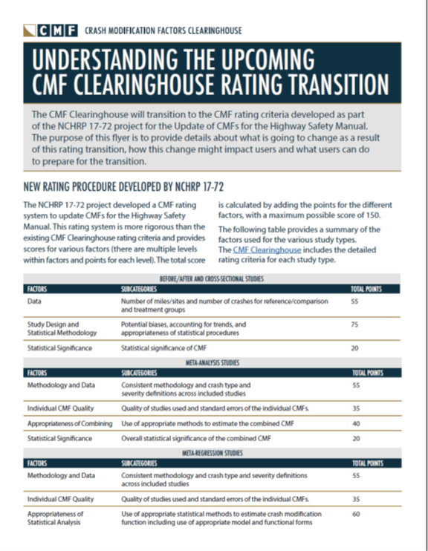
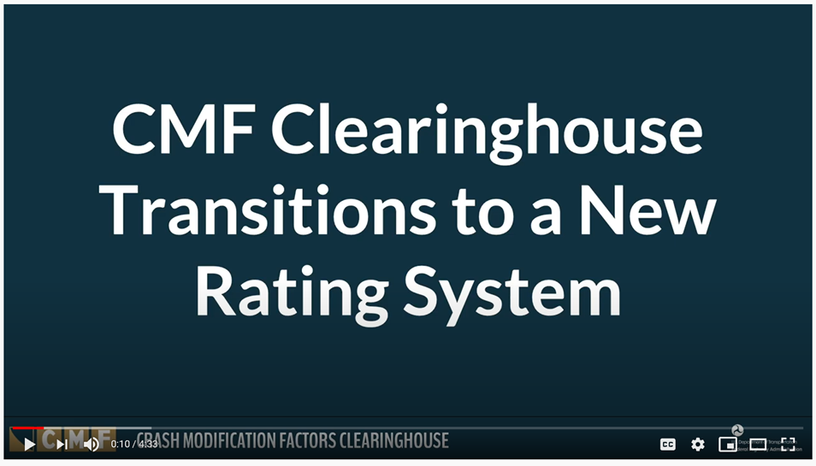
Education & Outreach
http://www.cmfclearinghouse.org/changes.cfm

Slide 57
Education & Outreach
http://www.cmfclearinghouse.org/developing_cmfs.cfm

Slide 58
NHI CMF Training
Application of CMFs
  FHWA-NHI-380093
Science of CMFs
  FHWA-NHI-380094
Developing Quality CMFs
  FHWA-NHI-380119
https://nhi.fhwa.dot.gov
  For further information, please contact John McFadden (John.McFadden@dot.gov)

Slide 59
Poll
What additional information would be helpful to you related to the new rating system (select all that apply)?
  More in-depth training on the new system
  Question & Answer Session
  Technical Assistance
  Presentation
  Other (enter in the chat or Q/A)

Slide 60
For more information,
please visit the CMF Clearinghouse (http://cmfclearinghouse.org/)
Notes:
Please visit the CMF Clearinghouse for more information about this rating system transition.

