Slide 1
Understanding the Upcoming CMF Rating Transition and Exploring Real-World Applications of CMFs
December 2, 2020
2:00 – 3:30 PM EST

Slide 2
Agenda
Karen Scurry, Federal Highway Administration
  Overview of CMFs and the CMF Clearinghouse
Taha Saleem, UNC Highway Safety Research Center and Manager of the CMF Clearinghouse
  CMF Clearinghouse rating transition
Troy Bucko, California Department of Transportation
  Incorporating Data Driven Safety Analysis in Traffic Impact Studies
Srinivas Geedipally, Texas A&M Transportation Institute
  Process used by TTI to assist TxDOT in the review and development of the CMFs used for HSIP projects.

Slide 3
Webinar “Housekeeping”
Rejoining the program
All lines are muted
Control Panel
Questions/assistance
Webinar Recording

Slide 4
Poll
How many people are attending the webinar at your location?

Slide 5
Overview of CMFs and the CMF Clearinghouse
Karen Scurry, FHWA Office of Safety

Slide 6
What is a Crash Modification Factor?
Multiplicative factor that reflects the expected safety effectiveness of a countermeasure
Used to compute the expected number of crashes after implementing a given countermeasure at a specific site
CMF < 1 | CMF = 1 | CMF > 1
Decrease in Crashes | No Change in Crashes | Increase In Crashes
Examples:
  CMF of 0 represents a 100% reduction in the number of crashes
  CMF of 0.8 represents a 20% reduction in the number of crashes
  CMF of 1.2 represents a 20% increase in the number of crashes

Slide 7
What is the CMF Clearinghouse?
A regularly updated, online repository of CMFs,
A mechanism for sharing newly developed CMFs, and
Educational information on the proper application of CMFs.

Slide 8
Poll
How often do you use the CMF Clearinghouse?
  Daily
  Weekly
  Monthly
  Quarterly
  Rarely

Slide 9
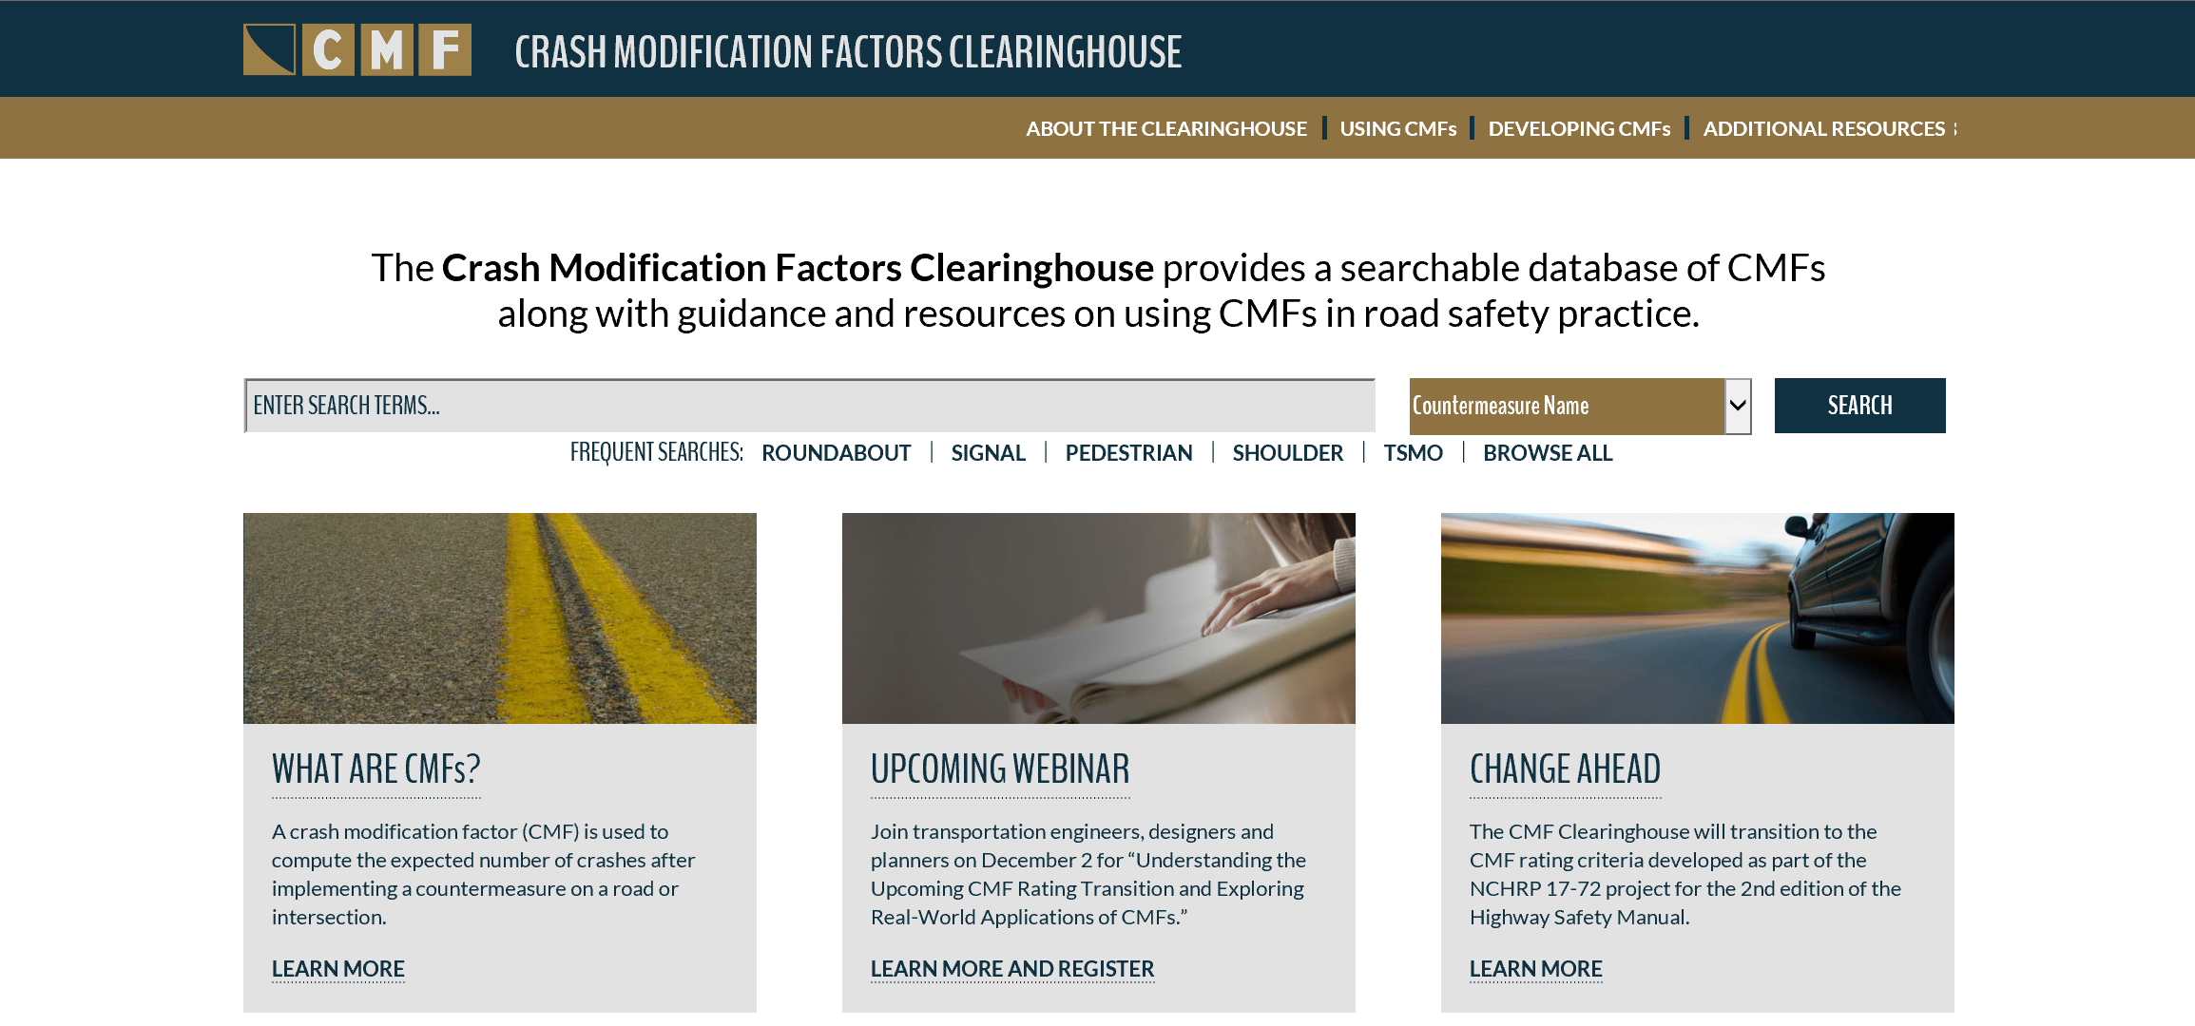
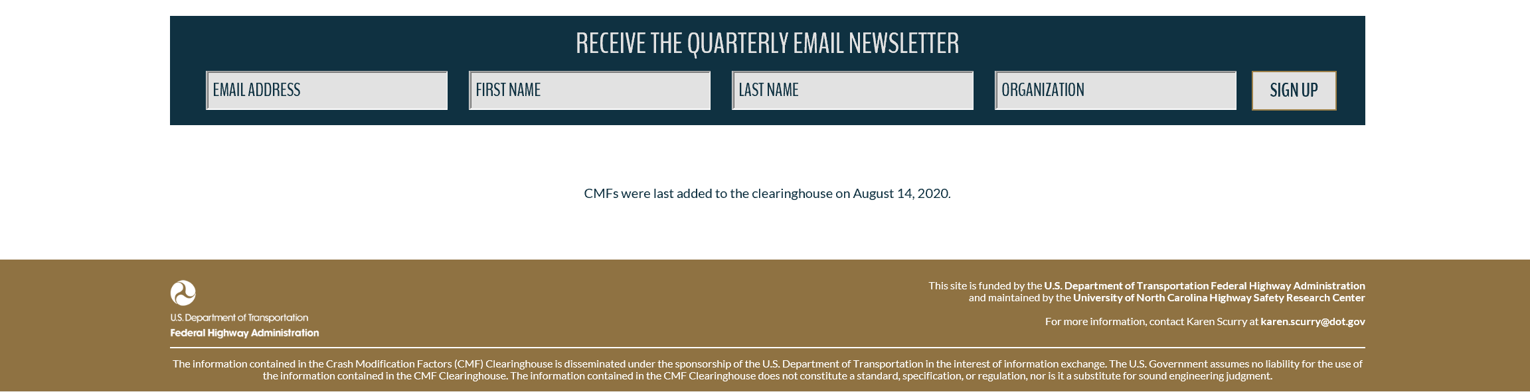
CMF Clearinghouse Features
Notes:
Earlier this year we gave the CMF CH a facelift. I’m sure many of you have figured out already that it’s still the same CMF Clearinghouse that we all know and love, with just a different look and feel.

Slide 10
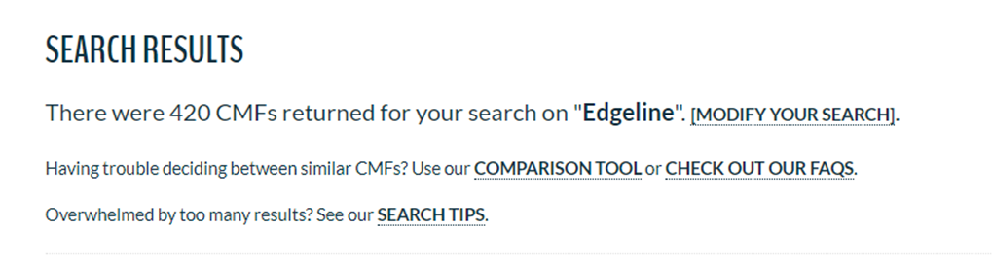
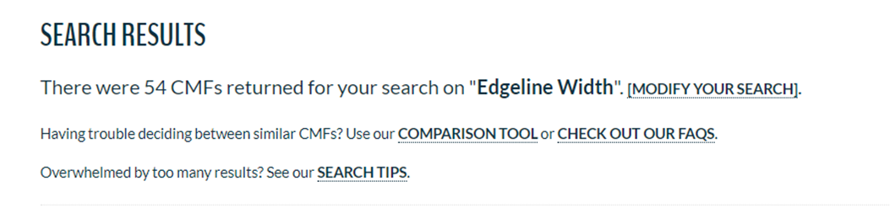
Dealing With Too Many Search Results
Option 1: Narrow down using more keywords

Slide 11
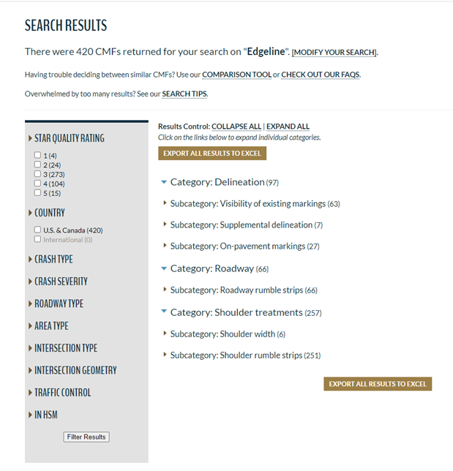
Dealing With Too Many Search Results
Option 2: Narrow down using filters

Slide 12
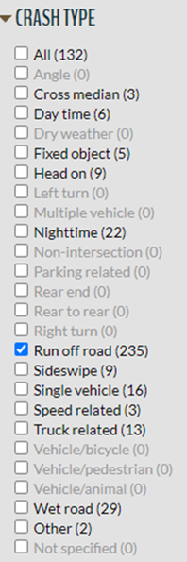
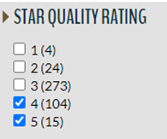
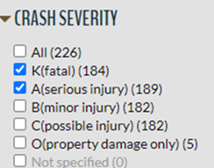
Dealing With Too Many Search Results
Option 2: Narrow down using filters (cont.)
116 CMFs
373 CMFs
235 CMFs

Slide 13
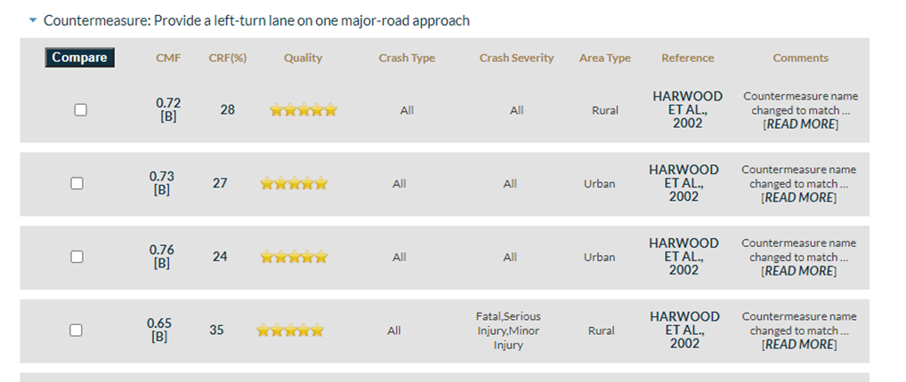
Dealing With Too Many Search Results
Use the CMF Comparison Tool

Slide 14
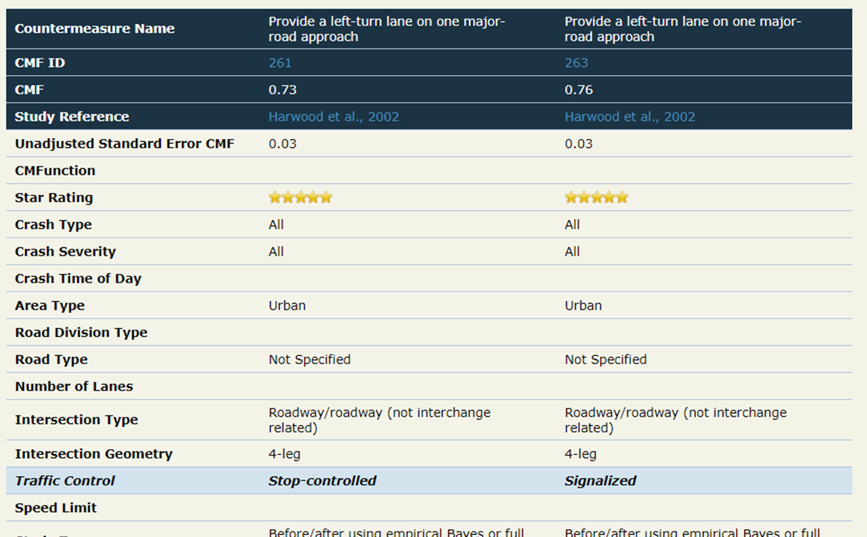

Slide 15
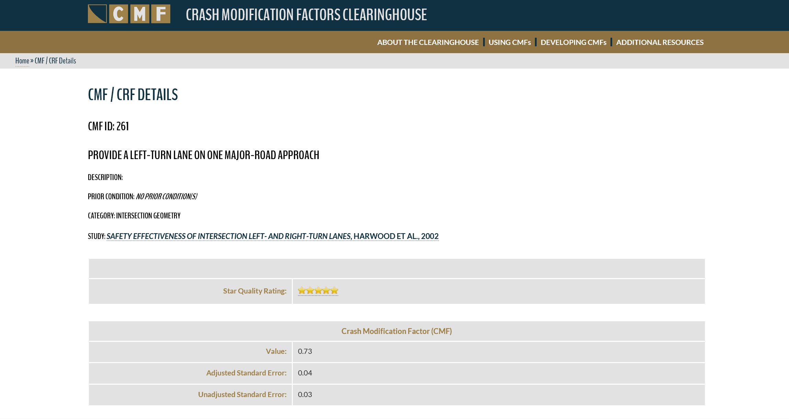
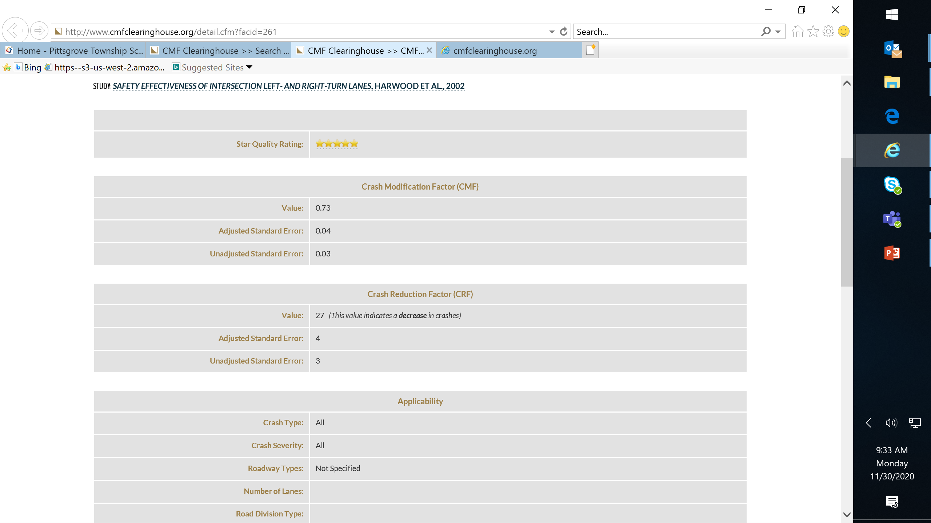
CMF Details Page

Slide 16
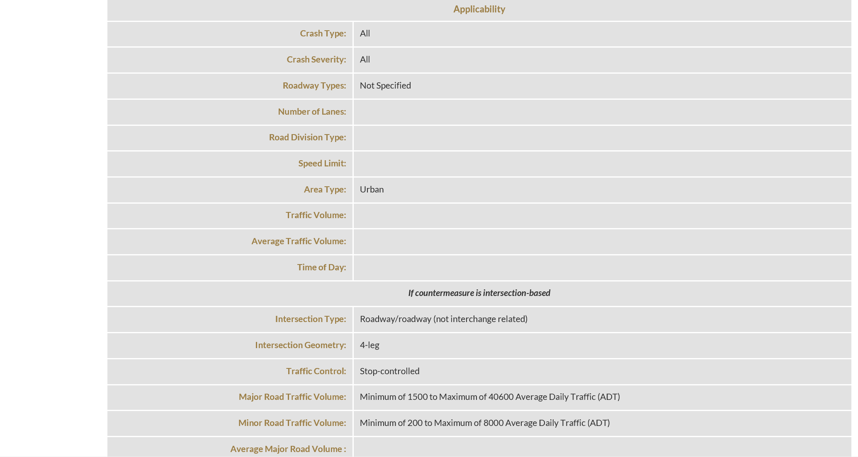
CMF Details Page (cont’d)

Slide 17
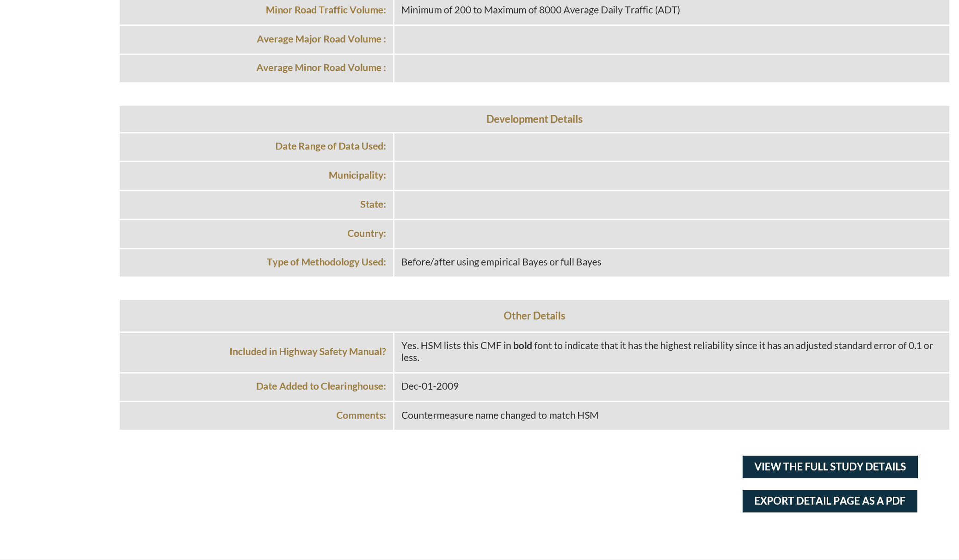
CMF Details Page (cont’d)

Slide 18
CMF Clearinghouse User Guide
Guide Outline
Video Tutorials
Introduction to CMFs
Introduction to the CMF Clearinghouse
Searching for CMFs
Identifying Appropriate CMFs
Information for Advanced Users
Conducting a CMF Search
Understanding Search Results
Filtering Search Results
Using the CMF Details Page
Notes:
For more information on CMFs and the CMF Clearinghouse, I would encourage you to review the CMF Clearinghouse User Guide and supplemental video tutorials.

Slide 19
Summary
Selecting an appropriate CMF is important
Applying CMFs correctly is important as well – can have large impact on results
CMF Clearinghouse team is available to provide technical assistance (e.g. help explain CMFs on the site or from a study report)

Slide 20
Q&A
Enter questions using the GoToWebinar window

Slide 21
Poll
In what processes/analyses does your organization use CMFs? (select all that apply)
  Funding applications
  System-level or project-level planning
  Alternatives analysis
  Design decisions
  Operations analysis

Slide 22
Poll
Have you conducted safety analysis using CMFs as part of Traffic Impact Analyses?
  Yes
  No
  Not sure
Notes:
After Troy (#1) and depending on his poll questions

Slide 23
Poll
For governmental agency attendees, does your organization require safety analysis including CMFs in Traffic Impact Analyses?
  Yes
  No
  Not Sure
  Not Government
Notes:
After Troy (#2) and depending on his poll questions

Slide 24
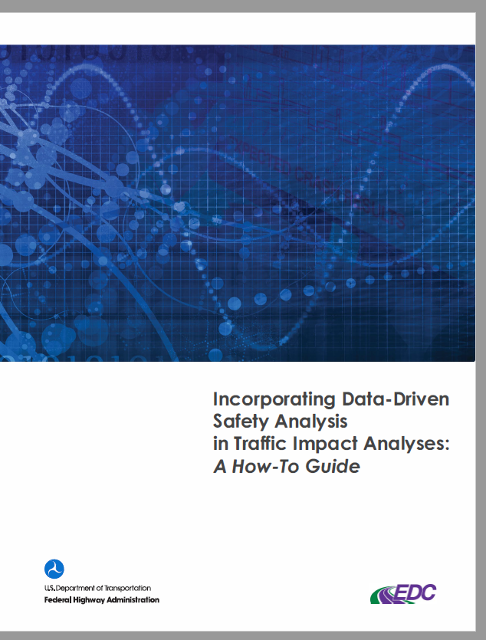
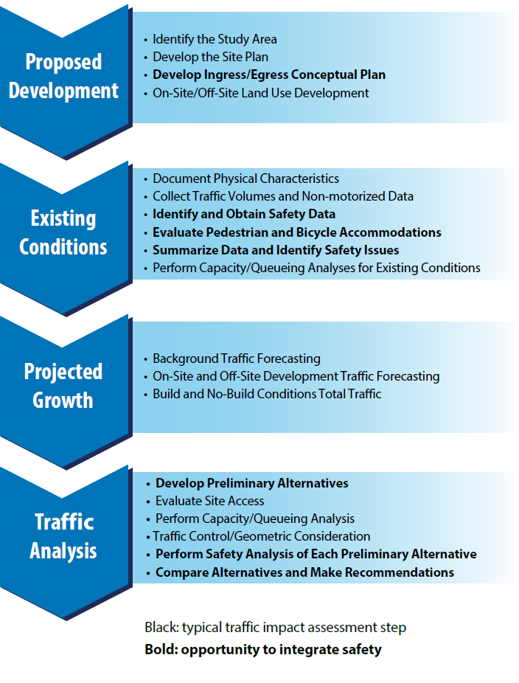
Incorporating DDSA into Traffic Impact Analyses: A How-To Guide
https://safety.fhwa.dot.gov/rsdp/downloads/fhwasa19026.pdf

Slide 25
Poll
Does your State have a State-specific CMF list?
  Yes
  No
  Don’t know
Notes:
After Srinivas

Slide 26
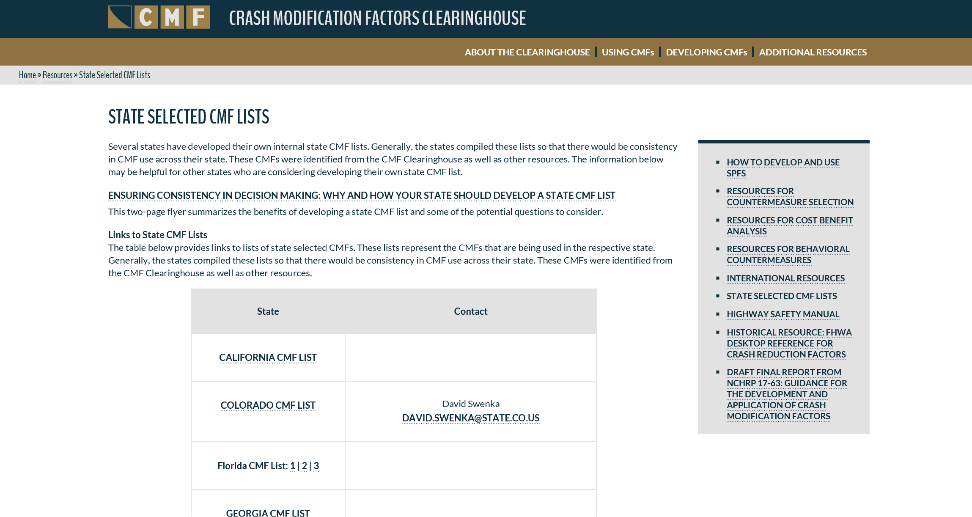
State-selected CMFs Lists
http://www.cmfclearinghouse.org/stateselectedlist.cfm

Slide 27
Moving Forward
CMF Clearinghouse Rating Transition
  Will be providing further details on the transition timeline in the coming months.
  Continue to check the “Changes Ahead” page (http://www.cmfclearinghouse.org/changes.cfm) for up-to-date information
Summary of State SPF Calibration and Development Efforts
  http://www.cmfclearinghouse.org/resources_spf.cfm
  Please review and let us know if additional SPFs have been developed
Notes:
then advertise the update and solicit additional SPFs that state may have developed?

Slide 28
Additional Resources
Roadway Safety Analysis Videos for CMFs
Training:
  Application of CMFs
  Science of CMFs
  Developing Quality CMFs
http://www.cmfclearinghouse.org/using_cmfs.cfm

Slide 29
Wrap-up
Post-webinar survey
Certificate of attendance

Slide 30
www.CMFClearinghouse.org
Karen Scurry, P.E.
FHWA Office of Safety Programs
202-897-7168
karen.scurry@dot.gov

