Slide 1
CMF Clearinghouse Rating Transition
Taha Saleem
UNC Highway Safety Research Center
December 2, 2020

Slide 2
Poll
Are you aware that the CMF Clearinghouse will transition to a new rating criteria next year?
  Yes
  No
  Not sure
Notes:
Before Taha presentation

Slide 3
CMF Rating System Changes
NCHRP 17-72 developed an updated rating system for CMFs
The purpose of NCHRP 17-72 was to update the rating/inclusion process for HSM2
We have been working on updating the CMF Clearinghouse rating system to be consistent with the NCHRP 17-72 rating scheme

Slide 4
Current CMF Star Rating System
Single rating scheme for Before/After, Cross-Sectional, Meta-Analysis, and Meta-Regression studies
CMFs are rated based on five criteria:
  Study Design (weight of 2)
  Sample Size (weight of 2)
  Standard Error (weight of 1)
  Potential Bias (weight of 1)
  Data source (diversity in states) (weight of 1)
Points are assigned to each criteria based on the level of rigor (excellent = 2 points, fair = 1 point, or poor = 0 points)

Slide 5
Current CMF Star Rating System
Score | Star Rating
14 (max possible) | 5 Stars
11 - 13 | 4 Stars
7 - 10 | 3 Stars
3 - 6 | 2 Stars
1 - 2 | 1 Star
0 | 0 Stars
Overall Score = (2 * study design) + (2 * sample size) + standard error + potential bias + data source
Max Possible Points = 14
  Very few 5 Star CMFs unless the study included multiple States

Slide 6
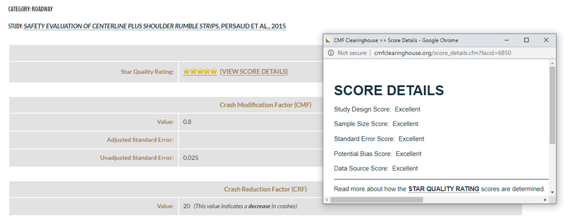
Score Details in the CMF Clearinghouse

Slide 7
NCHRP 17-72 Rating Procedure
The rating system developed by NCHRP 17-72 is much more detailed and provides scores for different factors including sample size, study design, methodology, and statistical significance
A separate rating criteria has been developed for Before/After, Cross-Sectional, Meta-Analysis, and Meta-Regression studies
Overall Procedure
  Points are assigned based on multiple factors
    Levels within factors and points for each level
  Total score calculated by adding the points; maximum possible score is 150

Slide 8
NCHRP 17-72 Rating Procedure
Before/After and Cross-Sectional studies:
Sample Size
Study Design and Statistical Methodology
Statistical Significance (standard error is used to determine statistical significance)
Meta-Analysis and Meta-Regression studies:
Methodology and Data
Individual CMF Quality
Appropriateness of Combining / Developing CMFunctions
Statistical significance / Appropriateness of Analysis

Slide 9
CMF CH Transition Plan
Internal Facing Activities
Develop
Develop method of providing star ratings based on HSM2 rating – Awaiting Final Approval
Expand
Expand database – Complete
Revise
Revise user input forms in the administrative section – Complete

Slide 10
CMF CH Transition Plan
External Facing Activities
Hold Stakeholder Calls – Complete
Understand how this proposed ratings transition would affect the field of safety practice and research
Identify opportunities to improve navigation/search functionality
Develop Outreach Materials – Ongoing
Advance materials announcing change – Available on Website
One-page flyer on ratings transition, what’s going to change & how – Coming Soon
Short video (2-3 minutes) – here’s what’s changing and why – Coming Soon
Revise website display – Ongoing (Behind the Scenes)
New Rating Criteria
CMF Details Page
Look & Feel of Website
Revise user guide – Ongoing (Behind the Scenes)
Conduct webinars – Ongoing

Slide 11
Converting NCHRP 17-72 Ratings to Star Rating
NCHRP 17-72 Rating Score | Star Rating in CMF Clearinghouse
135-150 | 5 star
110-134 | 4 star
75-109 | 3 star
35-74 | 2 star
0-34 | 1 star
* Pending Final Approval

Slide 12
Convert NCHRP 17-72 Ratings to Star Ratings
NCHRP 17-72 Star Rating | 5 Star | 4 Star | 3 Star | 2 Star | 1 Star
1 Star (0-34) | 3 | 21 | 116 | 341 | 215
2 Star (34-74) | 1 | 89 | 639 | 666 | 59
3 Star (75-109) | 67 | 485 | 1903 | 264 | 25
4 Star (110-134) | 91 | 954 | 988 | 11 | 4
5 Star (135-150) | 137 | 210 | 56 | 0 | 0
* Pending Final Approval

Slide 13
Convert NCHRP 17-72 Ratings to Star Ratings
The conversion scale leads to many CMFs being rated differently from their current ratings in the CMF Clearinghouse
  52.12% of the CMFs would maintain their current star ratings
  16.16% of CMFs currently rated 3 Stars or better would be rated 2 Stars or lower

Slide 14
Rating Transition Timeline
The exact launch date for this transition is still to be determined
It will likely occur towards the end of the first quarter of 2021
The CMF Clearinghouse is actively working behind the scenes to ensure a smooth transition for all users
We will continue to provide additional details regarding this transition to the CMF Clearinghouse users in the coming months

Slide 15
What Happens Post Rating Transition
The CMF ratings in the CMF Clearinghouse will continue to be presented in the form of a 5-Star scale, along with the total score calculated using the NCHRP 17-72 rating criteria.
Ratings for all the current CMFs will be converted to reflect the new rating criteria, following the rating system transition.
  The transition to the NCHRP 17-72 rating criteria will lead to few instances where the star rating for current CMFs would change (there will be some higher rated CMFs that will score low under the new rating criteria, as well as some lower rated CMFs that will score high under the new rating criteria).
  To minimize the impact of these changes, the CMF Clearinghouse will provide users with a spreadsheet consisting of both the old and new star ratings for the CMFs currently present in the CMF Clearinghouse for a period of time after the transition.

Slide 16
What Can You Do To Prepare For The Transition
CMFs added to the CMF Clearinghouse after the rating transition would only show the rating based on the new criteria
Continue to record CMF IDs for the CMFs that you are currently using.
State DOTs: Update your State CMF Lists following the rating transition to reflect the new rating criteria
Continue to check the dedicated “Changes Ahead” page on the CMF Clearinghouse website for up-to-date information (http://www.cmfclearinghouse.org/changes.cfm)

Slide 17
Q&A
Enter questions using the GoToWebinar window

