Slide 1
Caltrans Interim Guidance on LD-IGR Safety Analysis and CMF Clearinghouse
December 2, 2020

Slide 2
Troy Bucko California Department of Transportation Division of Safety Programs

Slide 3
Presentation Outline
What is the Caltrans role in CEQA reviews?
Commenting, Advisory, and Responsible Agency
What is new for Caltrans LD-IGR from a Safety Analysis Perspective
How CMF’s can be used in LD-IGR Reviews
Notes:
Today’s presentation provides an overview of how Caltrans is changing its approach to Local Development-Intergovernmental Review, or LD-IGR reviews to formally consider potential safety impacts. During the presentation, we’ll cover the three main questions on this slide to help LD-IGR and safety staff understand the basis for the change to the practice, what steps are involved in their reviews, and what to expect from lead agencies.

Slide 4
CEQA expectations for Safety Impact Analysis?
XVII. TRANSPORTATION
Conflict with program, plan, ordinance or policy addressing the circulation system, including transit, roadway, bicycle and pedestrian facilities?
Would the project conflict or be inconsistent with CEQA Guidelines section 15064.3, subdivision (b)?
Substantially increase hazards due to a geometric design feature (e.g., sharp curves or dangerous intersections) or incompatible uses (e.g., farm equipment)?
Result in inadequate emergency access?
Notes:
Provide background context on Appendix G—especially for Safety Reviewers newer to the CEQA process
Let’s start with the CEQA expectations for safety impact analysis. Appendix G has routinely asked questions related to safety. Projects may cause impacts if they create conditions that are inconsistent with safety plans or contribute to safety hazards. While these questions have existed for some time, most lead agencies have not performed safety impact analysis and Caltrans LD-IGR expectations for safety impact analysis have varied by district.

Slide 5
CEQA expectations for Safety Impact Analysis?
New California Senate Bill 743 Legislative Intent
Ensure that the environmental impacts of traffic, such as noise, air pollution, and safety concerns, are properly addressed and mitigated through the California Environmental Quality Act (CEQA).
Notes:
With the implementation of SB 743, safety has garnered more attention. In part, new interest is due to SB 743 legislative intent objective that ‘safety concerns’ continue to be properly addressed in CEQA. With many agencies not performing safety impact analysis, this statement raised awareness about this need.

Slide 6
Caltrans Role in CEQA reviews
Commenting Agency Any agency interested in the project under review.
Responsible Agency Defined by CEQA Guidelines Section 15381. “Responsible Agency” means a public agency which proposes to carry out or approve a project... (Caltrans has approval authority when encroachment permits are required, but otherwise the Local or Lead Agency has final approval authority)
Notes:
The new interim safety guidance is designed for LD-IGR reviews where Caltrans is commonly a commenting agency. However, it should be noted that Caltrans may also be an advisory or a responsible agency when it issues an encroachment permit. In these roles, Caltrans has greater influence over the project with the responsible agency having the most influence. Caltrans is elevated to a responsible agency that has some approval authority over the project when actions such as an encroachment permit are required. LD-IGR and safety staff should recognize that Caltrans comments can take on much greater importance to lead agencies and project applicants when Caltrans functions in the advisory and responsible roles.
Caltrans CEQA review includes early coordination with CEQA lead agencies and formal, public comment letters
Caltrans letters are seen and used by project proponents and opponents. What we say matters. How we communicate points is important.
Encroachment Permit Manual is used if Caltrans issues an encroachment permit.
The relationship of 21092.4 with safety since this section clearly states, "Consultation shall be conducted in the same manner as for responsible agencies pursuant to this division, and shall be for the purpose of the lead agency obtaining information concerning the project’s effect on major local arterials, public transit, freeways, highways, overpasses, on-ramps, off-ramps, and rail transit service within the jurisdiction of a transportation planning agency or a public agency that is consulted by the lead agency."

Slide 7
Caltrans Role in CEQA reviews
Caltrans Mission Statement
“Provide a safe, sustainable, integrated, and efficient transportation system to enhance California’s economy and livability.”
The mission statement is supported by the following safety goal.
“Provide a safe transportation system for workers and users, and promote health through active transportation and reduced pollution in communities.”
Notes:
To help guide Caltrans expectations for safety impact analysis under CEQA, the Caltrans mission statement and supporting safety goal provide a strong foundation. A safe transportation system is essential for California’s economy and livability in our communities. Hence, identifying potential safety impacts and needed mitigation through CEQA review is one way Caltrans can work towards this goal.
Caltrans LD-IGR program has always focused on all modes—how bicyclists, pedestrians, and drivers from a new land use development will travel on or over the State Highway System. The multimodal focus is maintained and enhanced as state goals and Caltrans mission focus on ensuring bicyclists and pedestrians can safely travel on roadways or sidewalks.

Slide 8
What is new for Caltrans LD-IGR and Safety Staff?
Past Practice involved LD-IGR coordinators obtaining technical inputs from Caltrans functional units and integrating the input into a formal comment letter.
New Practice adds Safety Staff and a formal traffic safety review to this process
This replaces the prior Traffic Operations review of land use projects
Notes:
So what is new in this interim safety guidance for the TISG? LD-IGR reviews will still functional internally as they have in the past with one exception. District safety staff will now be part of the formal review team and their input will be integrated in LD-IGR comment letters.
New CEQA analysis is based upon VMT, not LOS
Caltrans new process replaces prior analysis based upon LOS
Caltrans new process focuses on safety within CEQA context
Caltrans new process is multimodal
Caltrans new process is completed internally; we don’t ask lead agency for analysis
Districts have authority to identify what staff are conducting the new safety analysis. It is anticipated that engineers in district traffic operations or safety will do the analysis.
Address HQ Safety re-org and relationship to HQ Traffic Operations

Slide 9
What constitutes a review?
Proposed land use projects and plans affecting the State Highway System.
May include but are not limited to adding new automobile, bicycle, or pedestrian trips to state roadways;
modifying access to state roadways;
affecting the safety of connections to or travel on state roadways.
Notes:
When a LD-IGR project is impacting any of the bullet points then safety reviews are needed.

Slide 10
Safety Review Fundamentals
1. Collisions are fundamental indicators of safety performance
2. Know difference between objective and subjective safety concepts
3. Collisions are relatively rare and random events
4. Collisions are the result events/conditions converging at the same time
5. Design, exposure and operations have an impact on safety performance
6. Crash estimation methods are limited, but evolving, and cover a wide range of conditions encountered in a TIA
7. A variety of objective safety performance metrics

Slide 11
Safety Review Fundamentals
8. Identify/mitigates existing and future safety performance of project alternatives
9. Improves access and multimodal accommodations
10. Achieves greater intra/interorganizational consistency
11. Risk factors from systemic safety analysis and local road safety plans can help with localized traffic impact studies
12. Statewide safety performance targets and State Highway Safety Plan goals are applicable for every public roadway, including local system and roadways touched by land use development.
13. Safe access is good for businesses and the public in general

Slide 12
What may be triggers for safety countermeasures?
Established Network Screening Process’
Table C/Wet Table C– Potential Investigation Locations (All Collisions)
Monitoring Programs Reports
Type MW – Wrong-Way Collisions Monitoring Program
Type MX – Cross Over Collision Monitoring Program
Type MR – Run Off Road Program
Type MP – Pedestrian Monitoring Program
Type B1 and B2 – Bicycle Monitoring Program
Systemic Analysis contained in existing safety plans
Future network screening process’ not currently listed
Notes:
As noted on the previous slide, a new Type IR traffic investigation report (TIR) may be needed. This review will consider the information for the SHS shown on this slide.
District traffic safety staff should also review the site design for access management as it relates to current Caltrans standards and that might increase collisions on a state roadway." from page 5 of 7 in Interim Guidance

Slide 13
General
The Safety staff will classify locations for safety improvements into two types:
General, which apply whether the project or plan is built.
Locations should be from a network screened report
Recommendations should be consistent with those made from locations that have been network screened and investigated or will be investigated and recommendations made for safety improvements.
These would be improvements regardless if the development project is constructed or not.
Notes:
When safety staff complete their investigation, they will provide written input to the LD-IGR coordinator. Given the quick turnaround of LD-IGR comments to the lead agency, the LD-IGR coordinator and safety staff are encouraged to collaborate on the written input such that it is provided in a convenient and consistent manner that can be directly transferred into LD-IGR comments.
The written input will not include a significance determination for any safety impacts. That is the responsibility of the lead agency.
Instead, the LD-IGR safety related comments will identify locations for safety improvements categorized as either ‘general’ meaning that are already identified for implementation or ‘project/plan specific’ meaning they only apply because of the project or plan.

Slide 14
Project/Plan Specific
The Safety staff will classify locations for safety improvements into two types:
Project/plan specific, which will not apply unless the project or plan is built.
Same criteria as previous except the addition for project generated travel trips (any mode) will further impact safety that would not be needed if the project is not developed.
Should be based on data able to document a project’s impact to the location(s) and that the recommended countermeasure(s) will reduce collision severity and frequency (Highway Safety Manual Analysis for example may be used to show this).
Notes:
When safety staff complete their investigation, they will provide written input to the LD-IGR coordinator. Given the quick turnaround of LD-IGR comments to the lead agency, the LD-IGR coordinator and safety staff are encouraged to collaborate on the written input such that it is provided in a convenient and consistent manner that can be directly transferred into LD-IGR comments.
The written input will not include a significance determination for any safety impacts. That is the responsibility of the lead agency.
Instead, the LD-IGR safety related comments will identify locations for safety improvements categorized as either ‘general’ meaning that are already identified for implementation or ‘project/plan specific’ meaning they only apply because of the project or plan.

Slide 15
CASE STUDIES

Slide 16
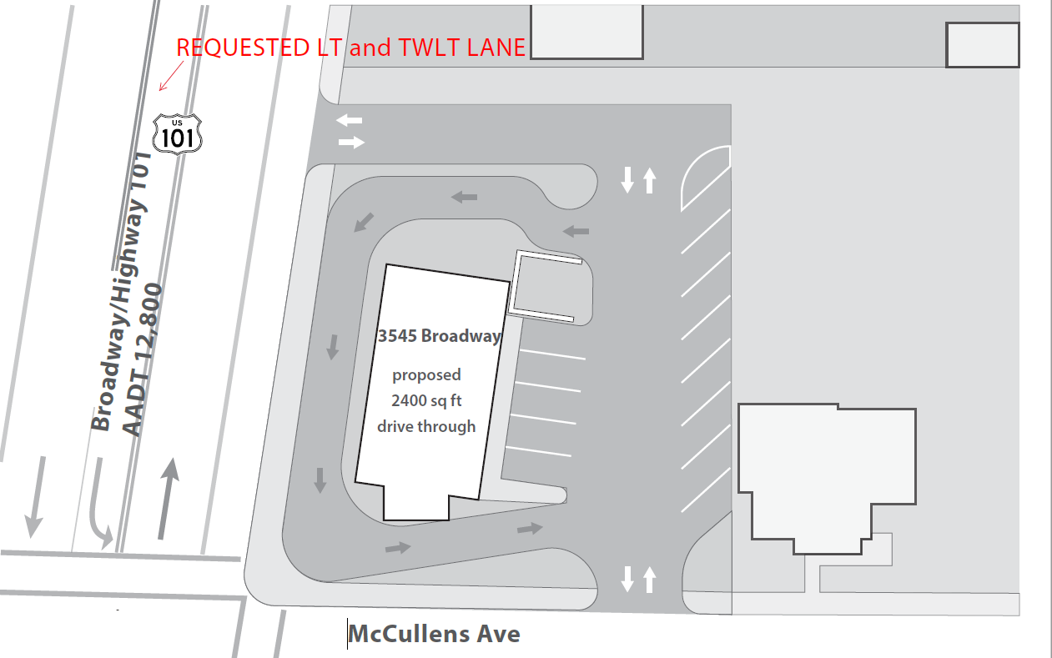
Case Study 1: Suburban Land Use project
2-Lane Conventional Highway
12,800 ADT – State Highway
5,200 ADT – Local Road
Proposed Starbucks Coffee Shop
Access off State Highway and
Local Road
High left turn movement in and out of
both driveway access points
ADD: Two-Way Left Turn Lane and
Left Turn Lane

Slide 17
Case Study 1: Suburban Land Use project
Countermeasure | CMF Description | CMF ID and CMF Value | Clearinghouse Applicability Description
Installation of TWLTL | CMF ID 2341 5 Star Rating | 0.797 (20.3) | TWLTL ON TWO LANE ROAD
Installation of LT Lane | CMF ID 268 5 Star Rating | 0.52 (48) | LEFT TURN LANE

Slide 18
Case Study 1: Suburban Land Use project
Analysis | Crash Severity | Crash Experience |  |  | Crash Type
 |  | Segment | Intersection | Total | Left Turn Driveway | Left Turn Intersection | Rear End Segment | Sideswipe
Existing | F+I | 2 | 0 | 2 | 2 | N/A | N/A | N/A
 | PDO | 1 | 1 | 2 | 1 | 1 | N/A | N/A
 | Total | 3 | 1 | 4 | 3 | 1 | N/A | N/A
Project – No Improvement | F+I | 7 | 2 | 9 | 6 | 2 | 1 | N/A
 | PDO | 6 | 8 | 14 | 6 | 8 | N/A | N/A
 | Total | 13 | 10 | 23 | 12 | 10 | 1 | N/A
Project - Improvement | F+I | 5 | 1 | 6 | 5 | 1 | 0 | N/A
 | PDO | 5 | 4 | 9 | 5 | 4 | N/A | N/A
 | Total | 10 | 5 | 15 | 10 | 5 | 0 | N/A

Slide 19
Results
The results allow us to show a reduction in collisions using the clearinghouse CMF’s, which supports the recommendations
Show the Lead Agency that reductions may occur with the proposed recommendations,
Protect the Lead Agency and State from potential tort claims
Notes:
When safety staff complete their investigation, they will provide written input to the LD-IGR coordinator. Given the quick turnaround of LD-IGR comments to the lead agency, the LD-IGR coordinator and safety staff are encouraged to collaborate on the written input such that it is provided in a convenient and consistent manner that can be directly transferred into LD-IGR comments.
The written input will not include a significance determination for any safety impacts. That is the responsibility of the lead agency.
Instead, the LD-IGR safety related comments will identify locations for safety improvements categorized as either ‘general’ meaning that are already identified for implementation or ‘project/plan specific’ meaning they only apply because of the project or plan.

Slide 20
Questions & Answers

Slide 21
Thank You!

