Slide 1
WisDOT’s experience using CMFs in DDSA
CMF Clearinghouse Annual Webinar
December 8th, 2021
Kevin M. Scopoline
Traffic Safety Engineer, Wisconsin DOT

Slide 2
How has safety analysis evolved?
Moving from qualitative to quantitative:
“The proposed alternative will improve the safety because it meets standards”
to
“The number of crashes is expected to be 1.2 per year with the improvement and 3.4 per year without”

Slide 3

Two Primary Uses for CMFs
Safety Certification Process (SCP)
  Institutionalized safety analysis for improvement projects
Highway Safety Improvement Program (HSIP)
CMFs needs for each area are different due to analysis software

Slide 4
Poll Question 1
What software do you use to perform safety analysis when comparing project alternatives?
Spreadsheet based tool
IHSDM
SPF Tool
Other

Slide 5
SCP Analysis Methods
Use the most reliable safety analysis method
    Method 1: Apply CMF to observed crashes → Estimated Crashes
    Method 2: Use safety performance function → Predicted Crashes
    Method 3: Use SPF & empirical Bayes method → Expected Crashes
“External” CMFs are needed for Method 1 and may be needed for Methods 2 & 3
Reliability Improves
Notes:
Main takeaway – primarily use IHSDM for analysis

Slide 6
“External” CMFs & IHSDM
“External” CMFs = HSM Part D CMFs
CMFs in IHSDM…
  are assumed to be independent of one another
    Independent CMFs = treatments do not impact the same crashes
  are for specific locations
    Segment CMFs for segments, intersection CMFs for intersections
  are for TOTAL, FI, or PDO crashes and applied to ALL crash types
Notes:
IHSDM will not limit the number of CMFs a user can input, WisDOT policy limits the number of treatments to 2
Policy is in Chapter 12 of the Traffic Engineering, Operations, and Safety Manual (TEOpS)
IHSDM does not have a way to store CMFs, will need to enter CMFs for each project separately
If two treatments target the same crashes (type, severity, location) they are not independent of one another

Slide 7
SCP CMF Use
Add shoulder rumble strips
Add high friction surface treatment (HFST)
Notes:
Example: 2-lane curve experiencing ROR crashes
Add shoulder rumble strips
Add HFST
Could add more treatments, but won’t include CMFs due to uncertainty of combining multiple treatments
Treatments are not independent, they overlap

Slide 8
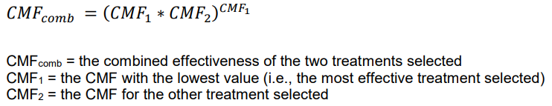
SCP CMF Use
Dominant Common Residuals Method
Dominant Effect Method
  Uses the most effective treatment only
Notes:
This means we need to do a little work before entering in values to IHSDM since IHSDM assumes independence. WisDOT uses either the Dominant Common Residuals Method or the Dominant Effect Method, depending on the CMF values.

Slide 9
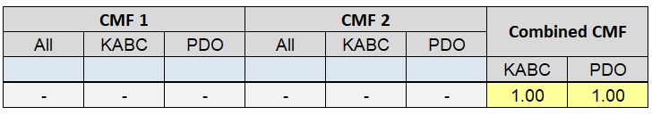
SCP CMF Use
Shoulder Rumble CMF = 0.92 for KABC crashes
HFST on Curves CMF = 0.76 for ALL crashes

Slide 10
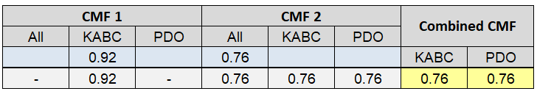
SCP CMF Use
Shoulder Rumble CMF = 0.92 for KABC crashes
HFST on Curves CMF = 0.76 for ALL crashes
CMF = 0.76 for KABC and PDO crashes
CMF is entered into IHSDM for length of curve

Slide 11
HSIP CMF Use
Same example for comparison
HSIP only uses Method 1 (CMF x Observed Crashes)
  Using a spreadsheet-based tool
  Allows more flexibility in the CMFs
Notes:
Remember Method 1 uses Excel. This means we have greater flexibility

Slide 12
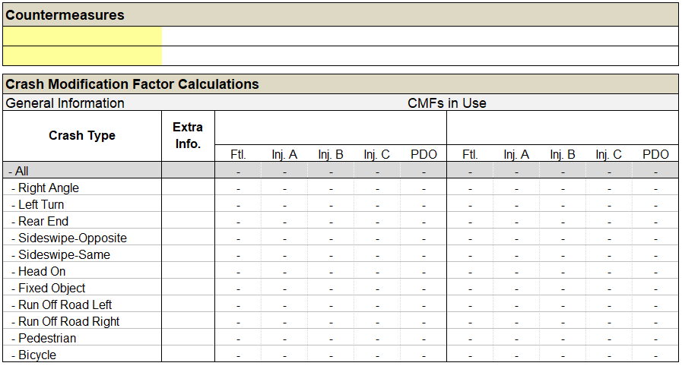
HSIP CMF Use
CMFs need to consider the crash severity
CMFs need to consider the crash type
Notes:
We can focus more specifically on the problems seen at the location. We can target crashes by type or severity.

Slide 13
HSIP CMF Use
HFST on Curves CMF = 0.76 for ALL crashes → Same as before
Shoulder Rumble CMF = 0.84 for all severities for ROR-Right and ROR-Left crashes
Notes:
Using the same example, we can instead have a more specific CMF that targets the runoff the road crashes.

Slide 14
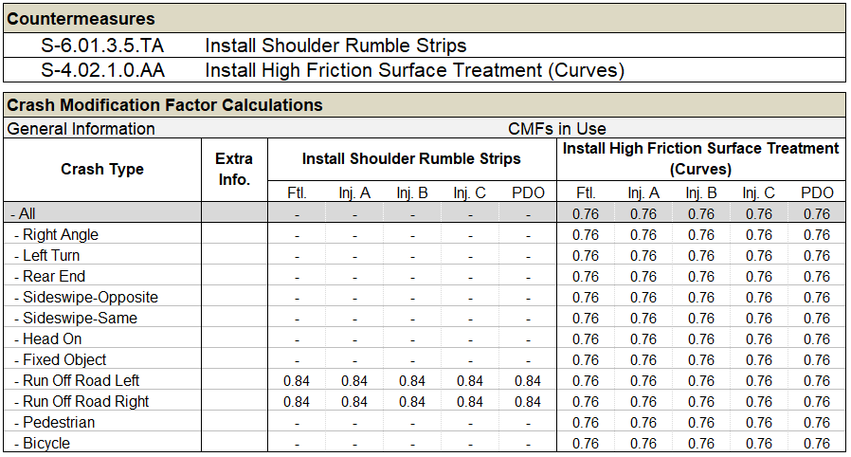
HSIP CMF Use
Notes:
Allows WisDOT to be more targeted with improvements

Slide 15
WisDOT CMF Uses
Depending on the program, can have access to a wider range of CMF options due to software limitations
Can lead to confusion as to what CMF to use, since there are so many to choose from
  Led to the creation of the WisDOT CMF Table

Slide 16
CMF Resources
CMF Clearinghouse
  Repository for CMFs and related materials
University of Wisconsin TOPS Lab
  Helps create Wisconsin specific CMFs
NHI courses
  Courses in understanding and developing CMFs
EDC DDSA webinars and technical support
  Always contains relevant material and willing to assist
Notes:
The CMF Clearinghouse is my go-to for CMFs. If they don’t have one, I usually reach out to our university partners to see if they have any information regarding the topic of interest. The TOPS lab has also worked with us to develop Wisconsin specific CMFs.
NHI has a very informational course called “Developing Quality CMFs” that has helped me greatly when reviewing CMF studies.

Slide 17
Poll Question 2
Have you developed your own CMF?
Yes
No
Would like to, but don’t have expertise
Would like to, but don’t have enough data

Slide 18
Questions?
Kevin M. Scopoline
Traffic Safety Engineer
Wisconsin DOT
Kevinm.scopoline@dot.wi.gov

