Slide 1
Development of Safety Benefit Factors for New Location and Widening Projects
CMF Clearinghouse Annual Webinar - December 8, 2021
Joy Davis, MPA, PMP
Brian Murphy, PE

Slide 2
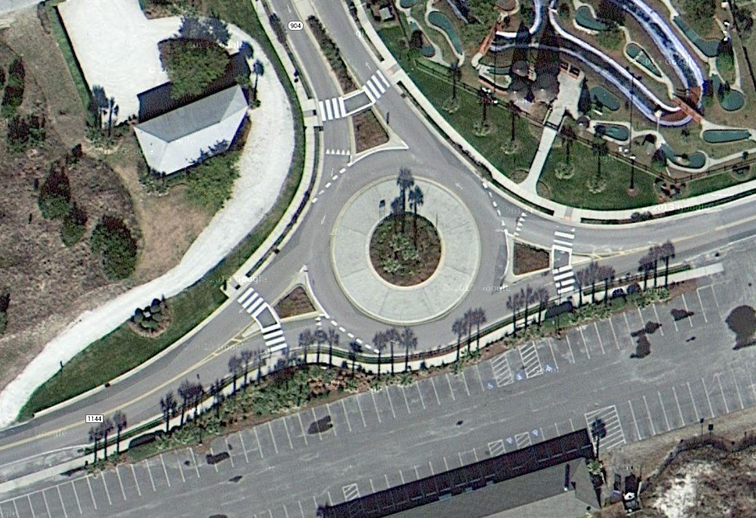
SBFs for New Location and Widening
Presentation Overview
1
2
3
4
Background / Need for Research
New Location Approach and Results
Widening Approach and Results
Application of Results

Slide 3
SBFs for New Location and Widening
Presentation Overview
1
2
3
4
Background / Need for Research
New Location Approach and Results
Widening Approach and Results
Application of Results

Slide 4

SBFs for New Location and Widening
Background
NCDOT’s Data Driven Approach to Project Prioritization
4

Slide 5
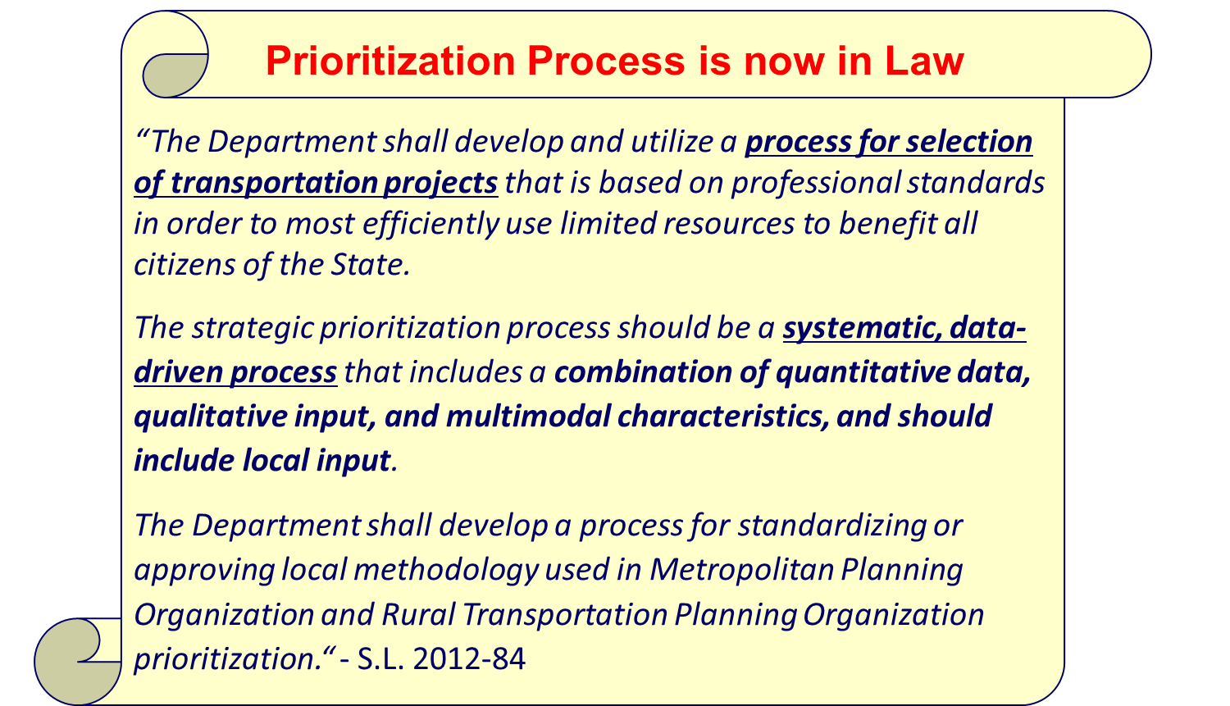
SBFs for New Location and Widening
Background
NCDOT’s Data Driven Approach to Project Prioritization
  Signed into law in 2013
5

Slide 6
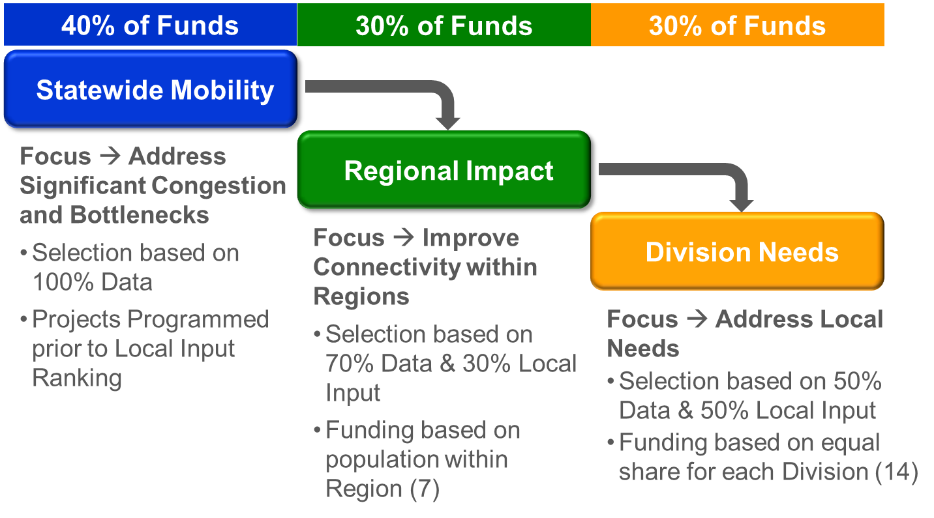
SBFs for New Location and Widening
Background
NCDOT’s Data Driven Approach to Project Prioritization
  Signed into law in 2013
  How Prioritization works:
6
Notes:
NCDOT Annual Budget is about 5 billion. About 2.5 Billion of that is for STI.

Slide 7
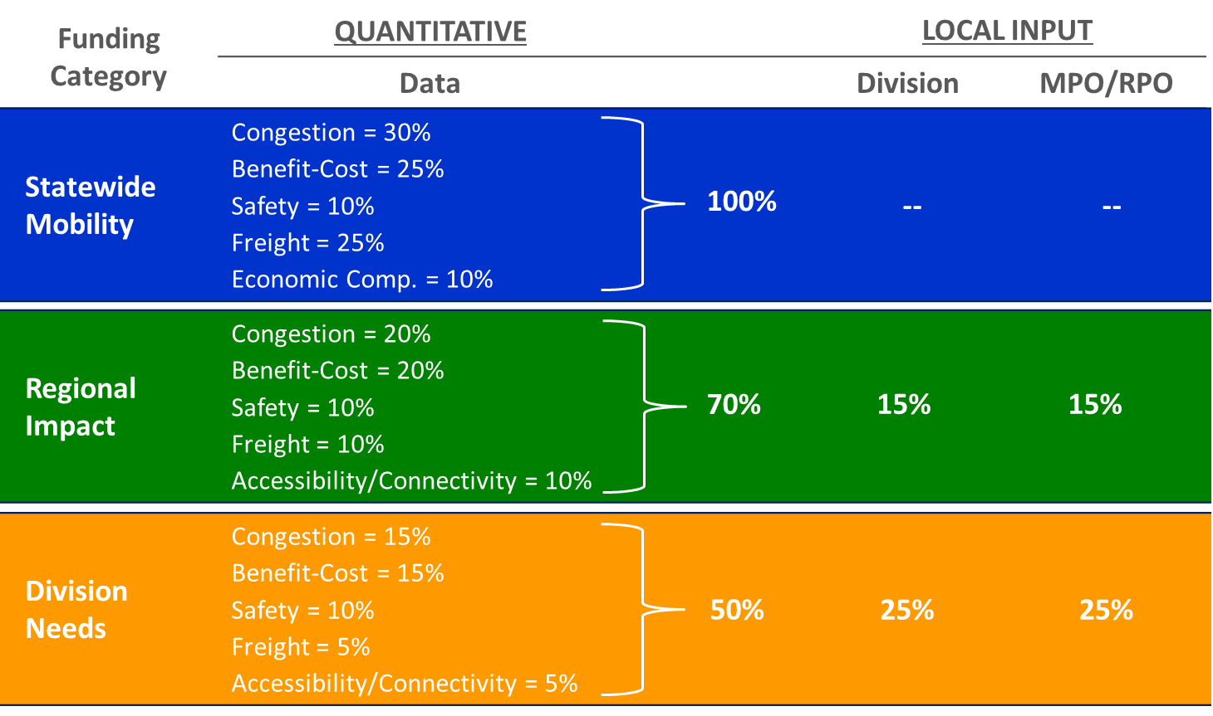
SBFs for New Location and Widening
Background
NCDOT’s Data Driven Approach to Project Prioritization
  Signed into law in 2013
  How Prioritization works:
7
Notes:
There is an obvious need to

Slide 8
SBFs for New Location and Widening
Background
Challenges to Quantifying the Safety Benefits for All Projects
  Latest round of prioritization analyzed 1,204 highway projects ($54 billion)
8
Notes:
There is an obvious need to

Slide 9
SBFs for New Location and Widening
Background
Challenges to Quantifying the Safety Benefits for All Projects
  Latest round of prioritization analyzed 1,204 highway projects ($54 billion)
  Limited amount of information for projects as they are submitted
    Example: “Improve Intersection”
9
Notes:
There is an obvious need to

Slide 10
SBFs for New Location and Widening
Background
Challenges to Quantifying the Safety Benefits for All Projects
  Latest round of prioritization analyzed 1,204 highway projects ($54 billion)
  Limited amount of information for projects as they are submitted
    Example: “Improve Intersection”
  Safety benefits must fit with Prioritization Office’s project categories (“SITs”)
10
Notes:
There is an obvious need to

Slide 11
SBFs for New Location and Widening
Background
Highway Specific Improvement Types for P5.0
1 - Widen Existing Roadway | 14 - Closed Loop Signal System
2 - Upgrade Arterial to Freeway/Expressway | 15 - Install Cameras and DMS
3 - Upgrade Expressway to Freeway | 16 - Modernize Roadway
4 - Upgrade Arterial to Superstreet | 17 - Upgrade Freeway to Interstate Standards
5 - Construct Roadway on New Location | 18 – Widen Existing or Construct New Local (Non-State) Roadway
6 - Widen Existing Roadway and Construct Part on New Location | 19 – Improve Intersection on Local (Non-State) Roadway-
7 - Upgrade At-grade Intersection to Interchange or Grade Separation | 20 – Convert Grade Separation to Interchange to Relieve Existing Congested Interchange
8 - Improve Interchange | 21 – Realign Multiple Intersections
9 - Convert Grade Separation to Interchange | 22 – Construct Auxiliary Lanes or Other Operational Improvements
10 - Improve Intersection | 23 - Construct Grade Separation at Highway / Railroad Crossing
11 - Access Management | 24 – Implement Road Diet to Improve Safety
12 - Ramp Metering | 25 – Upgrade Multiple Intersections
13 - Citywide Signal System | 26 – Upgrade Roadway
Challenges to Quantifying the Safety Benefits for All Projects
  Latest round of prioritization analyzed 1,204 highway projects ($54 billion)
  Limited amount of information for projects as they are submitted
    Example: “Improve Intersection”
  Safety benefits must fit with Prioritization Office’s project categories (“SITs”)
11
Notes:
There is an obvious need to

Slide 12
SBFs for New Location and Widening
Background
Challenges to Quantifying the Safety Benefits for All Projects
  Latest round of prioritization analyzed 1,204 highway projects ($54 billion)
  Limited amount of information for projects as they are submitted
    Example: “Improve Intersection”
  Safety benefits must fit with Prioritization Office’s project categories (“SITs”)
    Safety Benefit Factors (SBFs)
      Not the same as Crash Modification Factors (CMFs)
        CMFs typically describe a very specific treatment
        SBFs describe a SIT category or subcategory
      SBFs used the same as CMFs in this process to quantify safety benefits
12
Notes:
There is an obvious need to

Slide 13
SBFs for New Location and Widening
Background
Challenges to Quantifying the Safety Benefits for All Projects
  Latest round of prioritization analyzed 1,204 highway projects ($54 billion)
  Limited amount of information for projects as they are submitted
    Example: “Improve Intersection”
  Safety benefits must fit with Prioritization Office’s project categories (“SITs”)
  Gap in knowledge regarding the safety benefits of some highway project types
13
Notes:
There is an obvious need to

Slide 14
SBFs for New Location and Widening
Background
Highway Specific Improvement Types for P5.0
1 - Widen Existing Roadway | 14 - Closed Loop Signal System
2 - Upgrade Arterial to Freeway/Expressway | 15 - Install Cameras and DMS
3 - Upgrade Expressway to Freeway | 16 - Modernize Roadway
4 - Upgrade Arterial to Superstreet | 17 - Upgrade Freeway to Interstate Standards
5 - Construct Roadway on New Location | 18 – Widen Existing or Construct New Local (Non-State) Roadway
6 - Widen Existing Roadway and Construct Part on New Location | 19 – Improve Intersection on Local (Non-State) Roadway-
7 - Upgrade At-grade Intersection to Interchange or Grade Separation | 20 – Convert Grade Separation to Interchange to Relieve Existing Congested Interchange
8 - Improve Interchange | 21 – Realign Multiple Intersections
9 - Convert Grade Separation to Interchange | 22 – Construct Auxiliary Lanes or Other Operational Improvements
10 - Improve Intersection | 23 - Construct Grade Separation at Highway / Railroad Crossing
11 - Access Management | 24 – Implement Road Diet to Improve Safety
12 - Ramp Metering | 25 – Upgrade Multiple Intersections
13 - Citywide Signal System | 26 – Upgrade Roadway
Challenges to Quantifying the Safety Benefits for All Projects
  Latest round of prioritization analyzed 1,204 highway projects ($54 billion)
  Limited amount of information for projects as they are submitted
    Example: “Improve Intersection”
  Safety benefits must fit with Prioritization Office’s project categories (“SITs”)
  Gap in knowledge regarding the safety benefits of some highway project types
14
Notes:
There is an obvious need to

Slide 15
SBFs for New Location and Widening
Background
Highway Specific Improvement Types for P5.0
1 - Widen Existing Roadway | 14 - Closed Loop Signal System
2 - Upgrade Arterial to Freeway/Expressway | 15 - Install Cameras and DMS
3 - Upgrade Expressway to Freeway | 16 - Modernize Roadway
4 - Upgrade Arterial to Superstreet | 17 - Upgrade Freeway to Interstate Standards
5 - Construct Roadway on New Location | 18 – Widen Existing or Construct New Local (Non-State) Roadway
6 - Widen Existing Roadway and Construct Part on New Location | 19 – Improve Intersection on Local (Non-State) Roadway-
7 - Upgrade At-grade Intersection to Interchange or Grade Separation | 20 – Convert Grade Separation to Interchange to Relieve Existing Congested Interchange
8 - Improve Interchange | 21 – Realign Multiple Intersections
9 - Convert Grade Separation to Interchange | 22 – Construct Auxiliary Lanes or Other Operational Improvements
10 - Improve Intersection | 23 - Construct Grade Separation at Highway / Railroad Crossing
11 - Access Management | 24 – Implement Road Diet to Improve Safety
12 - Ramp Metering | 25 – Upgrade Multiple Intersections
13 - Citywide Signal System | 26 – Upgrade Roadway
Challenges to Quantifying the Safety Benefits for All Projects
  Latest round of prioritization analyzed 1,204 highway projects ($54 billion)
  Limited amount of information for projects as they are submitted
    Example: “Improve Intersection”
  Safety benefits must fit with Prioritization Office’s project categories (“SITs”)
  Gap in knowledge regarding the safety benefits of some highway project types
15
Notes:
Purpose of this research is to quantify the safety benefits of two types of projects so that this information can be fed into NCDOT’s data driven process for project selection.

Slide 16
SBFs for New Location and Widening
Poll Question
Does your agency have a data driven project prioritization process that incorporates expected safety benefits?
  No, our process does not incorporate expected safety benefits
  Yes, our process incorporates safety in a qualitative way (e.g. Minimal, Moderate, Significant)
  Yes, our process incorporates safety in a quantitative way (e.g. CMFs)
16
Notes:
There is an obvious need to

Slide 17
SBFs for New Location and Widening
Background: Research Approach
Interviews with Other States
SBF
Recommendations
Review of Prioritization Data and Other NC Data
Scan of Literature and Materials from Other States
Investigation of Crash Modification Factors (4 Star +)
  CMFs for all crash types/severities were included in the search
  Some CMFs for widening, no 4-star CMFs for new location projects
17
Notes:
There is an obvious need to

Slide 18
SBFs for New Location and Widening
Presentation Overview
1
2
3
4
Background / Need for Research
New Location Approach and Results
Widening Approach and Results
Application of Results

Slide 19
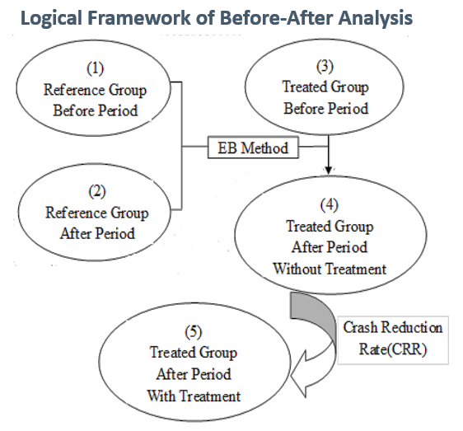
SBFs for New Location and Widening
Approach: New Location (Bypass) Projects
Overview of Naïve Empirical Bayesian (EB) Before-After Analysis
Compared the crashes that would be expected if the bypass was not built to the actual crashes after the building of the bypass
  Before Period - Original Route
  After Period - Original Route + Bypass
Method accounts for changes in traffic before the bypass compared to the increase in traffic after bypass was built
Method does not account for the effect of the bypass on the overall system due to redirecting of traffic from other parts of the network
19
Notes:
There is an obvious need to

Slide 20
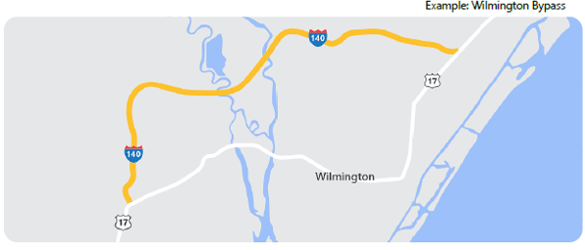
SBFs for New Location and Widening
Approach: New Location (Bypass) Projects
  Application of Naïve EB Before-After Analysis
  Sample of 16 NC sites (original route + bypass route) examined
  The following steps were undertaken to account for trends:
    Obtained NCDOT annual crash rates for All Primary Routes
    Used 1996 as baseline to scale the crash rates in the following years
  Conducted a disaggregate analysis based on facility type
    Differences were minimal and sample sizes were small
20
Notes:
There is an obvious need to

Slide 21
SBFs for New Location and Widening
Results: New Location (Bypass) Projects
Specific Improvement Type (SIT) | Sub SITs | Area Type | Current NCDOT SBF | Study Developed SBF | Study Recommended SBF | Recommendation Considerations
5 - Construct Roadway on New Location | 5A - Construct Roadway on New Location - Freeway Bypass | Urban/ Rural | 10 | 30 | 20 | Conservative SBF recommended due to the small number of sites of this type in the sample used to develop the SBF paired with the research team's expertise related to safety outcomes.
 | 5B - Construct Roadway on New Location - Superstreet Bypass | Urban/ Rural | 5 | 30 | 30 | Same SBF is recommended for SIT 5B and 5C project types due to amount of data available and similar SBF results for different types
 | 5C - Construct Roadway on New Location - All other projects | Urban/ Rural | - | 30 | 30 | Same SBF is recommended for SIT 5B and 5C project types due to amount of data available and similar SBF results for different types
21
Notes:
There is an obvious need to

Slide 22
SBFs for New Location and Widening
Presentation Overview
1
2
3
4
Background / Need for Research
New Location Approach and Results
Widening Approach and Results
Application of Results

Slide 23
SBFs for New Location and Widening
NCDOT Widening Types
1A - Widen Existing Roadway - Add lane to Freeway
1B ‐ Widen Existing Roadway ‐ Widen 2 lane roadway to 4 lane divided
1C - Widen Existing Roadway - Install two-way left turn lane on a two lane roadway
1D - Widen Existing Roadway - Widen 2 lane roadway to 4 lane divided Superstreet with Partial Control of Access
1E - Widen Existing Roadway - Widen 2 lane roadway to 4 lane divided with Partial Control of Access
1F - Widen Existing Roadway - Widen 4 lane divided roadway to 6 lane divided
1G.1 - Widen Existing Roadway - Widen 2 lane roadway to 4 lane divided roadway
1G.2 - Widen Existing Roadway - Widen 4 lane roadway to 5 lane roadway
1G.2 - Widen Existing Roadway - Widen 4 lane roadway to 5 lane roadway
1G.3 - Widen Existing Roadway - Widen 2 lane roadway to 4 lane divided roadway
1G.4 - Widen Existing Roadway - Install two-way left turn lane on a two lane roadway
1G.5 - Widen Existing Roadway - Install two-way left turn lane on a two lane roadway
1G.6 - Widen Existing Roadway - Widen 6 lane divided roadway to 8 lane divided roadway
4D to 6U Conversion
4U to 4D Conversion
23
Notes:
Purpose of this research is to quantify the safety benefits of two types of projects so that this information can be fed into NCDOT’s data driven process for project selection.

Slide 24
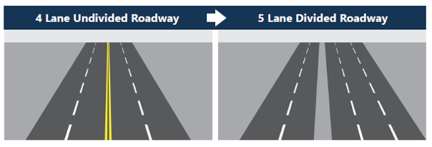
SBFs for New Location and Widening
Approach: Widening Projects
  Applied Safety Performance Functions
  Estimated the predicted number of crashes for the before and after facility types
  Used the HSM predictive models calibrated using NC data
  Used NC data to guides assumptions related to AADT and roadside parameters
  Data used for this analysis was collected as part of NCDOT RP 2020-27 “Updated and Regional Calibration Factors for Highway Safety Manual Crash Prediction Models (2016-2019)”
Example: 4U to 5D
24
Notes:
There is an obvious need to

Slide 25
SBFs for New Location and Widening
Results: Widening Projects
Specific Improvement Type (SIT) | Area Type | Current NCDOT SBF | Study Developed SBF | CMF Clearinghouse Results (4-Star or Higher) |  | Study Recommended SBF | Recommendation Considerations
 |  |  |  | SBF | Details
1A - Widen Existing Roadway - Add lane to Freeway | Urban/ Rural | 10 |  |  |  | TBD* | *Research team is unable to develop a recommendation for this SBF until the panel for NCHRP Project17-72 (which involves a revised method for this approach), approves that research
1B ‐ Widen Existing Roadway ‐ Widen 2 lane roadway to 4 lane divided | Rural | 55 | 60 | 30 | Uses FL data, Derived from EB B/A analysis | 60 | Developed SBF is consistent with Current NCDOT SBF
1C - Widen Existing Roadway - Install two-way left turn lane on a two lane roadway | Urban/ Rural | 20 |  | 20 | Uses NC data | 20 | CMF Clearinghouse SBF is consistent with Current NCDOT SBF
1D - Widen Existing Roadway - Widen 2 lane roadway to 4 lane divided Superstreet with Partial Control of Access | Urban | 15 |  |  |  | N/A | Recommended that the current NCDOT SBF is maintained because there are no Clearinghouse CMFs that are 4-stars or higher and available data was inadequate to estimate SBF
1E - Widen Existing Roadway - Widen 2 lane roadway to 4 lane divided with Partial Control of Access | Urban | 10 |  |  |  | N/A | Recommended that the current NCDOT SBF is maintained because there are no Clearinghouse CMFs that are 4-stars or higher and available data was inadequate to estimate SBF
1F - Widen Existing Roadway - Widen 4 lane divided roadway to 6 lane divided | Urban | 15 |  | 15 | Uses FL data, Derived from EB B/A Analysis | 15 | CMF Clearinghouse SBF is consistent with Current NCDOT SBF
25
Notes:
There is an obvious need to

Slide 26
SBFs for New Location and Widening
Results: Widening Projects
SIT 1G- Widen Existing Roadway - All other projects Subtype | Area Type | Current NCDOT SBF | Study Developed SBF | CMF Clearinghouse Results (4-Star or Higher) |  | Study Recommended SBF | Recommendation Considerations
 |  |  |  | SBF | Details
1G.1 - Widen Existing Roadway - Widen 2 lane roadway to 4 lane divided roadway | Urban (w/o controlled access) | - | 0 | 65 | Uses FL data, Derived from EB B/A analysis | 0** | ** Use with caution: SBF developed through this study shows no change in crashes, while CMF Clearinghouse SBF shows 65% crash reduction based on multiple sections of the same roadway
1G.2 - Widen Existing Roadway - Widen 4 lane roadway to 5 lane roadway | Urban (4-lane undivided) | - | 30 | 30 | Use LA data, Derived from EB B/A analysis | 30 | Developed SBF is consistent with CMF Clearinghouse SBF
1G.2 - Widen Existing Roadway - Widen 4 lane roadway to 5 lane roadway | Urban (4-lane divided) | - | 0 | - | - | 0
1G.3 - Widen Existing Roadway - Widen 2 lane roadway to 4 lane divided roadway | Urban/ Rural | - |  |  |  | N/A | Recommendation is informed by the separate SBF analyses for rural (60) and urban (0) projects of this type; Due to the wide spread between the two values, the research team is unable to recommend a an SBF that would apply to combined rural and urban locations.
1G.4 - Widen Existing Roadway - Install two-way left turn lane on a two lane roadway | Urban | - | 0 | 0 | Uses NC data | 0 | Developed SBF is consistent with CMF Clearinghouse SBF; NCDOT currently using the SBF for 1C (SBF = 20) for this project type due to a lack of area-specific SBF
1G.5 - Widen Existing Roadway - Install two-way left turn lane on a two lane roadway | Rural | - |  | 30 | Uses NC data | 30 | CMF Clearinghouse SBF uses NC data; NCDOT currently using the SBF for 1C (SBF = 20) for this project type due to a lack of area-specific SBF
1G.6 - Widen Existing Roadway - Widen 6 lane divided roadway to 8 lane divided roadway | Urban | - |  |  |  | TBD* | *Research team is unable to develop a recommendation for this SBF until the panel for NCHRP Project17-72 (which involves a revised method for this approach), approves that research
26
Notes:
There is an obvious need to

Slide 27
SBFs for New Location and Widening
Results: Widening Projects
NCDOT Special Request Project Type | Area Type | Current NCDOT SBF | Study Developed SBF | CMF Clearinghouse Findings (4-Star or Higher) |  | Study Recommended SBF | Recommendation Considerations
 |  |  |  | SBF | Details
4D to 6U Conversion | Urban/ Rural | - | - | - | - | TBD* | *Research team is unable to develop a recommendation for this SBF until the panel for NCHRP Project17-72 (which involves a revised method for this approach), approves that research
4U to 4D Conversion | Urban | - | 20 | - | - | 20*** | ***Use with caution due to limited sample available for calculations
27
Notes:
There is an obvious need to

Slide 28
SBFs for New Location and Widening
Presentation Overview
1
2
3
4
Background / Need for Research
New Location Approach and Results
Widening Approach and Results
Application of Results

Slide 29
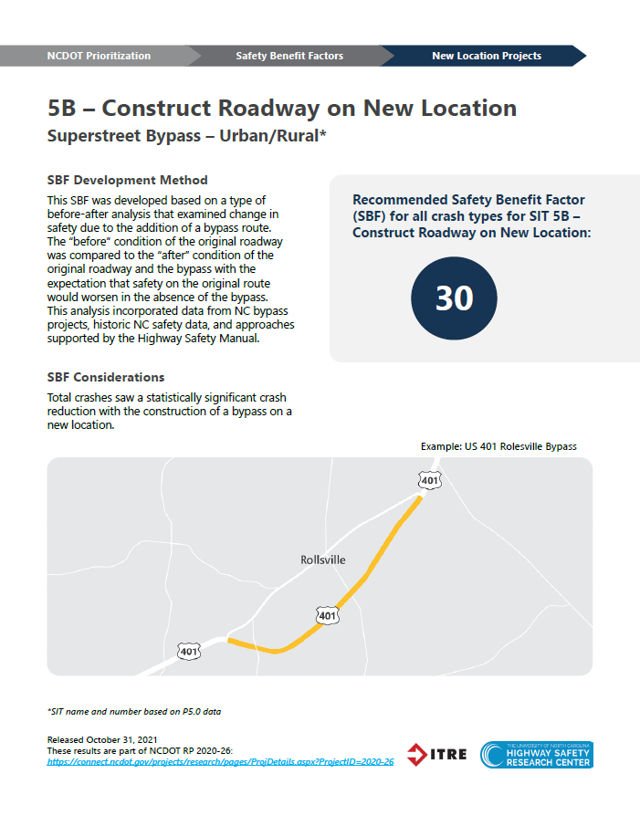
SBFs for New Location and Widening
Application of Results
  Resulted in 10 new SBFs for NCDOT and confirmation of 2 SBFs already utilized by NCDOT
  Sensitivity analysis conducted to show impact on prioritization process
  One-pagers developed for each new SBF to help inform decision-makers about recommendations
  New SBFs will be reviewed and will need to be adopted formally
29
Notes:
There is an obvious need to

Slide 30
Thank you!
Joy Davis, MPA, PMP
Research Coordinator
Institute for Transportation Research and Education
North Carolina State University
jcdavis7@ncsu.edu
Brian Murphy, PE
Safety Planning Engineer
Traffic Safety Unit
North Carolina Department of Transportation
(919) 814-4948
bgmurphy@ncdot.gov

