Slide 1
Looking Behind the Curtain: Spotlight on CMFs, DDSA and Decision-Making Processes in Wisconsin, North Carolina, and Beyond
Wednesday, December 8, 2021
2:00 – 3:30 PM EST

Slide 2
Agenda
Karen Scurry, Federal Highway Administration
Overview of CMFs and the CMF Clearinghouse
Taha Saleem, UNC Highway Safety Research Center and Manager of the CMF Clearinghouse
Overview of the recently updated CMF Clearinghouse rating system and the resources available for your assistance
Kevin Scopoline, Wisconsin Department of Transportation
WisDOTs Data Driven Safety Analysis (DDSA) efforts (and how they use CMFs from the CMF Clearinghouse in this process)
Brian Murphy & Daniel Carter, North Carolina Department of Transportation, and Joy Davis & Daniel Findley, North Carolina State University Institute for Transportation Research and Education
NCDOTs use of Safety Benefit Factors in the Strategic Transportation Investments process
Raghavan Srinivasan, UNC Highway Safety Research Center
Overview of the various current and recently completed CMF related National Cooperative Highway Research Program (NCHRP) projects

Slide 3
Webinar “Housekeeping”
Rejoining the program
All lines are muted
Control Panel
Questions/assistance
Webinar Recording

Slide 4
Poll
How many people are attending the webinar at your location?

Slide 5
Overview of CMFs and the CMF Clearinghouse
Karen Scurry
FHWA Office of Safety

Slide 6
What is a Crash Modification Factor?
Multiplicative factor that reflects the expected safety effectiveness of a countermeasure
Used to compute the expected number of crashes after implementing a given countermeasure at a specific site
Examples
CMF of 0 represents a 100% reduction in the number of crashes
CMF of 0.8 represents a 20% reduction in the number of crashes
CMF of 1.2 represents a 20% increase in the number of crashes

Slide 7
What is the CMF Clearinghouse?
A regularly updated, online repository of CMFs,
A mechanism for sharing newly developed CMFs, and
Educational information on the proper application of CMFs.

Slide 8
Poll
How often do you use the CMF Clearinghouse?
Daily
Weekly
Monthly
Once or Twice Per Year
Never

Slide 9
CMF Inclusion Criteria
The CMF Clearinghouse presents CMFs from studies that meet the following criteria:
The study must be based on crash data
The study must have the objective of quantifying the safety effect of a roadway feature or characteristic
The study must be focused on determining the safety effect of an infrastructure characteristic, feature, or modification that would fall under engineering responsibilities
The study must explicitly present quantified CMF values or CMFunctions

Slide 11
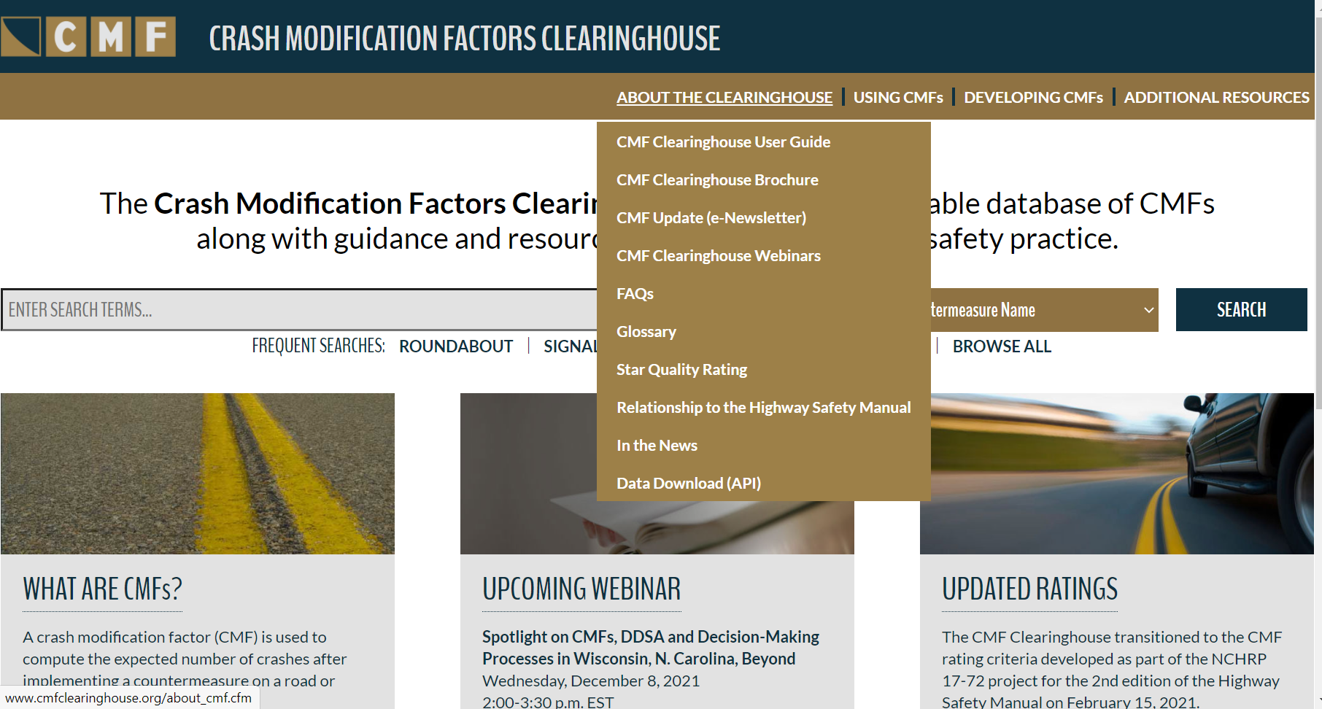

Slide 12
Using CMFs

Slide 13
Developing CMFs

Slide 14
Additional Resources

Slide 15
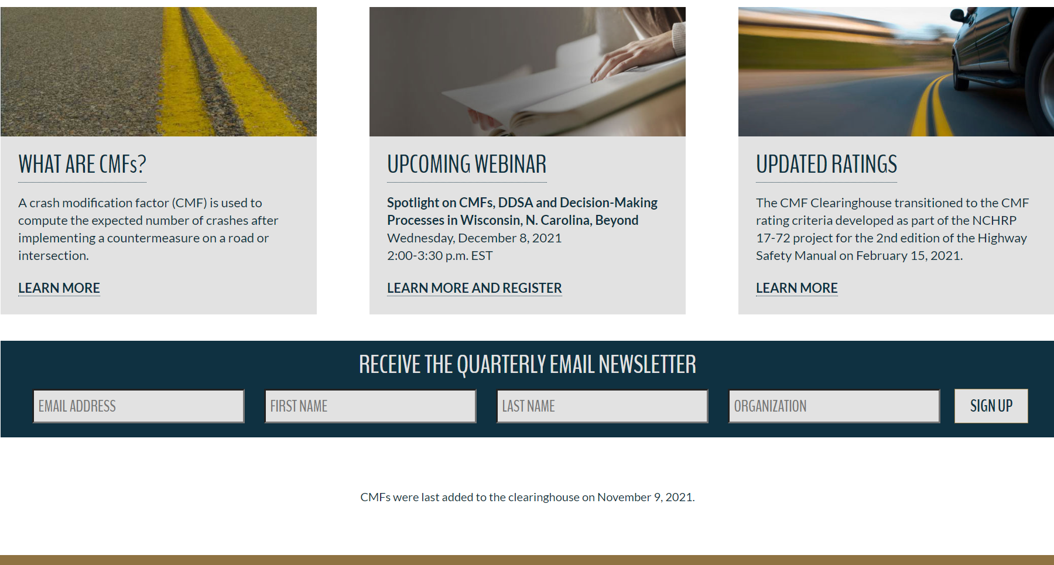

Slide 16
Searching for CMFs

Slide 17
Filtering CMFs

Slide 18
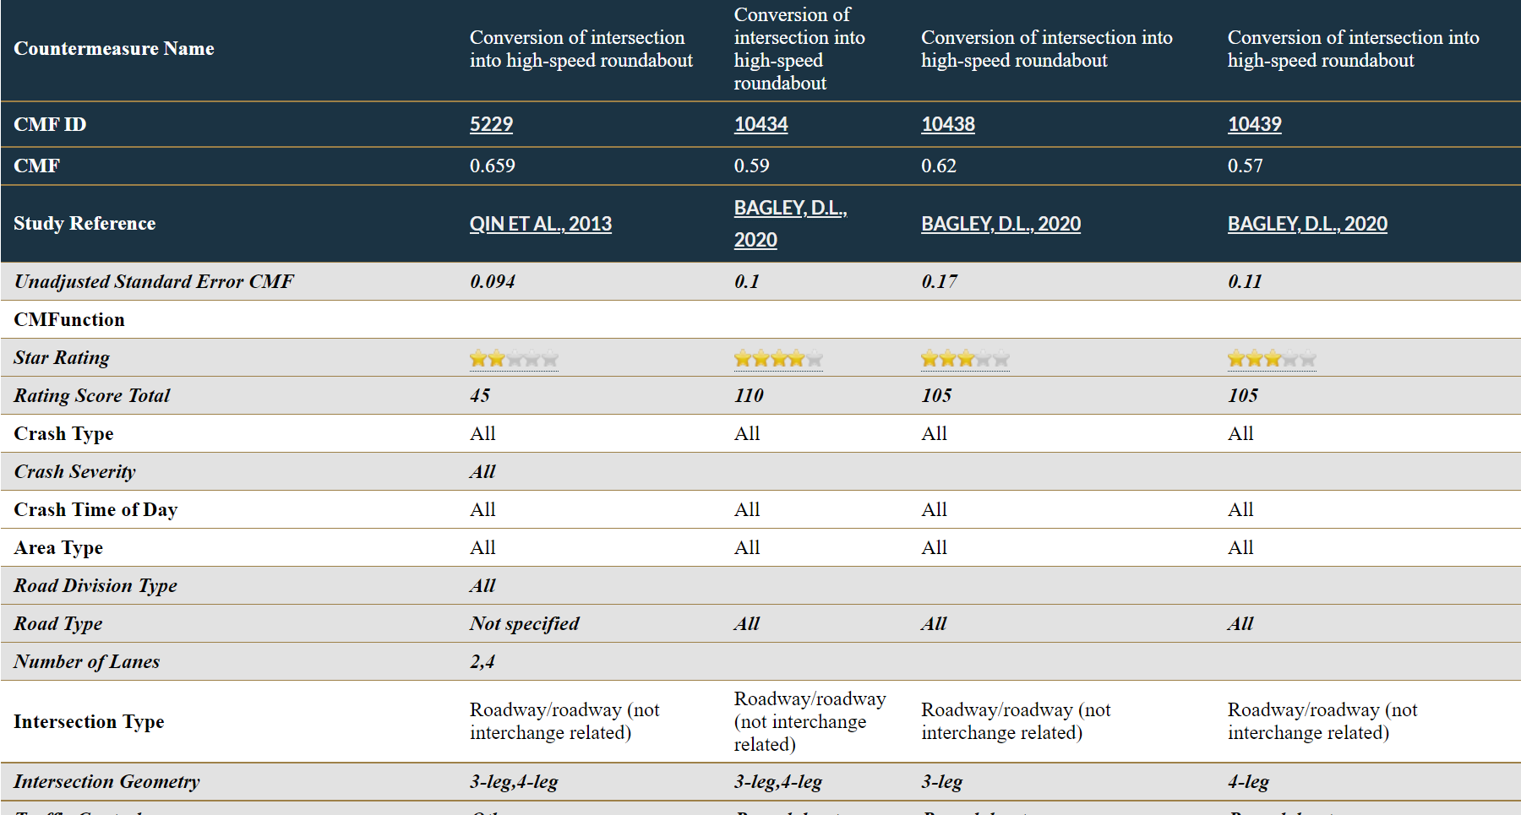
Comparing CMFs

Slide 19
Understanding CMFs

Slide 20
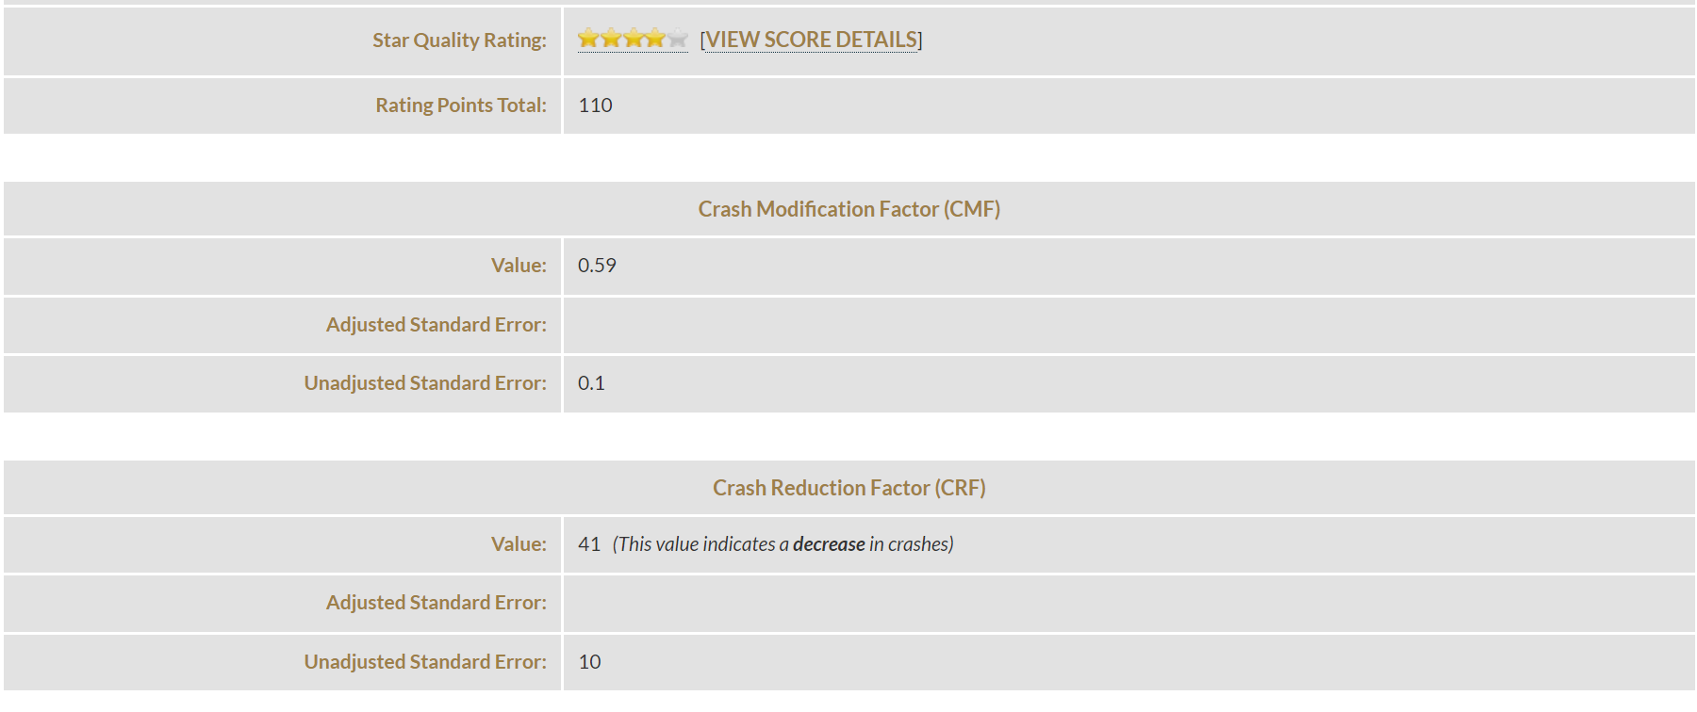
Understanding CMFs

Slide 22
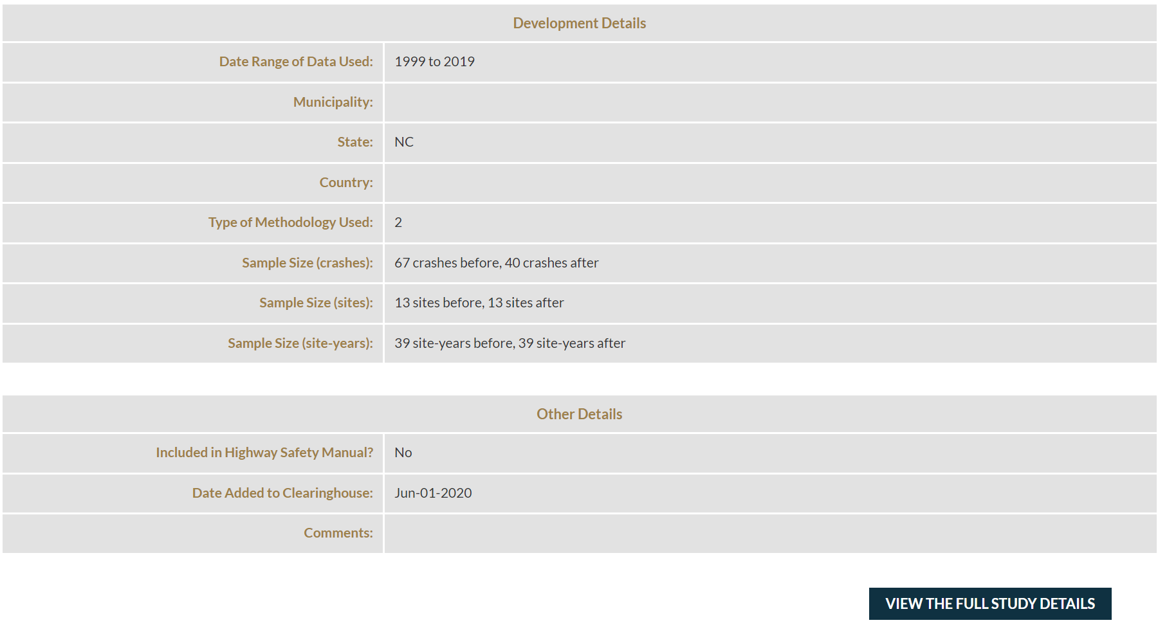

Slide 23
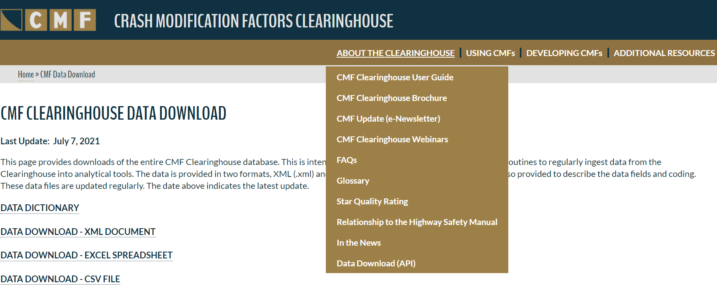
Downloading CMFs

Slide 24
Wrap-up
Future activities
Implement focus group recommendations
Convert programming language from ColdFusion to PHP
Change domain name to dot.gov
Post-webinar survey
Certificate of attendance

Slide 25
www.CMFClearinghouse.org
Karen Scurry, P.E.
FHWA Office of Safety Programs
202-897-7168
karen.scurry@dot.gov

