Slide 1
CMF How-tos:
Planning, Multiple Treatments and API – Oh My!
December 16, 2019

Slide 2
Introduction
Karen Scurry, P.E.
FHWA Office of Safety Programs

Slide 3
Agenda
Karen Scurry, Federal Highway Administration, and Taha Saleem, UNC Highway Safety Research Center and Manager of the CMF Clearinghouse
  Overview of CMFs and the CMF Clearinghouse
Frank Gross, VHB
  Resources on combing CMFs for multiple treatments including the issue of independence
Matthew Hinshaw, Federal Highway Administration – office of Federal Lands
  Using CMFs for project planning and identification at Federal Lands
Shanshan Zhao, University of Connecticut
  Linking to the CMF Clearinghouse through the new API

Slide 4
Webinar “Housekeeping”
Rejoining the program
All lines are muted
Control Panel
Questions/assistance
Webinar Recording

Slide 5
Poll
How many people are attending the webinar at your location?

Slide 6
Additional Resources
CMF Videos (Coming Soon)
  Analyzing the Combined Effect of Multiple Countermeasures
    Part 1: Selecting the appropriate method
    Part 2: Applying methods
Training: Developing Quality CMFs
  NHI Course #380119
  Next offering: March – April 2020
Technical Assistance

Slide 7
Moving Forward
CMF Clearinghouse Facelift
CMF Clearinghouse Transition to HSM2 Inclusion Criteria

Slide 8
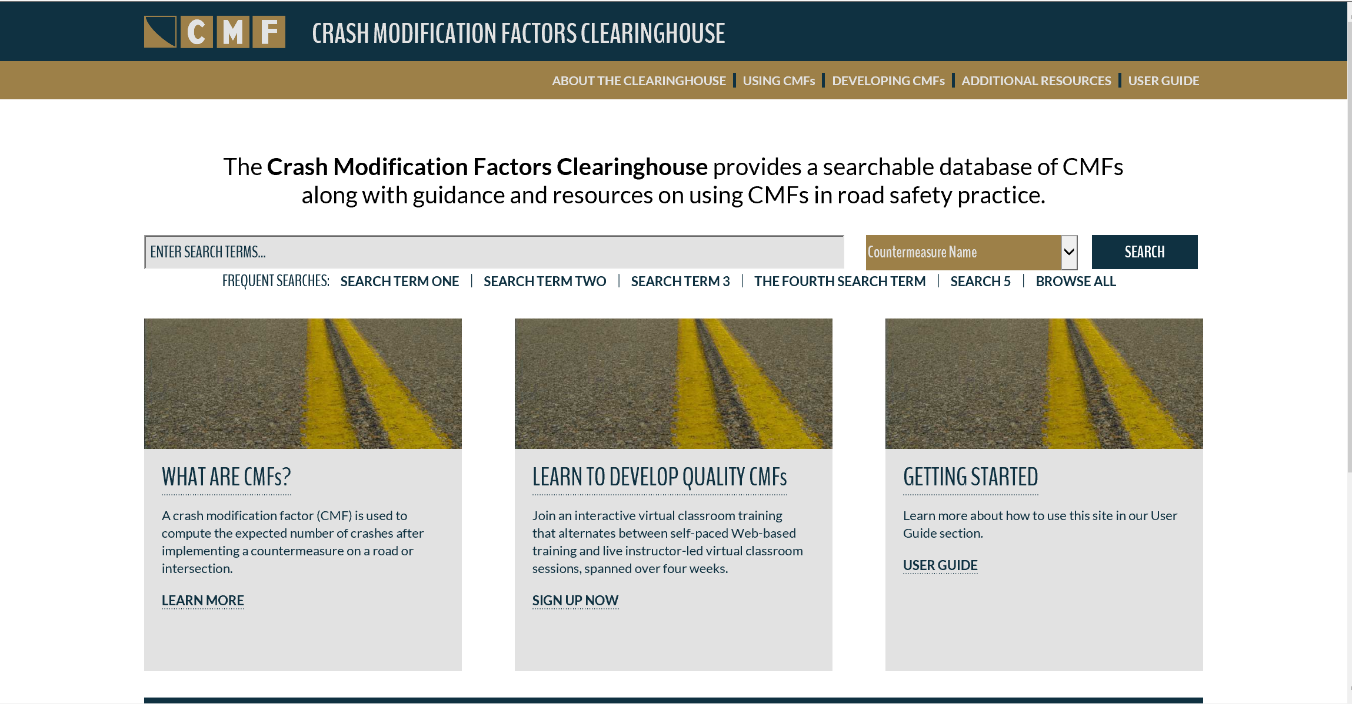
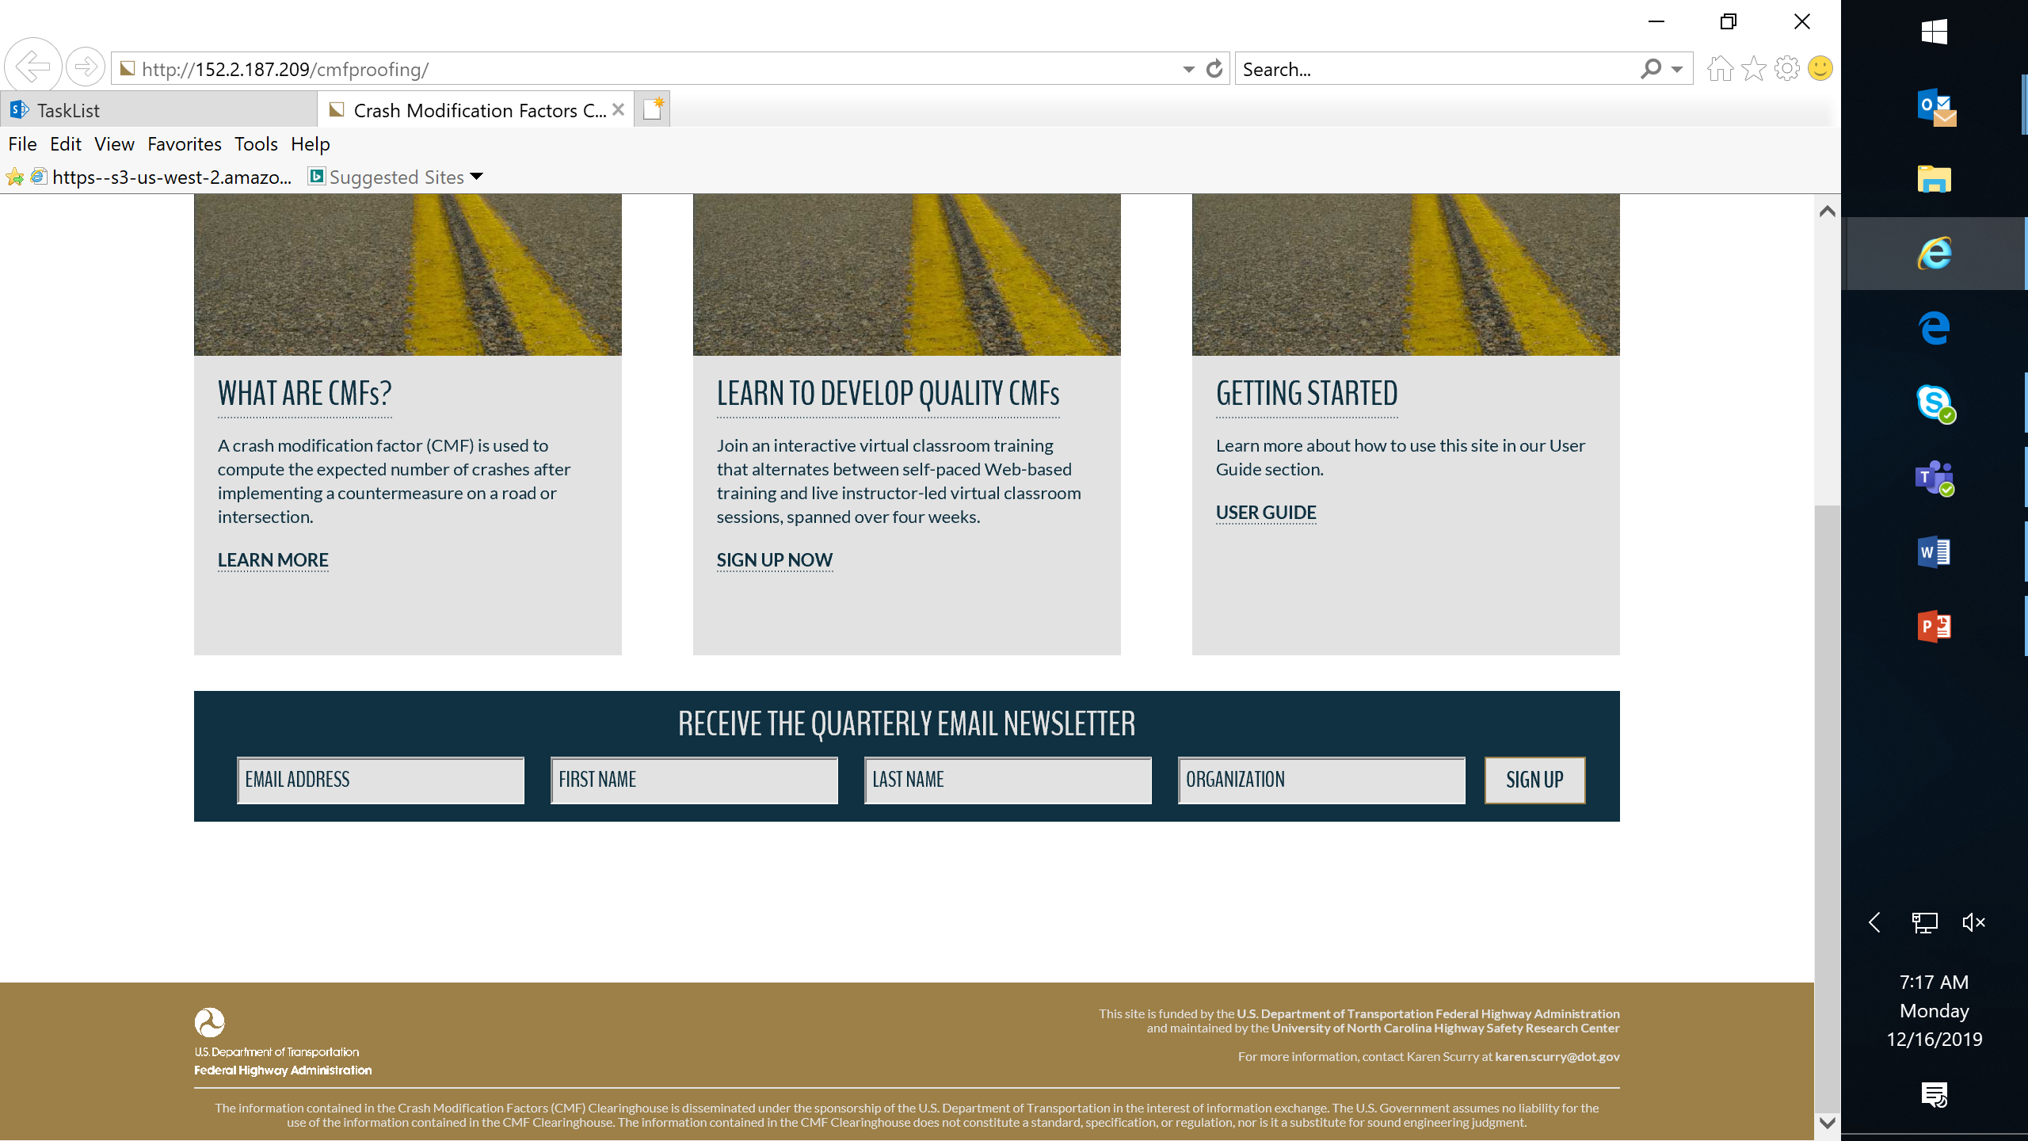

Slide 9
HSM2 Inclusion Criteria
NCHRP 17-72 developed rating/inclusion process for HSM2
Inclusion criteria considers:
  Individual CMFs from Before-After Studies
  Individual CMFs from Cross Sectional Studies
  Meta-Analysis Studies
  Meta-Regression from Study or Site/Group Level Estimates
CMFs assigned rating up to 150 Points
Points assigned based on multiple factors:
  Before-After/Cross Sectional Studies
    Data
    Confounding and Appropriateness of Statistical Analysis
    Statistical Significance
  Meta Analysis/Meta Regression Studies
    Methodology & Data
    Individual CMF Quality
    Appropriateness of Combining/Developing CMFunction
    Statistical Significance/Appropriateness of Statistical Analysis
Notes:
Meta-Analyses use individual CMF estimates from multiple studies to develop a single combined CMF estimate.
In order to consider a meta-analysis study all the individual studies used must meet several criteria:
Be crash based
Studies should explicitly report a CMF
Studies with a single estimate are consistent with theory
Studies with multiple estimates exhibit consistency in the direction of effect, i.e. an increase or decrease in crashes due to the treatment
Meta-Regression uses individual CMF estimates from either (a) multiple studies (each producing one or more CMF estimates) or (b) a single study providing multiple CMF estimates to develop a CMFunction.
In order to consider a meta-regression study all the individual estimates used must meet several criteria:
Be crash based
Studies should explicitly report a CMF
Studies with a single estimate are consistent with theory
Studies with multiple estimates exhibit consistency in the direction of effect, i.e. an increase or decrease in crashes due to the treatment, or explain diverging results due to site or application differences

Slide 10
CMF CH Transition Plan
Internal Facing Activities
Develop method of providing star ratings based on HSM2 rating
Expand database
Revise user input forms in the administrative section
EXAMPLE ONLY – POINT VALUE RANGES IN THIS TABLE ARE ABITRARY AND FOR PURPOSE OF EXAMPLE ONLY
HSM2 Rating Score | Star Rating in CMF Clearinghouse
135-150 | 5 star
120-134 | 4 star
100-119 | 3 star
70-99 | 2 star
0-69 | 1 star

Slide 11
CMF CH Transition Plan
External Facing Activities
Hold Stakeholder Calls
  Understand how this proposed ratings transition would affect the field of safety practice and research
  Identify opportunities to improve navigation/search functionality
Develop Outreach Materials
  Advance materials announcing change
  One-page flyer on ratings transition, what’s going to change & how
  Short video (2-3 minutes) – here’s what’s changing and why
  Include in 17-83 training materials for HSM2
Revise website display
  New Rating Criteria
  CMF Details Page
  Look & Feel of Website
Revise user guide
Conduct webinars
  Executive – formalized link with HSM2, staff training needs & decisions
  Practitioner – how transition will affect searching selecting CMFs

Slide 12
Wrap-up
Post-webinar survey
Certificate of attendance

Slide 13
www.CMFClearinghouse.org
Karen Scurry, P.E.
FHWA Office of Safety Programs
202-897-7168
karen.scurry@dot.gov

