Slide 1
Overview of CMFs and the CMF Clearinghouse
Taha Saleem
CMF Clearinghouse Webinar
Dec 16, 2019

Slide 2
Introduction
Selecting an appropriate CMF is important
Applying CMFs correctly is important as well – can have large impact on results
CMF Clearinghouse team is available to help explain CMFs on the site or from a study report

Slide 3
Dealing With too Many Search Results

Slide 4
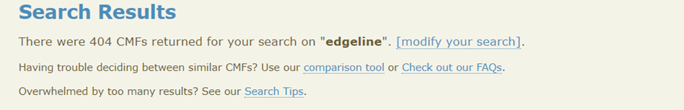
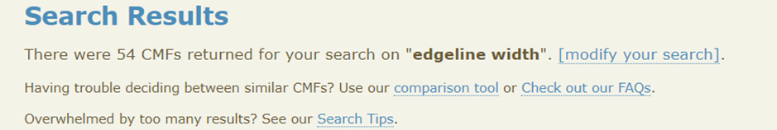
Narrow Down using More terms

Slide 5
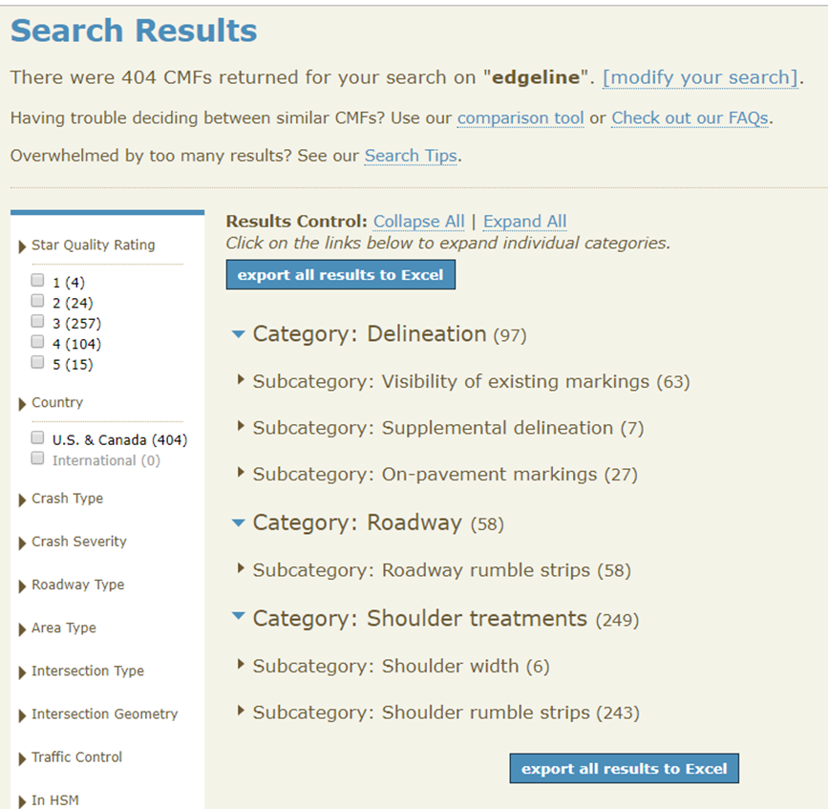
Narrow Down using Filters

Slide 6

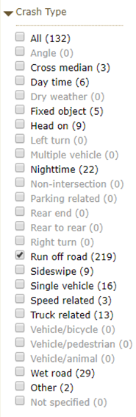
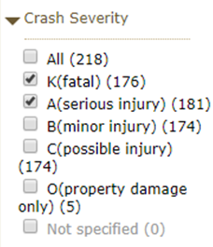
116 Results
357 Results
219 Results

Slide 7
Multiple CMFs for the Same Crash Type And Severity in a Study how to differentiate?

Slide 8
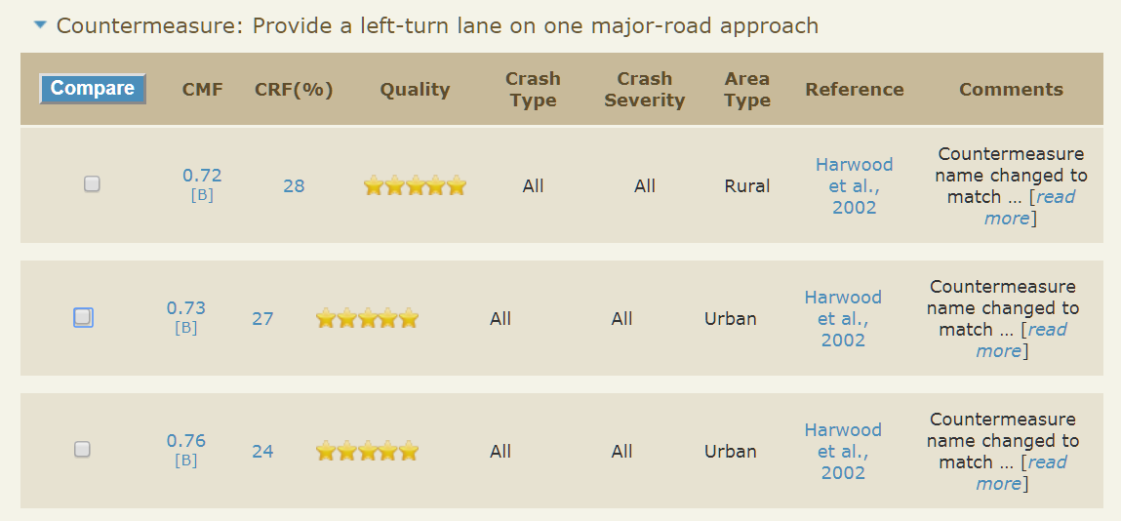
Compare CMFs Tool

Slide 9
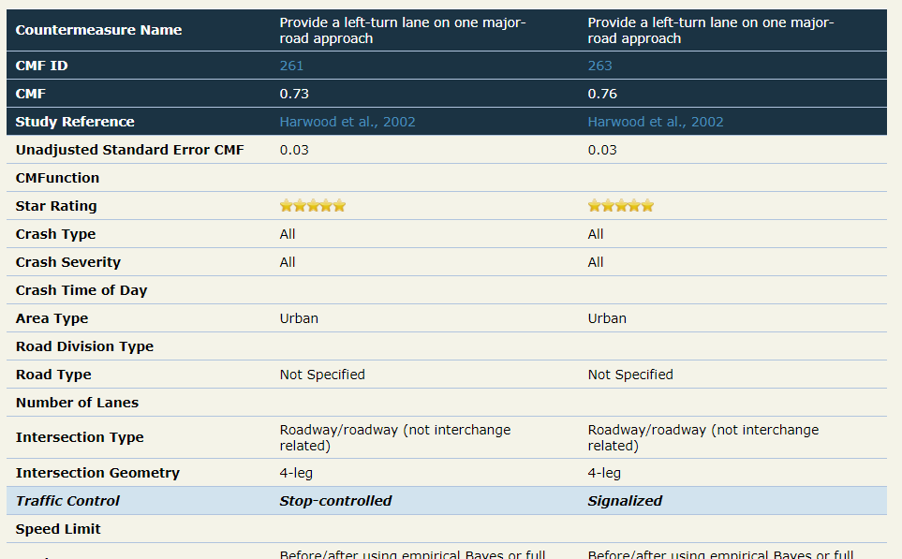

Slide 10
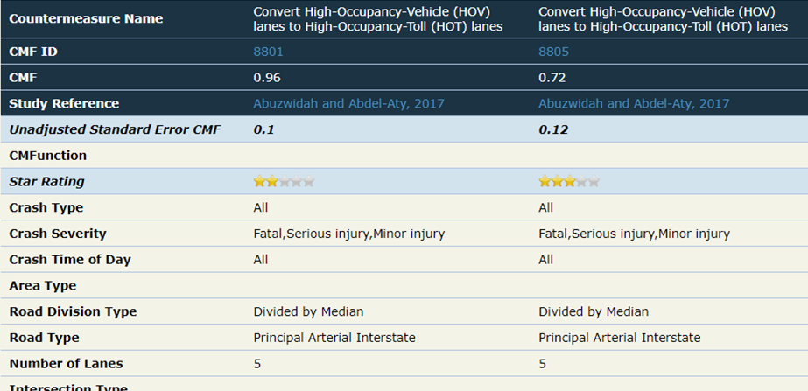
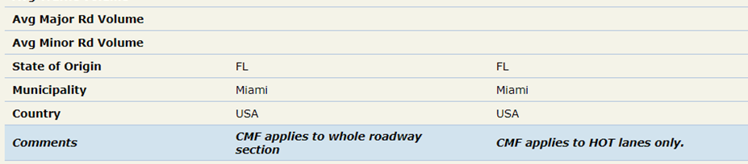

Slide 11
Calculating the Reverse Treatment effect

Slide 12
Reverse Treatment Effect
Research study indicates a CMF of 1.48 for a 75 degree intersection compared to a 90 degree intersection
What is the reasonable assumption of CMF for realigning an intersection to 90 degrees?

Slide 13
Reverse Treatment Effect
Mistake: assuming that a 1.48 CMF would lead to a 52% reduction in crashes (presumably because 2.0-1.48=0.52?)
This represents an expected 32% reduction in crashes (100-100x0.68 = 32), not 52%
CMF = (CMF for new condition) / (CMF for old condition)
= (CMF for 90 degrees) / (CMF for 75 degrees)
= 1.00 / 1.48 = 0.68.

Slide 14
Applying too many CMFs without accounting for interrelationship of effect

Slide 15
Applying too many CMFs without accounting for interrelationship of effect
CMFs may address the same crash type
For example, addressing run off road crashes at curves
  Chevrons
  Wider edgelines
  High friction surfacing
The effects are related (not independent)

Slide 16
Applying too many CMFs without accounting for interrelationship of effect
Multiplying CMFs together likely overstates benefit, especially when considering many countermeasures
A tool (or analyst) must account for interrelationship of effect
Conservative: Use CMF from only the most effective treatment
More discussion on this topic in the next presentation

Slide 17
Q&A
Enter questions using the GoToWebinar window

