Slide 1
Application of Multiple CMFs
Frank Gross, VHB

Slide 2
Questions
Can you use CMFs to estimate the combined effect of multiple countermeasures?
What methods should you use?
Add CMFs?
Multiply CMFs?
Other methods?

Slide 3
Ideal Answer
Apply CMF that represents combined effect
Examples of CMFs for Combined Countermeasures | CMF | Star Rating | CMF ID
Install shoulder rumble strips and widen shoulder | 0.61 | 4-star | 6665
Install centerline and shoulder rumble strips | 0.80 | 5-star | 6850
Install a traffic signal and left turn lanes | 0.57 | 4-star | 7967
Install raised median with marked crosswalk | 0.54 | 3-star | 175

Slide 4
In an Unideal World
Estimate combined effect using CMFs that represent individual countermeasure effects
Countermeasure 1 | CMF 1 | CMF ID | Countermeasure 2 | CMF 2 | CMF ID | Combined Effect
Install left-turn lane | 0.72 | 260 | Improve intersection sight distance | 0.63 | 1638 | ?
Install two-way-left-turn lane | 0.80 | 2341 | Reduce driveway density from 15 to 10 per mile | 0.89 | 2248 | ?
Install high-visibility crosswalk | 0.60 | 4123 | Implement leading pedestrian interval | 0.87 | 9918 | ?

Slide 5
Potential Methods
Methods to Estimate Combined Effect of Multiple Countermeasures
Multiplicative | $${CMF}_{t}={CMF}_{1}∗{CMF}_{2}$$ *CMF₁ = most effective countermeasure
Additive | $${CMF}_{t}={1−[(1−CMF}_{1})+{(1−CMF}_{2})]$$ *maximum reduction = 100% (i.e., CMF = 0)
Dominant effect | $${CMF}_{t}={CMF}_{1}$$ *only consider countermeasure with smallest CMF
Dominant common residuals | $${CMF}_{t}={{(CMF}_{1}∗{CMF}_{2})}^{{CMF}_{1}}$$

Slide 6
Method Selection Process
Define scenario of interest
Understand limits of combined countermeasure effect
Determine potential for overlapping effects among countermeasures
Categorize magnitude of individual countermeasure effects

Slide 7
1. Define Scenario of Interest
Countermeasures
Roadway characteristics
Traffic volume
Crash type and severity
Time of day
Specific treatment location

Slide 8
2. Understand Limits of Combined Effect
1+1 = 2 | 1-1 = 0
1-1-1 = -1 | 1+1 = 3

Slide 9
3. Determine Potential for Overlapping Effects
Defined with respect to target crashes
Represents likelihood that individual countermeasures would address similar crashes
Different than applicability of CMF
Reflects crash types used to develop CMF

Slide 10
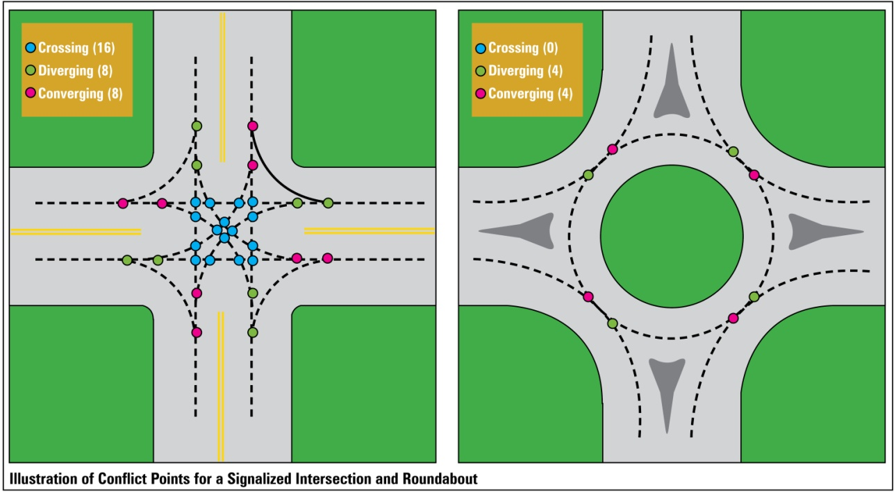
3. Determine Potential for Overlapping Effects
Convert intersection with minor-road stop control to roundabout
CMF | 0.13
Crash Type | All
Crash Severity | Injury
Area Type | Rural
CMF ID | 230

Slide 11
3. Determine Potential for Overlapping Effects
Scenario
Location: 2-way, stop-controlled intersection
CM1: install lighting on major road
CM2: install intersection warning signs on minor road
Question
Do you think there would be no overlap, some overlap, or complete overlap in the target crashes?

Slide 12
3. Determine Potential for Overlapping Effects
Potential Overlap
Zero Overlap
Complete Overlap
Some Overlap
Enhancing Effects
Counteracting Effects

Slide 13
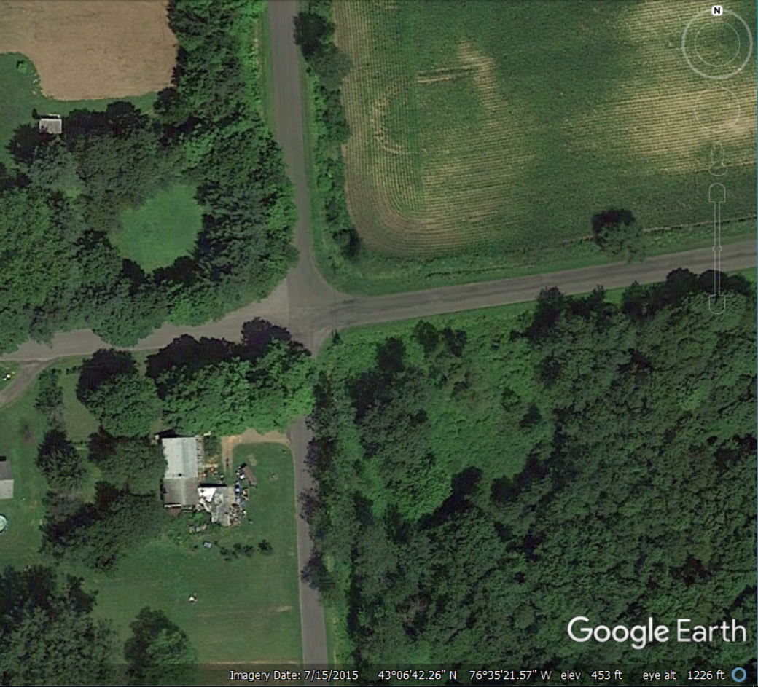
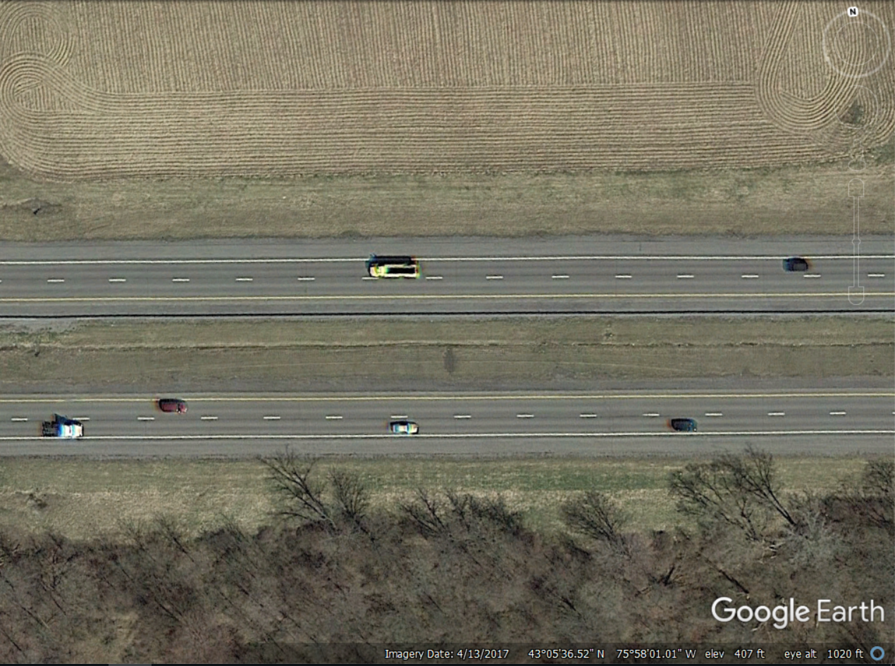
3. Determine Potential for Overlapping Effects

Slide 14
4. Categorize Magnitude of Individual Effects
Individual Effect | Assigned Magnitude
< 10% change | Small
10 – 25% change | Medium
> 25% change | Large

Slide 15
Select Method to Estimate Combined Effect (CMFs apply to same crash type and severity)
Magnitude | Overlap | Method
One or more CMFs > 1.0 | Not Applicable | Multiplicative
Both CMFs < 1.0 | Zero Overlap or Enhancing Effects | Additive
 | Complete Overlap | Dominant effect
 | Some Overlap | Dominant effect OR Dominant common residuals; whichever produces greatest reduction (i.e., smallest combined CMF)

Slide 16
Example Application
Countermeasure | CMF | Applicable Crash Type | Applicable Severity | Applicable Facility Type | CMF ID
Install two-way-left-turn lane | 0.80 | All | All | Rural, 2-lane roads | 2341
Reduce driveway density from 15 to 10 driveways per mile | 0.89 | All | All | All 2-lane roads | 2248
$${CMF}_{t}={{(CMF}_{1}∗{CMF}_{2})}^{{CMF}_{1}}={(0.80∗0.89)}^{0.80}=0.76$$

Slide 17
Select Method to Estimate Combined Effect (CMFs apply to different crash type or severity)
Apply smallest CMF to applicable crashes
Excluding crashes associated with other CMFs
Apply next smallest CMF to applicable crashes
Excluding crashes associated with other CMFs
If necessary, estimate CMF for combined effect and apply it to applicable crashes
Sum change in crashes to calculate combined effect
Check that estimated change ≤ 100%

Slide 18
Example Application
Crash Group₁
Total Crashes = X-median + ROR-right + S.S. same direction
Crashes Without (9 total) | Crash Group 1 (3 X-median) | Crash Group 2 (4 ROR-right) | Crash Group 3 (2 S.S. same)
CMF 1 applies to X-median crashes; CMF 2 applies to ROR-right crashes
CMF1 | 0.87 | -- | --
CMF2 | -- | 0.93 | --
CMF₁
Crash Group₂
Crashes With | CMF 1 * C.G. 1 0.87 * 3 = 2.61 | CMF 2 * C.G. 2 0.93 * 4 = 3.72 | 2 S.S. same no CMFs, no change
CMF₂
Difference | 3 – 2.61 = 0.39 | 4 – 3.72 = 0.28 | 2 – 2 = 0
Combined Countermeasure Effect = 0.39 + 0.28 + 0 = 0.67 Confirm this is ≤ Total Crashes (0.67 < 9; confirmed!)

Slide 19
Example Application
Crash Group₁
Crash Group₁
Crash Group₂
Crash Group₃
CMF₁
CMF₁
CMF₂
Crash Group₂
Crash Group₁
Crash Group₃
Crash Group₂
CMF₂
CMF₁
CMF₂

Slide 20
Questions
Can you use CMFs to estimate the combined effect of multiple countermeasures?
What methods should you use?
Add CMFs?
Multiply CMFs?
Other methods?

Slide 21
Questions
Frank Gross
VHB
919-334-5602
fgross@vhb.com

