Slide 1
Using CRFs at Federal Lands Highway
Matt Hinshaw
Highway Safety Engineer
Western Federal Lands Highway Division
Notes:
Good afternoon, good morning. My name is Matt Hinshaw and I’m a Highway Safety Engineer at the Western Federal Lands Highway Division. I’ll be going over how our highway safety team has been using crash reduction factors at Federal Lands Highway.

Slide 2
Outline
What is Federal Lands Highway (FLH)?
Using CRFs for Project Development
Using CRFs for Business Measure Reporting
Feedback
Notes:
Here is the outline for my presentation today. I’ll start with a brief introduction of our agency. Then I’ll describe how we’re using crash reduction factors for project development, as well as our agency’s business measures. Finally, I’ll request some feedback of you all to see how we can improve our process.

Slide 3
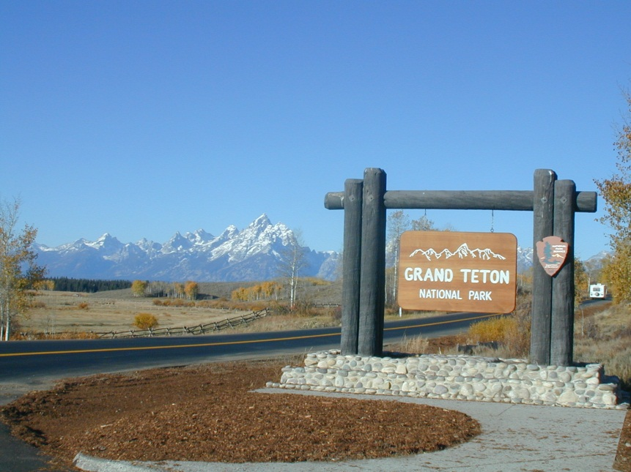
What is Federal Lands Highway (FLH)?
Mission:
Improving transportation to and within Federal and Tribal Lands by providing technical services to the highway/transportation community, as well as building accessible and scenic roads that ensure the many national treasures, within our Federal Lands, can be enjoyed by all.
Notes:
I’d first like to describe who we are here at Federal Lands Highway as there may be many of you who have never heard of us.
Read mission

Slide 4
USDOT
Federal Highway Administration
Federal-Aid Program
Federal Lands Highway
Others (FAA, NHTSA, etc.)
WFLHD
CFLHD
EFLHD
Division Offices
50 States
Notes:
We are a division of the Federal Highway Administration. You’ve probably heard of or worked with the FHWA Division Offices that work with all the state DOTs out there. Our Federal Lands Highway Division functions very similar to many of the state DOTs out there, as we provide project planning, project development and construction administration of a wide variety of transportation projects for projects on federal lands as well as state, county, city and tribal roads. The main difference from us to all the state DOTs and local governments is that we do not own and maintain the highways and roads that we have projects on.

Slide 5
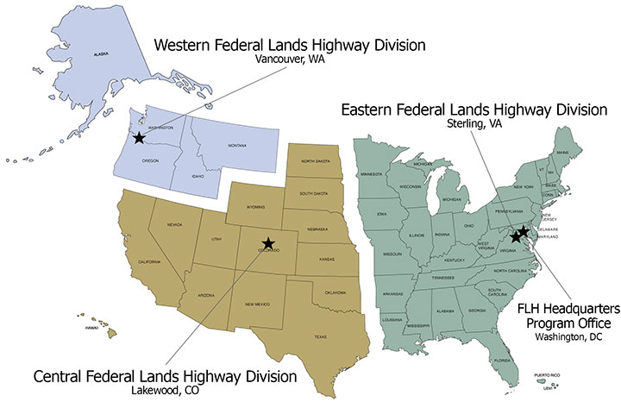
Notes:
And this is the map of the regions each of our three Divisions covers. I am in the Vancouver, Washington office and we have offices in Lakewood, Colorado, Sterling, Virginia and Washington, D.C. Our projects are located throughout the country, so we have field staff dispersed throughout these regions as well.

Slide 6
Where and Who We Work With
  Federal Land Management Agencies
    National Park Service
    National Forests
    Others (BLM, FWS, etc.)
  Tribal Lands
  State DOTs
  Local Agencies (counties, cities)
We’re hiring!
Notes:
So where and who we work with.
The programs our agency administers give us a wide variety of project partners, as you can see there. The historic core of our program has been with our federal partners at the National Park Service, the Forest Service and others such as the Bureau of Land Management and Fish and Wildlife Service. In recent years, we’ve taken on more projects with fellow state DOTs and local agencies through the Federal Lands Access Program.
We have a lot of similar challenges when it comes to improving safety as many of you face, with questions of how to improve safety for some very low to low ADT roads, to very mountainous, rugged and hazardous terrain, and lots of competing interests for transportation funding. We also have very context-sensitive challenges in some locations where the aesthetics and preservation of the nature of the land is very important.

Slide 7
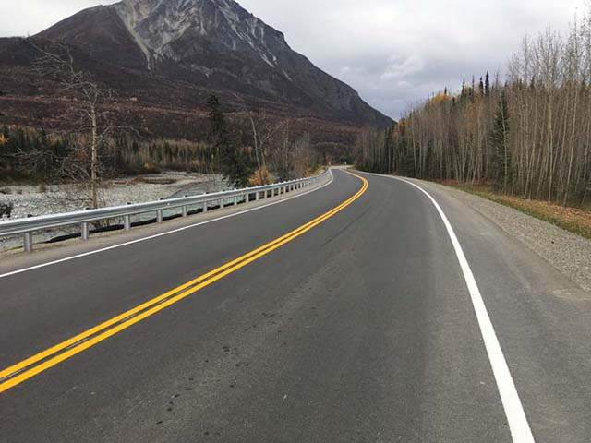
Using CRFs for Project Development
Project CRF Worksheet
Calculate preliminary CRF
Calculate final CRF
Promote the proven safety countermeasures
West Chickaloon Project near Chickaloon, AK
Notes:
So moving on to how we are using crash reduction factors at Federal Lands. We’ll talk about the CRF spreadsheet we use, how we use it to calculate the preliminary and final CRFs, while promoting proven safety countermeasures to drive safety improvements.

Slide 8
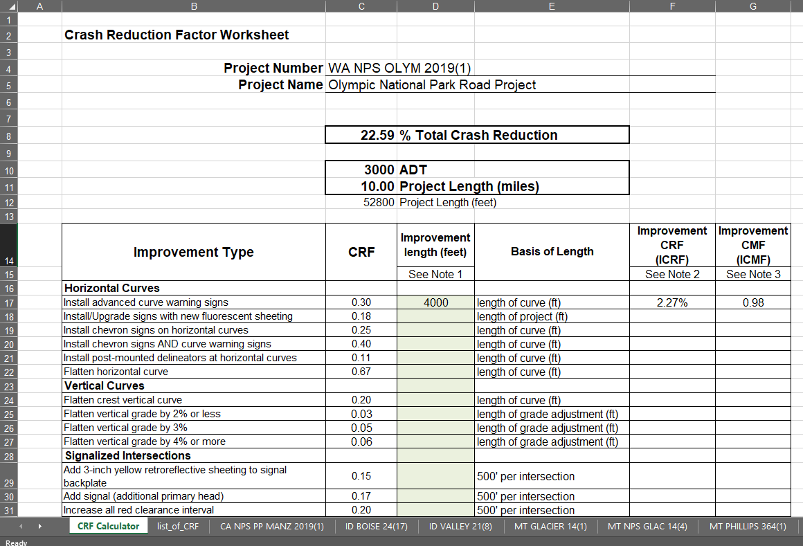
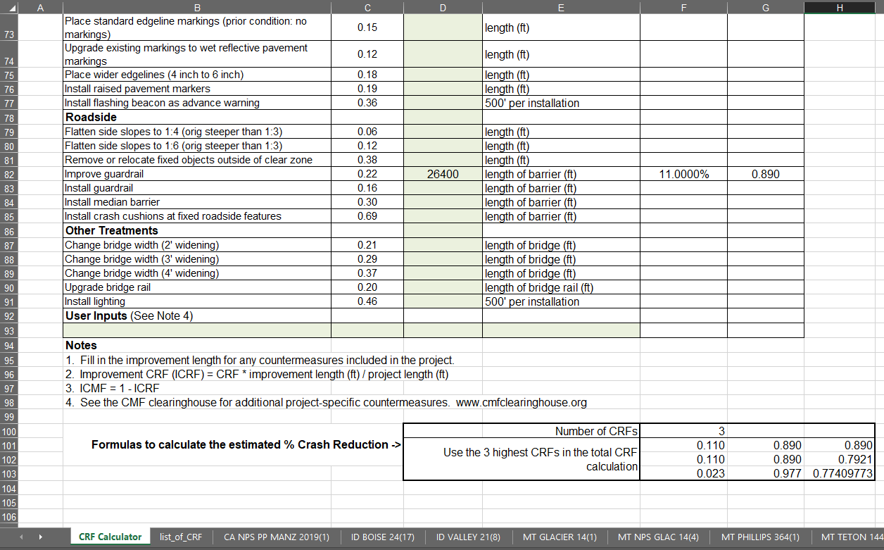
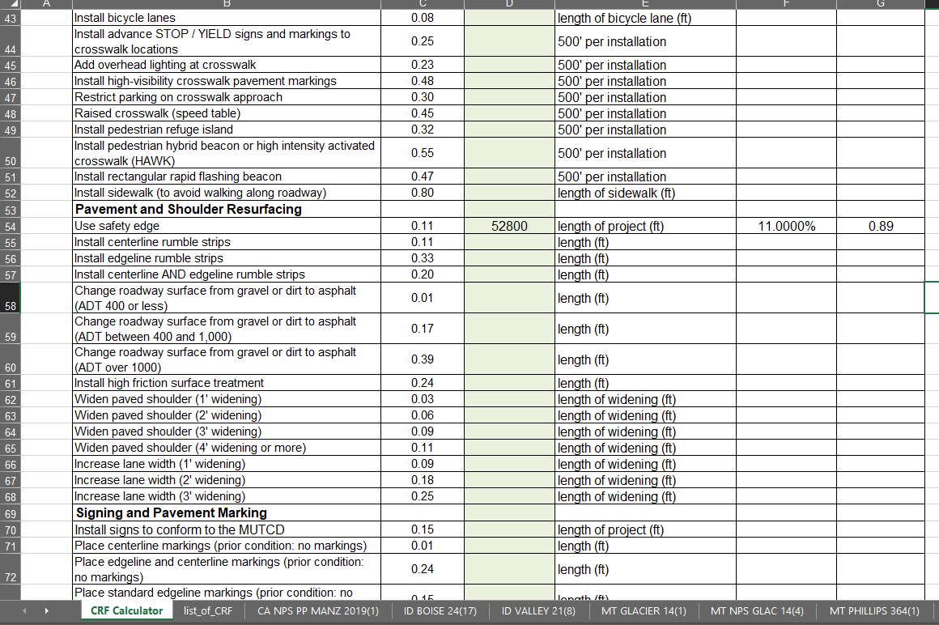
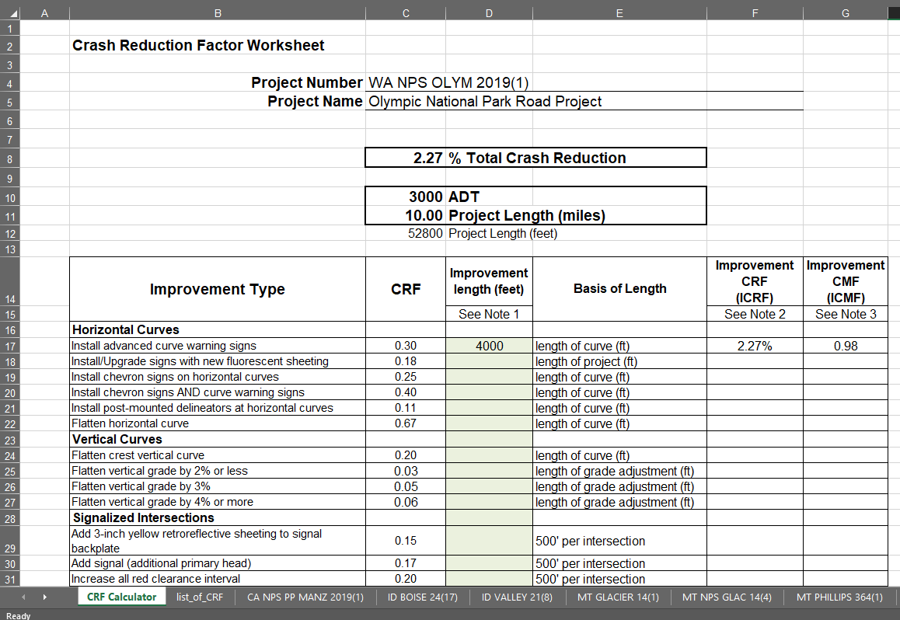
CRF Worksheet
FLH has a list of common CRFs applicable to our projects
Strive for the CRFs to apply to all crash types and severities
  Exceptions OK for our purposes
Notes:
Similar to what some or many of the state DOTs out there use for their Highway Safety Improvement Program, we have a list of our most commonly used CRFs that we have included in our worksheet. The list is based primarily off the CMF Clearinghouse but also includes some other sources, such as the Desktop Reference and other sources like FHWA’s Every Day Counts literature. We’ve strived to be consistent on the types of crashes and severities of crashes that the CMFs apply to, with a goal to have the total project CRF apply to all crash types and all severities. As many of you know, there isn’t always the ideal CMF that you’re looking for as far as type and severity. So, it’s not perfect but as we’ll see it is serving a purpose for our agency.
We calculate an improvement CRF for each improvement type on the project, for example, installing advanced curve warning signs on a project. We apply a basis of length to calculate the amount of the CRF that will apply to the entire project, and the resulting improvement CRF is determined for the project. For this case, we’re estimating that the curve warning signs on this project will give a crash reduction of 2.3% overall for the project (POINT). Each applicable project safety feature is input into the worksheet, and the resulting Total CRF for the project is determined based on the top 3 most effective CRFs. (CLICK) So for this example I’ve added in the safety edge for the length of the project, as well as (CLICK) an Improve Guardrail CRF for half of the project. The top 3 CMFs are used to calculate the resulting CMF, in this case I just have 3 entered, and our resulting total project CRF becomes 22.6%.
(anything to mention from Frank’s presentation on this?)

Slide 9
Preliminary Project CRFs
FLH safety engineers determine the project’s preliminary CRF by preliminary engineering milestone (30%)
  Provides status of project safety features
  Helps open the conversation with the project team and partners
  Refine the project scope to increase safety
Notes:
So when are we calculating the project CRFs? First, we want to calculate the project’s CRF as we develop the preliminary engineering milestone, typically a 30% plan set. Our safety engineers provide early recommendations for safety features to be included with our projects based on the project’s traffic, existing safety concerns, the proposed geometry and roadside design, and context of the roadway. Even if exact areas of barrier and say the use of warning signs are not fully developed by 30%, or it’s known that the alignment may shift some, the preliminary project CRF is estimated to help show the relative effect that the project will have on reducing crashes.
By calculating the project’s preliminary CRF and including with the 30% milestone review documents, our project team and our partners, such as the National Park Service, Fish & Wildlife, state DOTs or counties, can have a productive conversation on how the project is helping reduce crashes, and identify further countermeasures or other ways to improve safety and operations on our projects.

Slide 10
Final Project CRFs
FLH safety engineers determine the project’s final CRF when plans are completed
  Measure the final expected crash reduction
  Use each project’s final CRF to determine an overall Division CRF
  Report as a business measure for FLH
Notes:
After project development is complete, our safety engineers update the crash reduction factor worksheet to determine any differences from the preliminary countermeasures. The final project CRFs then get used to determine our business measure. If a safety feature dropped out of the project unexpectedly, we can review why this happened and see how we can prevent that from happening next time.

Slide 11
Calculating Division-Wide CRF
Each project’s CRF is weighted to combine into one Division-wide CRF, based on:
  Project ADT
  Project Length
  Project CRF
Similar to calculating a crash rate
Notes:
Now I’d like to go over how we are looking our project CRFs at a program-wide level. For a number of years now, we’ve had a business measure at each of our three Divisions to track our overall crash reduction factors.
In order to combine each project’s crash reduction factor, our team has recently begun weighting the CRFs based on factors intended to get a sense of the exposure of the project to the traveling public, so that projects that are longer and have higher traffic have a more significant effect on our total weighted average versus shorter projects with lower traffic. We do this by using the project ADT, length and the project CRF to get a sense of its exposure, similar to a crash rate.

Slide 12
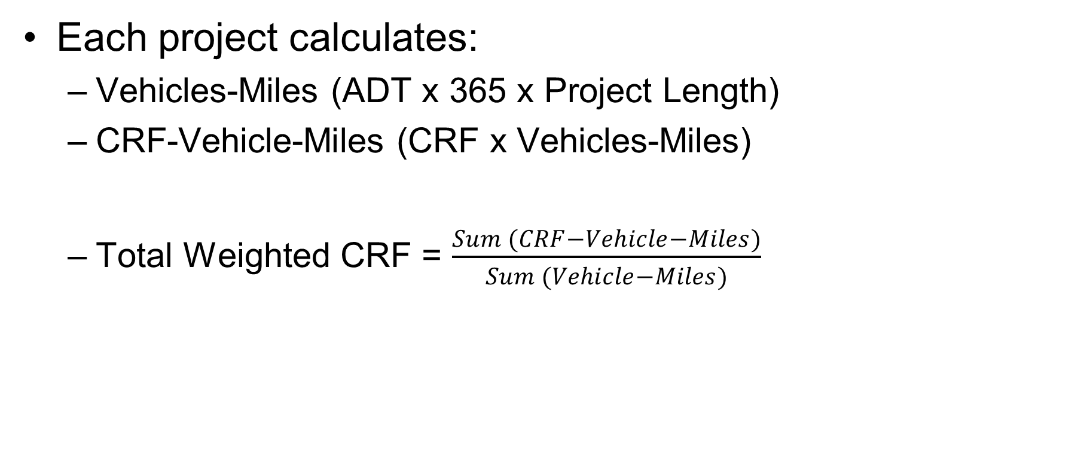
Calculating Division-Wide CRF
Each project calculates:
  Vehicles-Miles (ADT x 365 x Project Length)
  CRF-Vehicle-Miles (CRF x Vehicles-Miles)
  Total Weighted CRF = $\frac{Sum (CRF−Vehicle−Miles)}{Sum (Vehicle−Miles)}$
Notes:
So this is what that looks like. We multiply the project ADT x 365 days per year x the project length to get a vehicle-miles value. Then we multiply the project CRF times the vehicle-miles. To get the overall weighted CRF, we sum all the project’s CRF-Vehicle-Miles and divide by the sum of the Vehicle-Miles. The resulting number is then the total program CRF.

Slide 13
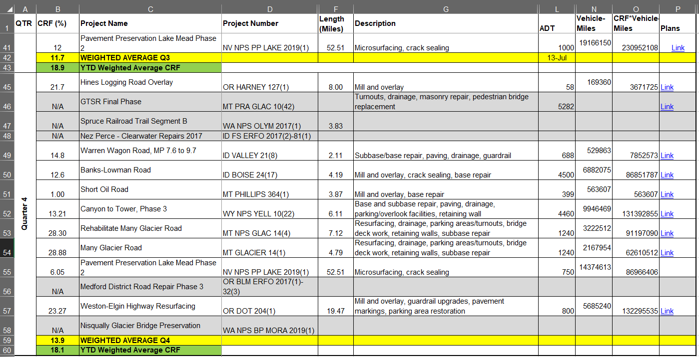
Calculating Division-Wide CRF
Notes:
For this last fiscal year, this is a excerpt from our summary spreadsheet that shows the individual project CRFs, and the intermediary calculations, with Vehicle-Miles and CRF-Vehicle-Miles shown here (POINT). We typically report on this measure at the end of each quarter, so we show the weighted average for the quarter here, and then the final weighted result for the year is calculated here, at an 18.1% reduction.
You’ll notice some Not Applicable shown in grey here. There are some projects that we do not calculate the CRF for due to the nature of those programs. For example, our Emergency Relief for Federally Owned Roads (ERFO) program typically limits us to restoring the original conditions before the disaster, so safety improvements are rare. Some of our other projects may be parking lot enhancements or geotechnical stabilization projects, so traditional safety improvements are generally excluded from those as well.

Slide 14
Calculating Division-Wide CRF
Western Federal Lands, FY19 resulting CRF = 18.1%
  Surpassed Division goal of 15%
  One project out of 31 total qualifying projects was a major influencer with 7% attributed to it
Notes:
So for fiscal year 2019, our Division surpassed our goal of a 15% overall crash reduction factor. Due to the exposure of our biggest project on US-20 in Oregon, with 17,500 vehicles per day and a larger CRF with multiple safety features on the project, that project allowed us to meet our goal. Without it, it would have been a 7% swing downward.

Slide 15
Summary
Rolling CRFs up to a Division-wide or agency-wide average has pros and cons
  Pros:
    Provides a relative measure to track safety improvements based on the exposure to the project users
    Help drive decisions during project development
    Once individual project CRFs are determined, easy to weight and combine in a spreadsheet
    Helps leadership understand the impact our projects have on the most important agency goal (safety)
Notes:
In summary, there are some advantages and disadvantages to note with our approach to using CRFs to determine a program-wide factor. On the positive side, it’s a reasonable method to track our safety improvements and help drive additional safety features during project development. By getting the safety countermeasures identified early in the development process, we have time to consider adding countermeasures before the project scope is fully locked down.
Once the individual project CRFs are determined, it’s just a matter of organizing the data in spreadsheets to calculate an overall Division CRF, based on the weighting factors. So the weighting and combining part is pretty simple.
This approach provides our agency’s leadership with a business measure that helps acknowledge the work our agency does to improve safety on our projects and support FHWA’s goals. We can also filter the projects by our different program types or project types, such as rehabilitation versus reconstruction, to demonstrate how well we are doing with those programs or types of projects.

Slide 16
Summary
Rolling CRFs up to a Division-wide or agency-wide average has pros and cons
  Cons or limitations:
    “Inexact science” of combining CRFs and weighting
      Some CRFs targeted different crash types/severities
      Basis of length was developed for ease of use, but adds subjectivity
      Project ADTs are a source of error as well
    Some countermeasures (e.g. pavement markings) have shorter life
    FLH strives for consistency, but there will be differences from one safety engineer to another
Notes:
There are several disadvantages or limitations to note as well. Our goal with this procedure is to not split hairs, and we know this process is definitely not a research-grade university analysis, but we’re instead shooting for a practical way to use CRFs to see how our program is doing. As mentioned before, we’re sometimes combining CRFs with different crash types or severities into one overall CRF, so there is some error there.
The basis of length is needed to resolve individual countermeasures into a project-level CRF, but that can be subjective when we’re estimating these. Some of the ADT estimates that we use on our projects are also sources of error, and that does come into play with our exposure calculations for the weighted average. But again, we’re just looking to get a relative measure of the project’s exposure effect, so lower to higher ADTs will help smooth that error out.
Other challenges that some of you likely face are that some important countermeasures, like refreshing pavement markings or replacing with more durable markings, have a shorter life and require maintenance, something this isn’t taking into account. It can be a challenge to determine how much credit to give for safety features like pavement markings, especially if the road already had some degree of pavement markings before the project.
Finally, we try for consistency in our approach to calculating the project CRFs, but there will be some differences from safety engineer to safety engineer when determining the project crash reduction factors.

Slide 17
Feedback Requested
Does your agency have a procedure for calculating project CRFs for a regional, district, or even agency-wide basis?
  Is a combined CRF calculated?
  Any best practices out there?
Send feedback to: Matt Hinshaw
Matthew.Hinshaw@dot.gov
360-619-7677
Notes:
So lastly, I’d like to actually turn it around and ask the audience for feedback on this approach for calculating an agency-wide, weighted-average crash reduction factor. Does anyone out there do something similar to understand how your agency’s projects are improving safety? And if so, how do you do it and are there any best practices out there?

Slide 18

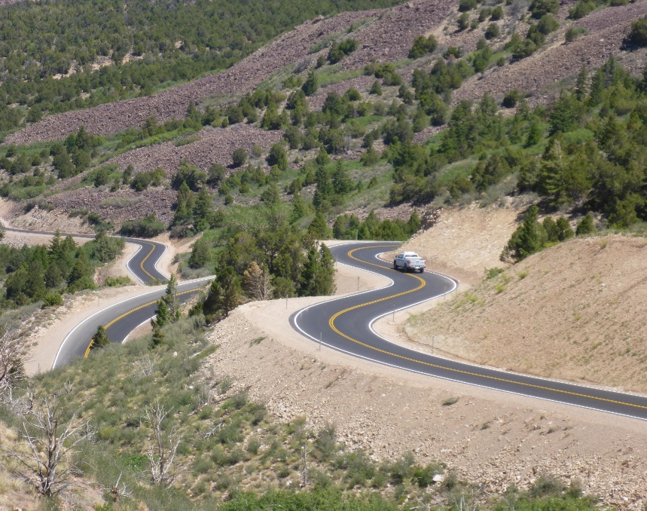
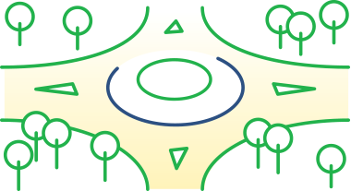
FHWA Strategic Goals and Objectives
Safety
Reduce transportation-related fatalities and serious injuries across the transportation system.
La Sal National Forest, UT
Notes:
Overall, using CRFs is one way our safety team at Federal Lands Highway is working towards FHWA’s goal to reduce transportation-related fatalities and serious injuries across the transportation system.

Slide 19
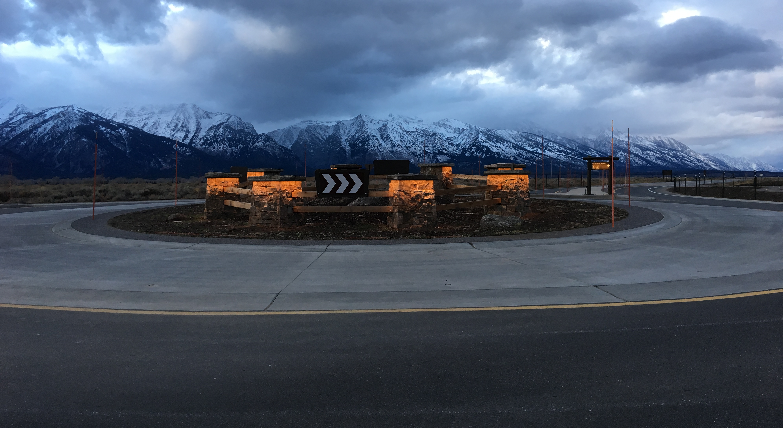


Questions
Roundabout at Grand Teton National Park, WY
Notes:
I’m happy to take any questions at the end and welcome feedback on our approach to using CRFs.

